Slide 1
Breakfast
“The most important meal of the day!”

Slide 2
SWBAT…
Identify typical breakfast times
Give an opinion on which breakfast foods they like
Discuss when different kinds of foods are eaten, such as on weekday mornings or special days

Slide 3
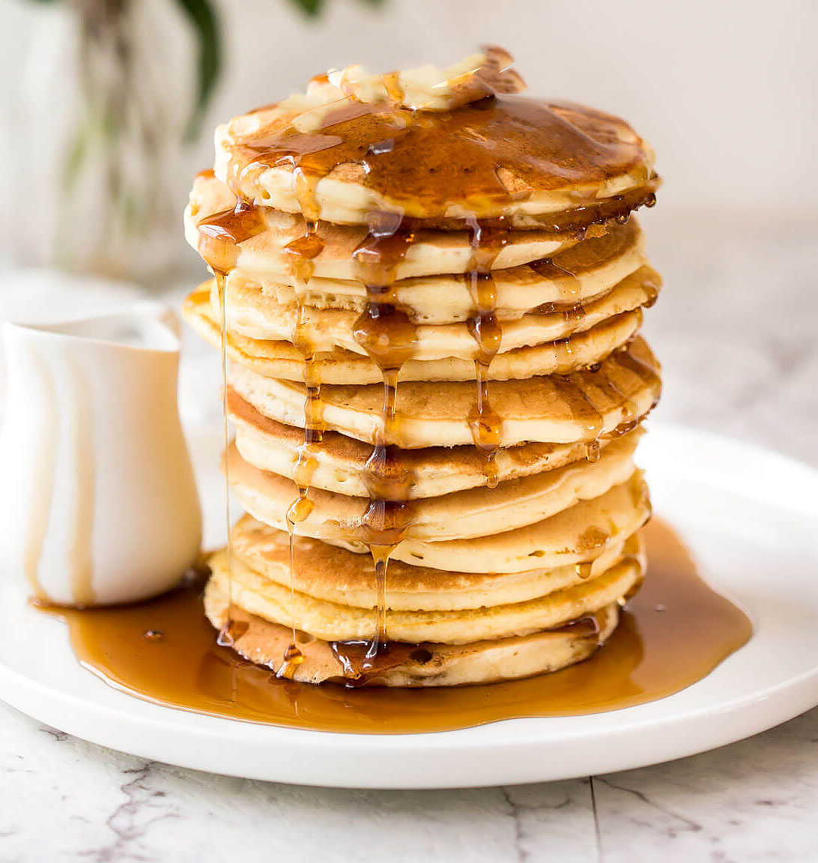
Table of Contents
Title
When is breakfast eaten?
What do you eat?
Coffee
Questions
Permission slip

Slide 4
Read carefully! Click on underlined words to hear them pronounced.

Slide 5
When is breakfast eaten?
Breakfast is the first meal of the day. It can be eaten at any point from when you wake up to about 11am. By 11am it is too late for breakfast and the meal in considered brunch or lunch. Some Americans enjoy breakfast on the go and grab something on the way to work or before school and others prefer to enjoy a large meal at home.

Slide 6
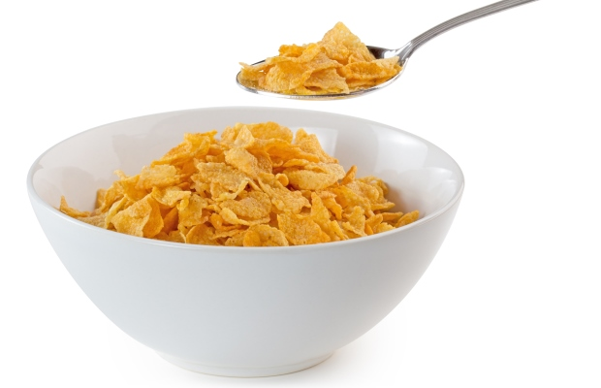
What do you eat?
Most days, breakfast is simple. Many Americans choose toast, cereal, or oatmeal for breakfast on weekdays.
There are many different breakfast foods to choose from, such as waffles, pancakes, French toast, home fries, hash browns, eggs, bacon, toast, sausage, biscuits, and more.

Slide 7
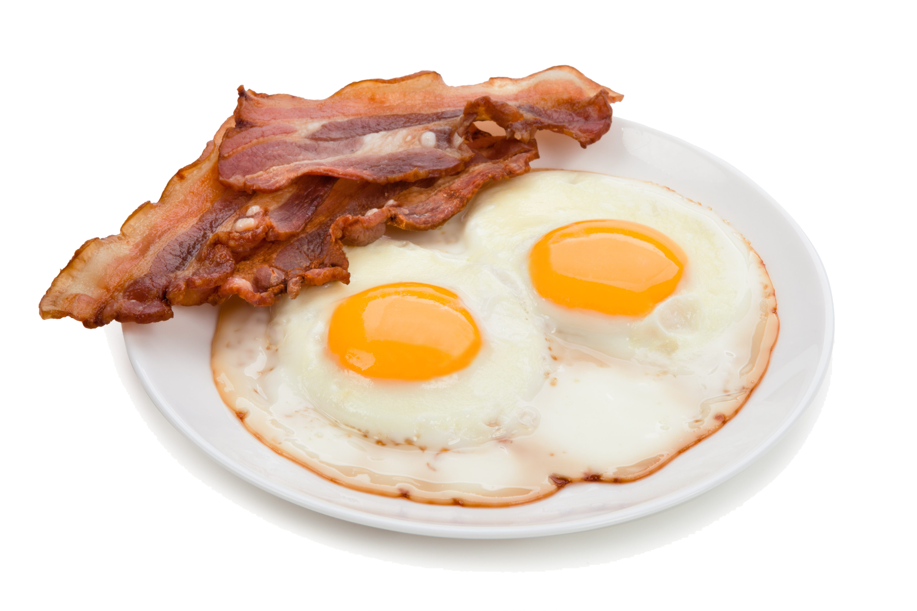
What do you eat? cont.
A big breakfast is seen as a good way to begin the day. While pancakes, waffles, French toast, eggs, bacon or sausage, etc. are not eaten everyday by most people, they are popular on weekends and holidays. On Mother’s day and Father’s Day many parents enjoy breakfast in bed made by their families.

Slide 8
Coffee
For many adults, breakfast is not complete without coffee. Most Americans own a filter or drip coffee pot in their home. French presses are also popular, but moka pots are not popular. While some people drink coffee at home in mugs, others use travel mugs to bring coffee out of the house.

Slide 9
Test yourself!

Slide 10
It’s Saturday! What popular breakfast should you pick?
Try again!
Toast
Pancakes and eggs
Oatmeal
Cereal
Correct!
Try again!
Try again!

Slide 11
Breakfast time! Select the clock showing breakfast time.
This Photo by Unknown Author is licensed under CC BY-SA

Slide 12
This is too late for breakfast!
Try again!

Slide 13
Well done!
Next question

Slide 14
Write! Which of the below foods would you like for breakfast and why?
Waffles
Cereal
Eggs and toast
French toast

Slide 15
Print and bring back to class
Dear Parents,
Next Saturday our class is taking a field trip to a popular American breakfast restaurant. We will be trying some foods that we have studied recently.
Please sign and date this form giving permission for your child to attend. We are seeking chaperones if you are interested in joining us.
Childs name:____________________________________________
Your signature:___________________________________________

