Slide 1

Winter Wonderland
Planet
Where you can experience the
Joys of Winter anytime, without the hassle…

Slide 2
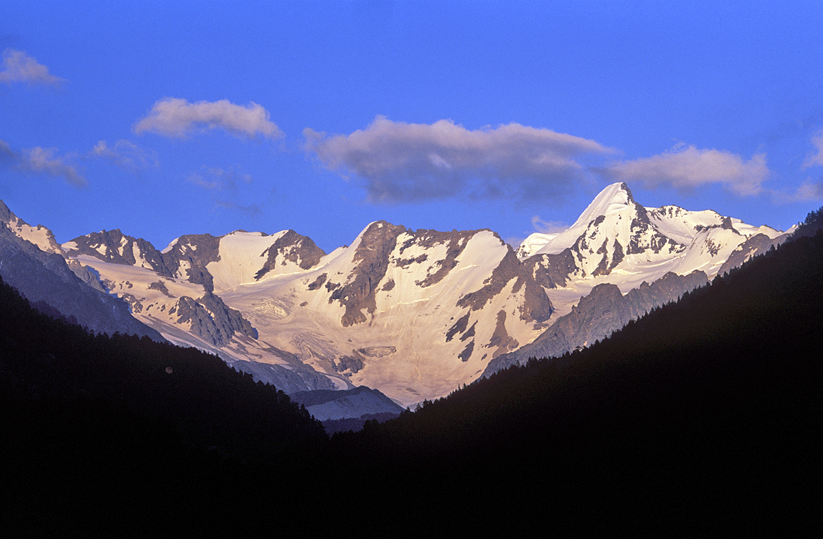
Love Winter, but sick of the shoveling, freezing temperatures, and cabin fever, but love the activities and beauty of Winter? Then Tri-Season’s Winter Wonderland Planet is the place for you!

Slide 3
Here is a List of Some of the Great Activities Winter Wonderland offers
For the Kids:
For the “Big” Kids:
Tubing
Sleigh riding/Sleigh riding trail
Creative Snow Building
Miniature Ski/Board Areas with down hill and cross country skiing accommodations
Snowmobile Rides
Ice Skating
Family Sleigh Rides
Hockey
Ski/Board Areas with down hill and cross country skiing accommodations for all levels
Dog Sledding
Snowmobiling
Ice Skating
Sleigh Rides through the Mountains
Sky Flying
Hockey

Slide 4
Here, Check them out!

Slide 5
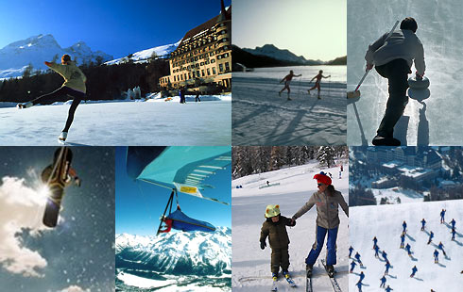

Slide 6
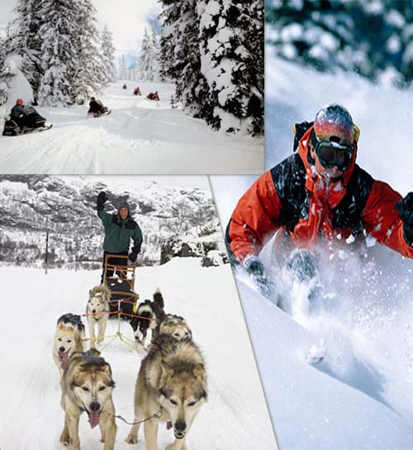

Slide 7

Afterwards you can warm up in our highly modeled lodging…
Offers: Food, Drinks (alcoholic/non), Hot Chocolate with marshmallows, a cozy fire, and an unforgettable time!

Slide 8
Hope to see you soon!

