Slide 1
Tri-Seasons Resort and Spa
Owned By: Courtney Johnston, Marybeth Morrison, Christine Beck, and Jillian Dischinger

Slide 2
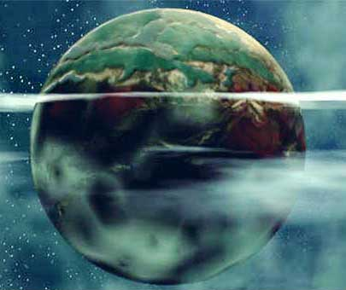
Planet Helios
The newest addition to our solar system!!! Located North of the Milky Way Galaxy.
Physical Environment
  Steady Wind
  Low temperatures
  Small bodies of water
  Low Gravity
  In the Dome
    Controlled Temperature → Each Zone
  Through years of research and exploration we have created an environment that can sustain life within our Resort.
Notes:
Create a situation--- what if earth was to be destroyed…where would life live…if we our resort is successful we can duplicate …backup plan if disaster were to occur

Slide 3
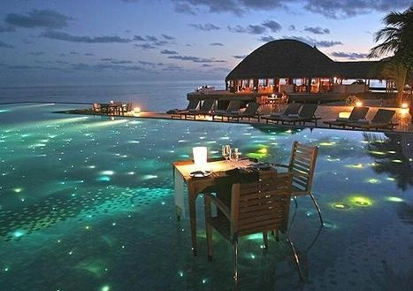
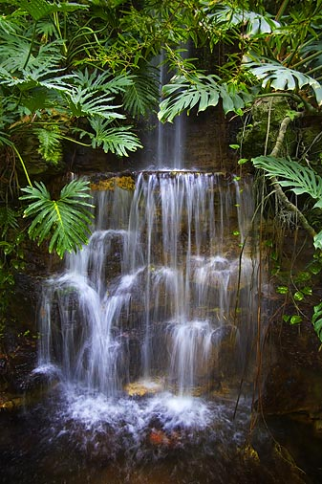
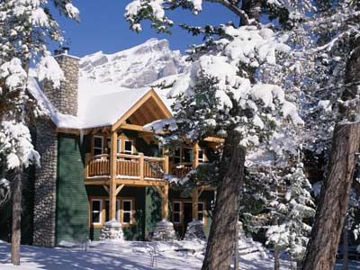
3 Breath-taking Zones
Level 1- Beach Zone
Level 2- Mountain Zone
Level 3- Tropical Rainforest Zone
Notes:
Escape the hustle and bustle of your daily life to experience a vacation out of this world! A vacation where you don’t have to choose between a relaxing day at the beach, an exotic adventure through the rainforest, or an adrenaline rush on the ski slopes because TriZones has it all!!!

Slide 4
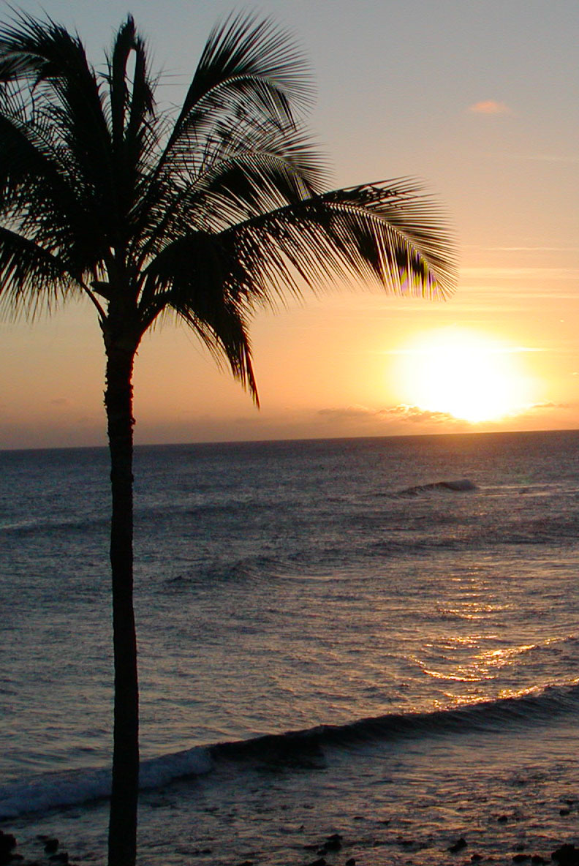
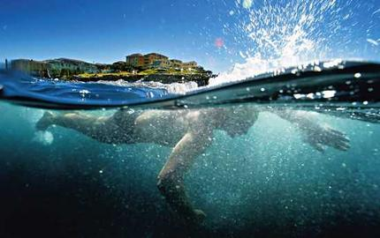
BEACH ZONE
A place where you can come and relax or have a day packed full of fun!
Notes:
Want to sit and relax under a beautiful sunset with the one you love? Or need a fun family vacation? The beach zone has it all for everyone.

Slide 5
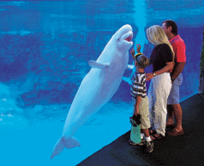
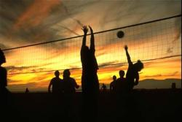
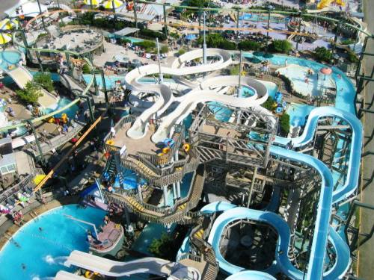
BEACH ZONE
ACTIVITIES
FOR FAMILIES
Aquarium
-Over 3,000 types of fish completely surrounding you!!
Waterpark
-fun for the whole family with over 30 different rides, slides, and tides!
Beach Activities
-volleyball, snorkeling, scuba diving, and surfing
Night Life
-fireworks by the pier
Notes:
There is tons of fun for the entire family. For days full of fun and adventure check out our waterpark that has over 30 different rides, slides, and tides. Kids of all ages are guaranteed to have a wet and wild time! There’s also a neat aquarium where you’ll see fish that are out of this world!! Noo…literally!! Then when you’re ready to have fun on the beach there tons of activities like volleyball, snorkeling, scuba diving, and surfing. Then when it’s time to wind down the night go to the pier to watch the beautiful fireworks.

Slide 6
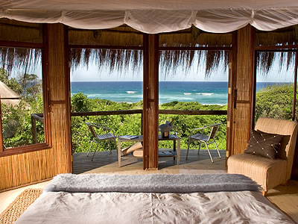
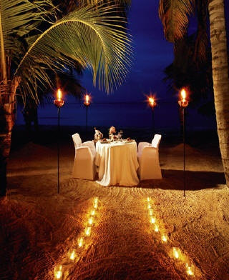
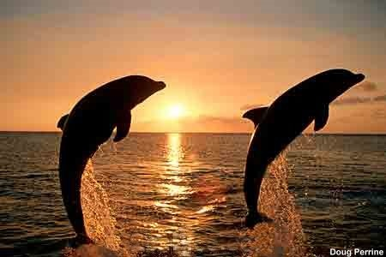
BEACH ZONE ACTIVITIES FOR COUPLES
Condos
-private beach, candlight dinner in room, and hot tub
Beach Activities
-snorkeling, scuba diving, surfing, and swimming with the dolphins
Night Life
-clubs, sunset cruise, dinner cruise, and casino
Kids Place
-Place for your children to be supervised while you and your loved one have some “alone time”
Notes:
Want to escape the world with the one you love to spend an exotic and private vacation? The beach zone will let you do exactly this! We have condos you can rent that comes with a private beach, candlight dinner every night, and a hot tub to cuddle up in on a cool night. When you want to escape to the public beach for more excitement there’s opportunities to go snorkeling, scuba diving, swimming with the dolphins, or learn how to surf. Then later on at night there’s a variety of clubs to visit, a romantic sunset cruise, dinner cruise, or a gambling night at the casino. And if you’re with the whole family, but want a romantic night away with the one you love we have a place to watch your kids while you get your “alone time”. The Kids Place allows opportunity for kids to play with other children and do a variety of activities set up by the faculty. They definitely won’t be bored, and probably won’t want to leave!!

Slide 7
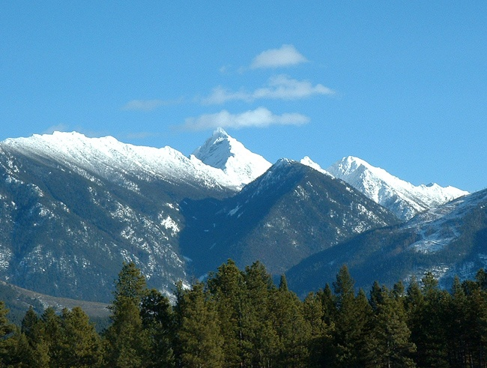
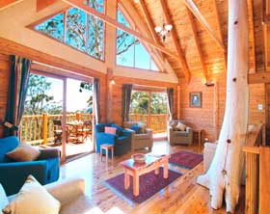
Mountain Zone
Love Winter, but sick of the shoveling, freezing temperatures, and cabin fever, but love the activities and beauty of Winter?
Then Tri-Season’s Winter Wonderland is the place for you!
This zone stays at a constant temperature of 32 degrees F enough just cold enough to maintain snow.
After enjoy over 15 of our fun activities for everyone, ride around from place to place on our lifts, and then after warm up in our fine mountain lodging.
Notes:
Love the snow, but hate freezing in the cold? Then this zone is right for you! Our temperature stays at a constant 32 degrees, not to hot and definitely too cold.

Slide 8
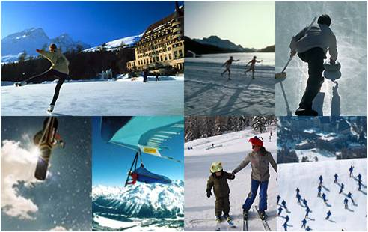
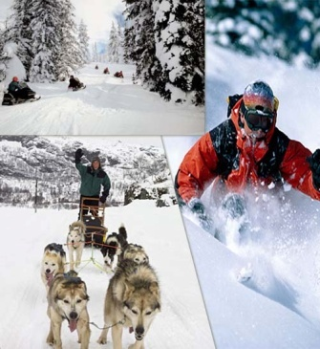
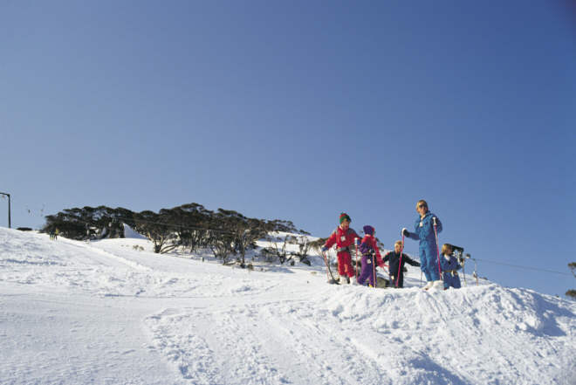
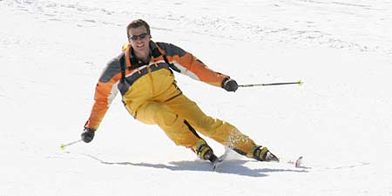
Fun Activities For Everyone!
For the Kids:
Tubing
Sleigh riding/Sleigh riding trail
Creative Snow Building
Miniature Ski/Board Areas with down hill and cross country skiing accommodations
Snowmobile Rides
Ice Skating
Family Sleigh Rides
Hockey
For the Adults:
Ski/Board Areas with down hill and cross country skiing accommodations for all levels
Dog Sledding
Snowmobiling
Ice Skating
Sleigh Rides through the Mountains
Sky Flying
Hockey
Notes:
Check out all sorts of fun winter activities for both adults and children!

Slide 9
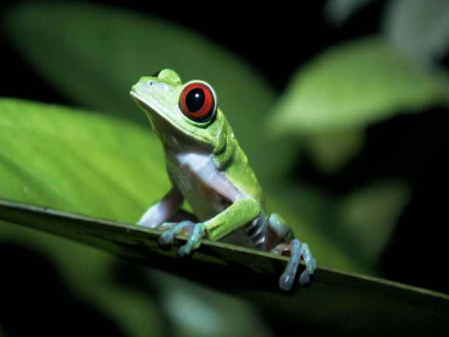
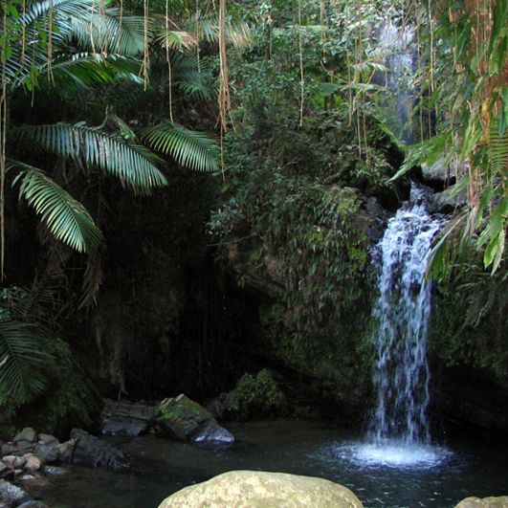
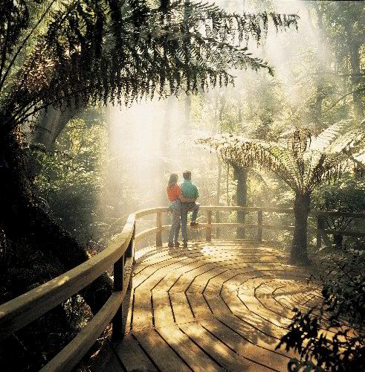
Tropical Rainforest Zone
Experience the tropics like you’ve never seen them before!
Take a casual walk on our nature hikes and experience tranquility through the sound and view of the many different waterfalls.

Slide 10
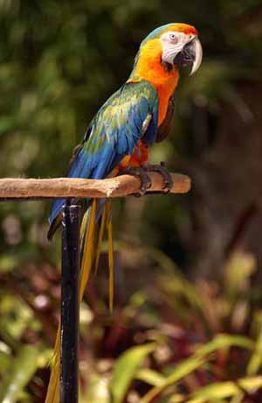
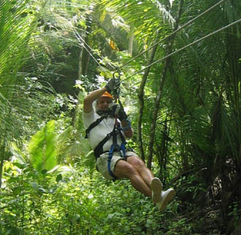
What is there to do?!
There is plenty to do in the Rainforest Zone!
Want to get back faster? Experience the Rainforest by zipping through on the zip line!
Ride the Tram high above the forest and look down at the beautiful flowers, trees and animals.

Slide 11
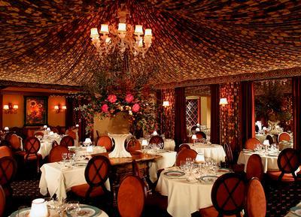
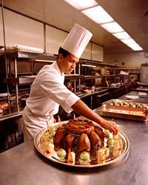
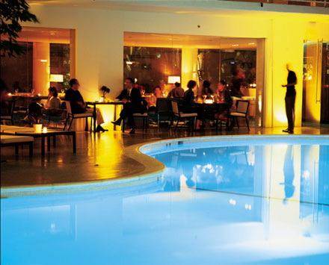
Underground Lodging and Relaxation
Welcome to the first underground lodging area ever to exist at a resort! The underground area contains two different levels in which families and couples can relax and enjoy similar activities that one would experience at earth, but in a unique way.
Hate waiting in long lines? Our quadratic elevator is an efficient way to reduce time spent in traveling to all the different levels of our resort.

Slide 12
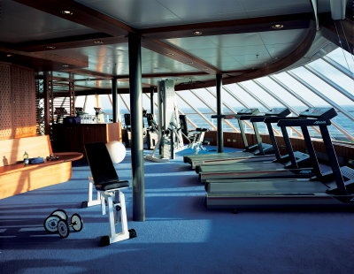
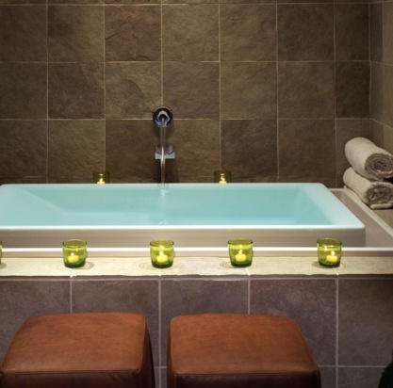
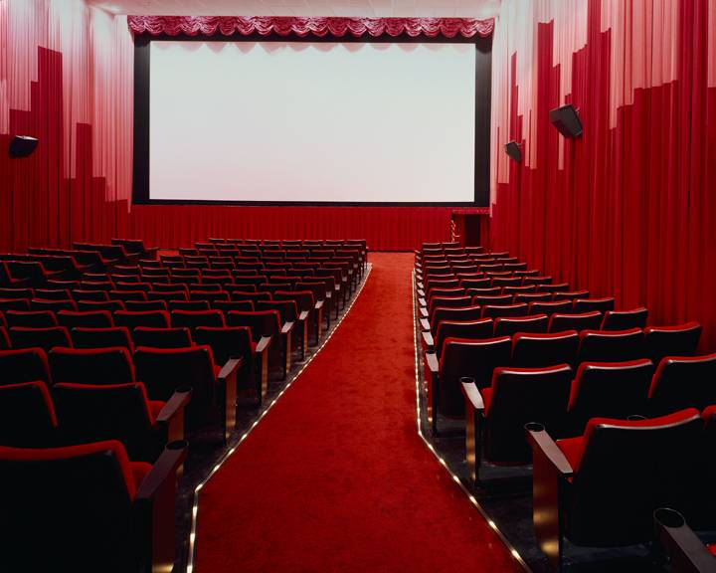
Level One: Activity Zone
Health Club & Spa
  Provides a variety of spa treatments to relax after a long day of exploration and fun.
  Variety of machines and classes to practice good health.
  Maintain your wellness and allow yourself to escape to a stress free zone.
  Small hospital available for health needs.
Restaurants
  Food grown within the Rainforest, and collected from the ocean. Other products will be transported from Earth with other passengers.
  Melting Pot – Experience different food from different cultures.
  Roses are Red- Romantic dining for you and your loved one.
  Kids Corner- parents and children learn how to make their own food.
Movie theater
  Experience our comfortable atmosphere with waiter survice.
Speedy Gift Store
  Forget something at home? Need a souvenir ? Speedy gift store has anything you could possibly need. If we don’t have it, we will make a speedy order to earth to meet your needs.

Slide 13
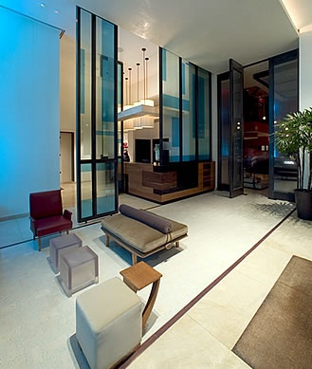
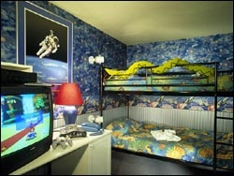
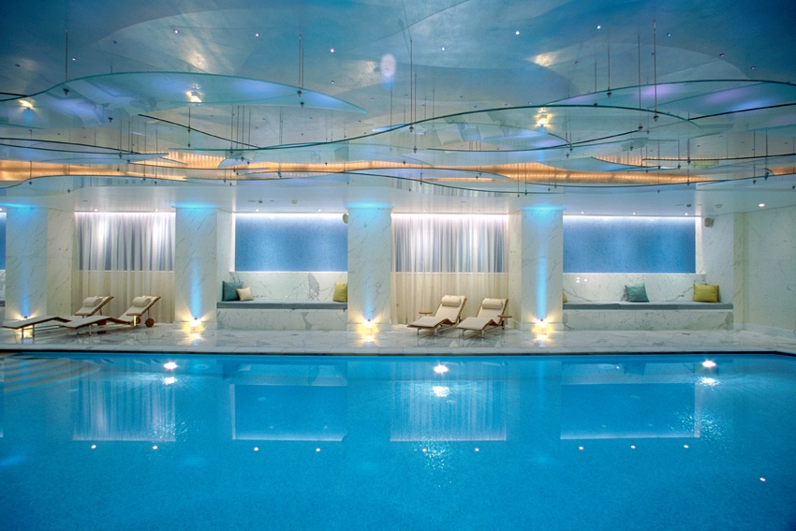
Level Two: Lodging Area
Arrival Station: Tourists will be brought directly to their suite as soon as they arrive.
ABC Suite- Designed to meet children's interests. There are different suites to choose from that were created for different age levels. The age levels range from birth to 12 years old.
Heart Hotel- For you and your loved one! Fill out a survey so that we can accommodate your room to meet your ideal romantic gateway.
Comfort Inn- Ideal for all ages! Enjoy a comfortable setting where you can relax with your loved ones.
Pool area
  In ground swimming area where the waters blue.
  Shallow area for non- swimmers.
  Enjoy swimming in water without the smell of chlorine.
  Life guards are present at all times.

Slide 14
Transportation & Costs
All Inclusive Resort Rates!
Family Rates:
Per week- (5 members and under)
$5,000 per week. Every additional person $100 per day
Couples Rates:
Per week- $1,950
Transportation to Helios has to be set up by you and your local travel agency. (Cost varies between locations)
*All tourist must complete safety training before attending our resort*
The workshop will be provided at your local travel agency for free.

Slide 15
Science Factors
Energy
    Solar
      Also for heating and cooling
    Windmills
    Waterfalls- Rainforest
    Indoor lighting
      Compact fluorescent bulbs
Waste
    landfill
Entering and Exiting Planet Helios
  During transportation, on and off planet, passengers and employees must wear at all times protective gear.
    This will be covered in detail and will be put in practice before trip.
Recycling
    Items are stored into a compartment under the space ship and brought back to earth to be recycled.
    Water from sinks recycled for use in restroom facilities.

Slide 16
Why money should be invested in developing our resort?
Create a source of living outside of Earth in case of natural disaster
Preserving the environment that is now being destroyed by global warming
Success → creation of similar resorts on different planets
Medical research→ rainforest
Create a healthy, low polluted, enjoyable resort → disaster happens, life will need an alternative planet to live on
Explore and test now for future safety of travelers and workers
Notes:
Our major concern is preserving certain aspects of the environment that are now being destroyed by global warming.
If successful we will be able to create similar resorts on other planets.
Medical research will be performed within different parts of the rainforest.
Very passionate about developing a healthy, low polluted, enjoyable resort.
It will take a year to test every aspect of the resort for the safety of travelers and workers

Slide 17
Questions or Concerns?
Feel free to contact us by telephone or email!
  Tri-Zones@Helios.com
  Phone Number: (555)-333-3333

