Slide 1
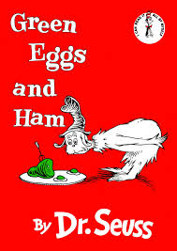
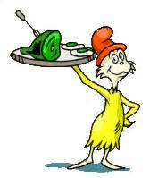
Green Eggs and Ham
By
Dr. Seuss

Slide 2
Objectives
Table of contents:
Page 1 – Title page
Page 2 – Table of Contents and Objectives
Page 3 – Rhyming words
Page 4 – Listen to passage
Page 5 – Pick the rhyming word
Page 6 – Pick the rhyming word
Page 7 – Pick the rhyming word
Page 8 – Pick the rhyming word
Page 9 – You are correct!
Page 10 – Oh no, try again!
Page 11 – Survey question
Page 12 – Yes page
Page 13 – No page
Page 14 – Credits
SWBAT listen and understand the passage
SWBAT read along with the passage
SWBAT recognize the rhyming words
SWBAT match rhyming words by clicking on the picture or sound
SWBAT individually assess their correct choice of rhyming word

Slide 3
Rhyming Words
Mouse House Boat Goat | Fox Box Rain Train | There Anywhere Tree Be

Slide 4
Listen for the rhyming words in this passage
I could not, would not, on a boat.
I will not, will not, with a goat.
I will not eat them in the rain.
I will not eat them on a train.
Not in the dark! Not in a tree!
Not in a car! You let me be!
I do not like them in a box.
I do not like them with a fox.
I will not eat them in a house.
I do not like them with a mouse.
I do not like them here or there.
I do not like them ANYWHERE!

Slide 5
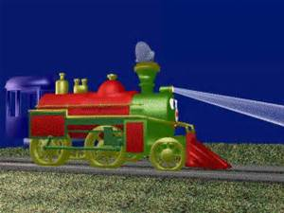
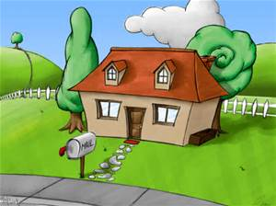
Which word and picture rhymes with mouse?
Train
House
Next

Slide 6
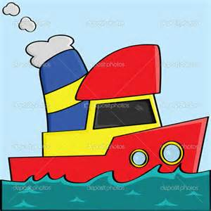
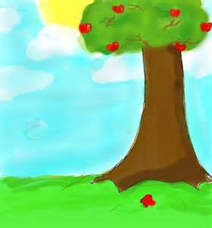
Which word and picture rhymes with goat?
Boat
Tree
Next

Slide 7
Which word and picture rhymes with rain?
Train
Boat
Next

Slide 8
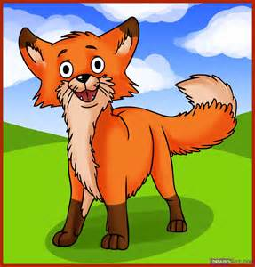
Which word and picture rhymes with box?
Fox
Tree
Next

Slide 9
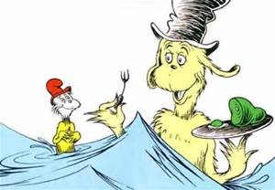
Correct, Good Thinking!
Next

Slide 10
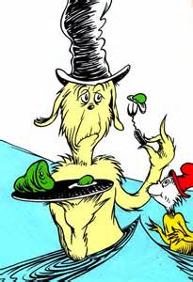
Oh No,
Try Again!
Go back

Slide 11
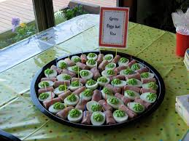
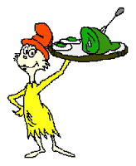
Would you try Green Eggs and Ham?
Press
Yes
or
No

Slide 12
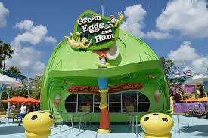
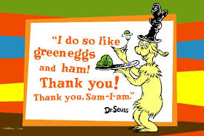
Yummy!!
Credits

Slide 13
No Way !!
Credits

Slide 14
