Slide 1
Food & Beverages in America
Ismet CAVUSOGLU
MA ELT – ANADOLU UNIVERSITY
MSc SLEd: TESOL –SUNY CORTLAND

Slide 2
TABLE OF CONTENTS
What is this Food?
What is this Drink?

Slide 3
OBJECTIVES
SWBAT recognize and name American foods
SWBAT recognize and name American beverages

Slide 4
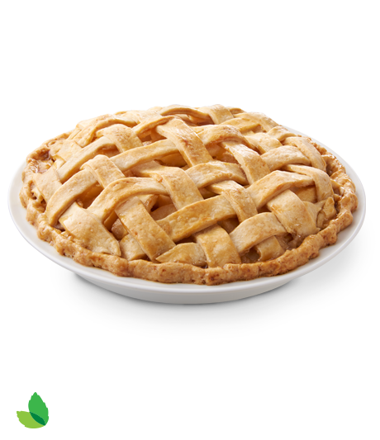
What is this food?
Pasta
Apple Pie
Burger

Slide 5
What is this food?
Sub Sandwich
Pizza
Hot Dog

Slide 6
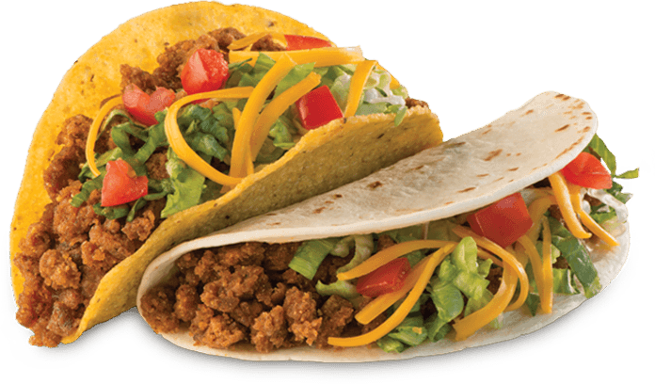
What is this food?
Pasta
Apple Pie
TACOS

Slide 7
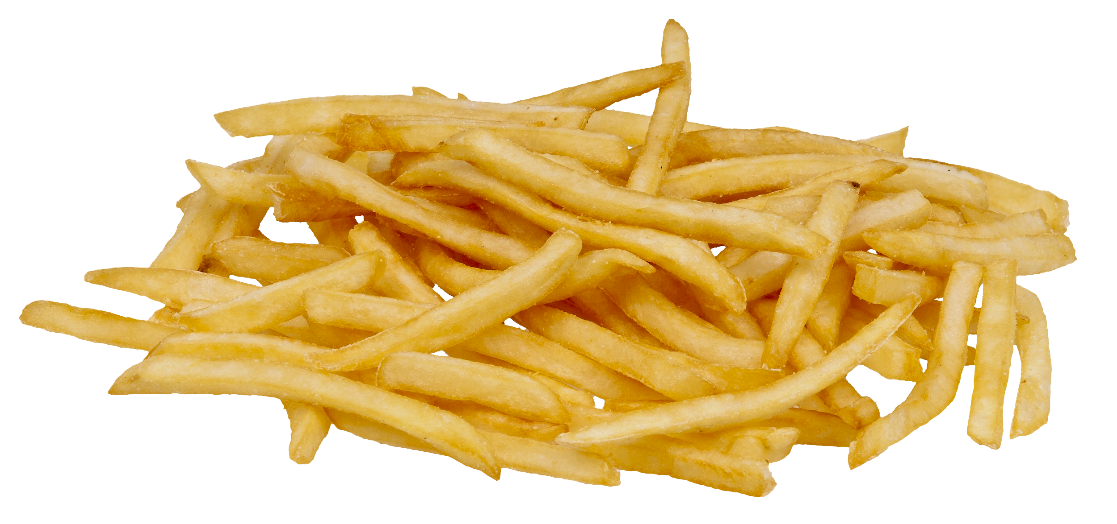
What is this food?
Fries
Peanut Butter and Jelly
Hot Dog

Slide 8
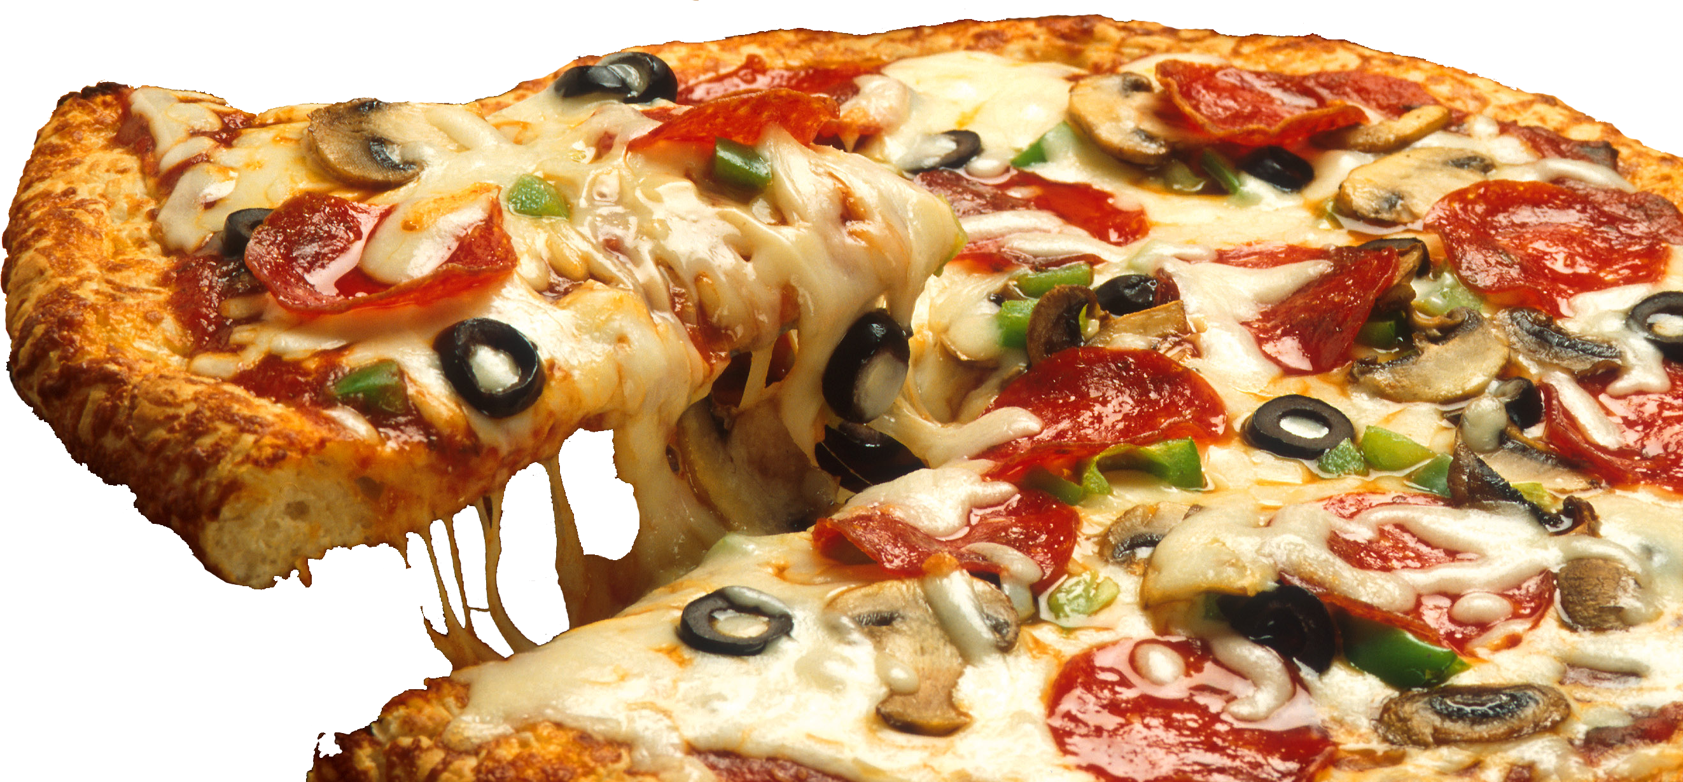
What is this food?
Pizza
Peanut Butter and Jelly
Burger

Slide 9
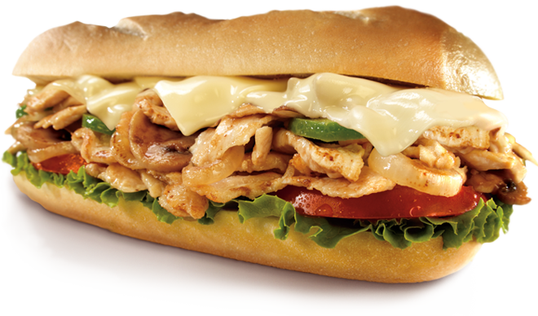
What is this food?
Pasta
Apple Pie
Sub Sandwich

Slide 10
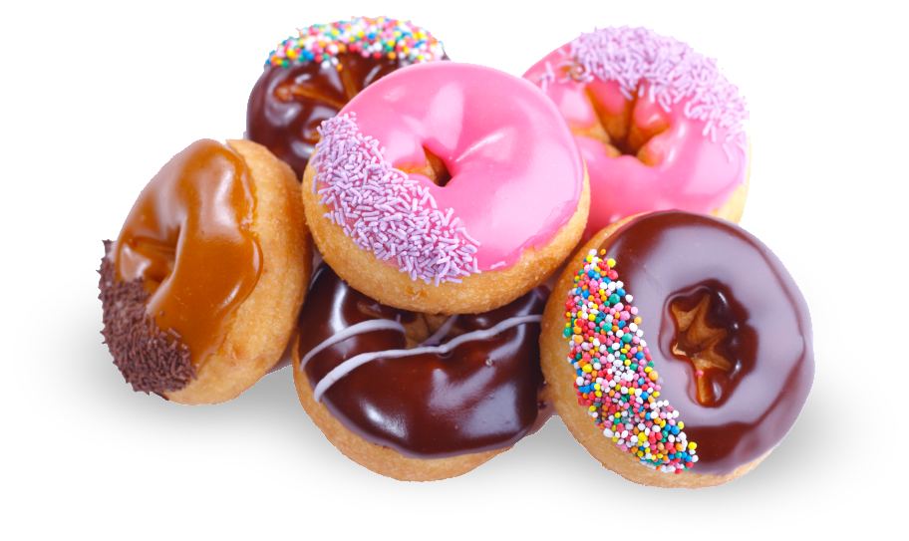
What is this food?
Donut
Pizza
Hot Dog

Slide 11
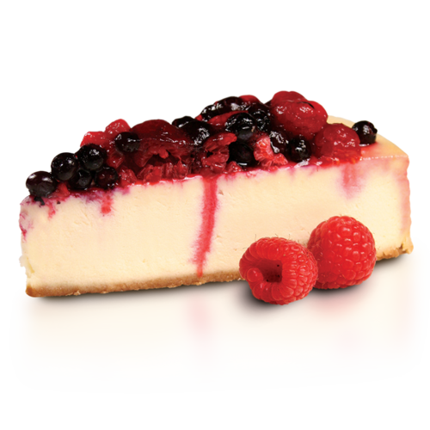
What is this food?
Cheese Cake
Apple Pie
Pizza

Slide 12
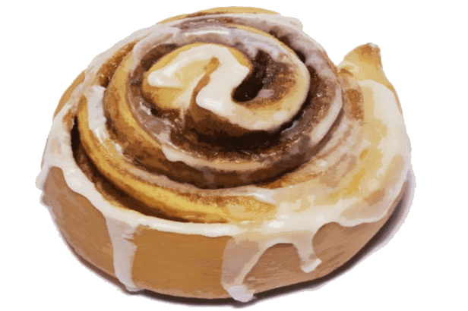
What is this food?
Cinnamon Roll
Pizza
Donut

Slide 13
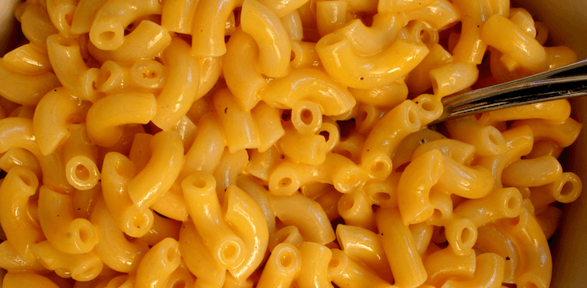
What is this food?
Mac and Cheese
Pizza
Burger

Slide 14
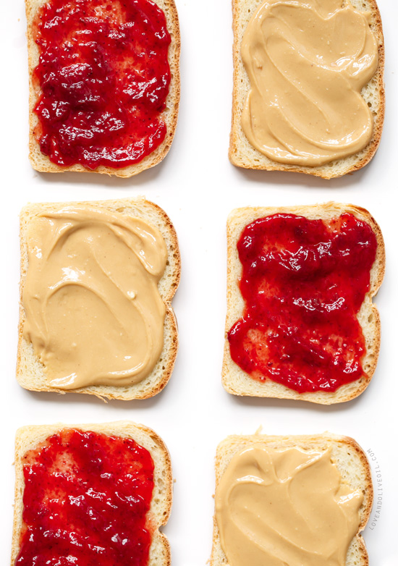
What is this food?
Peanut Butter and Jelly
Fries
Sub Sandwich

Slide 15
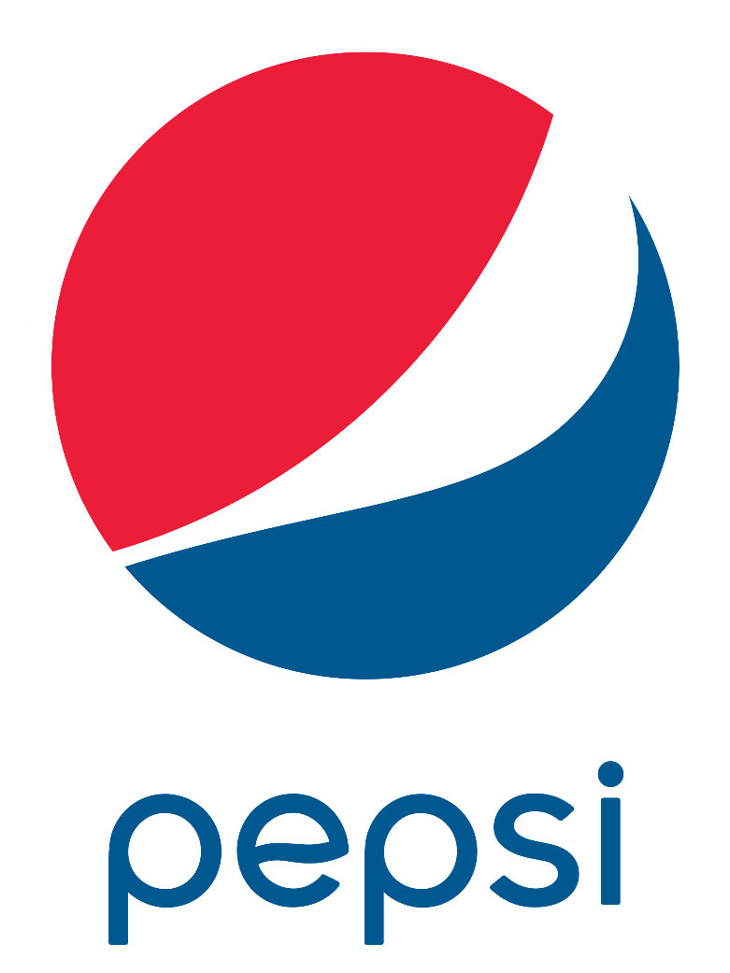
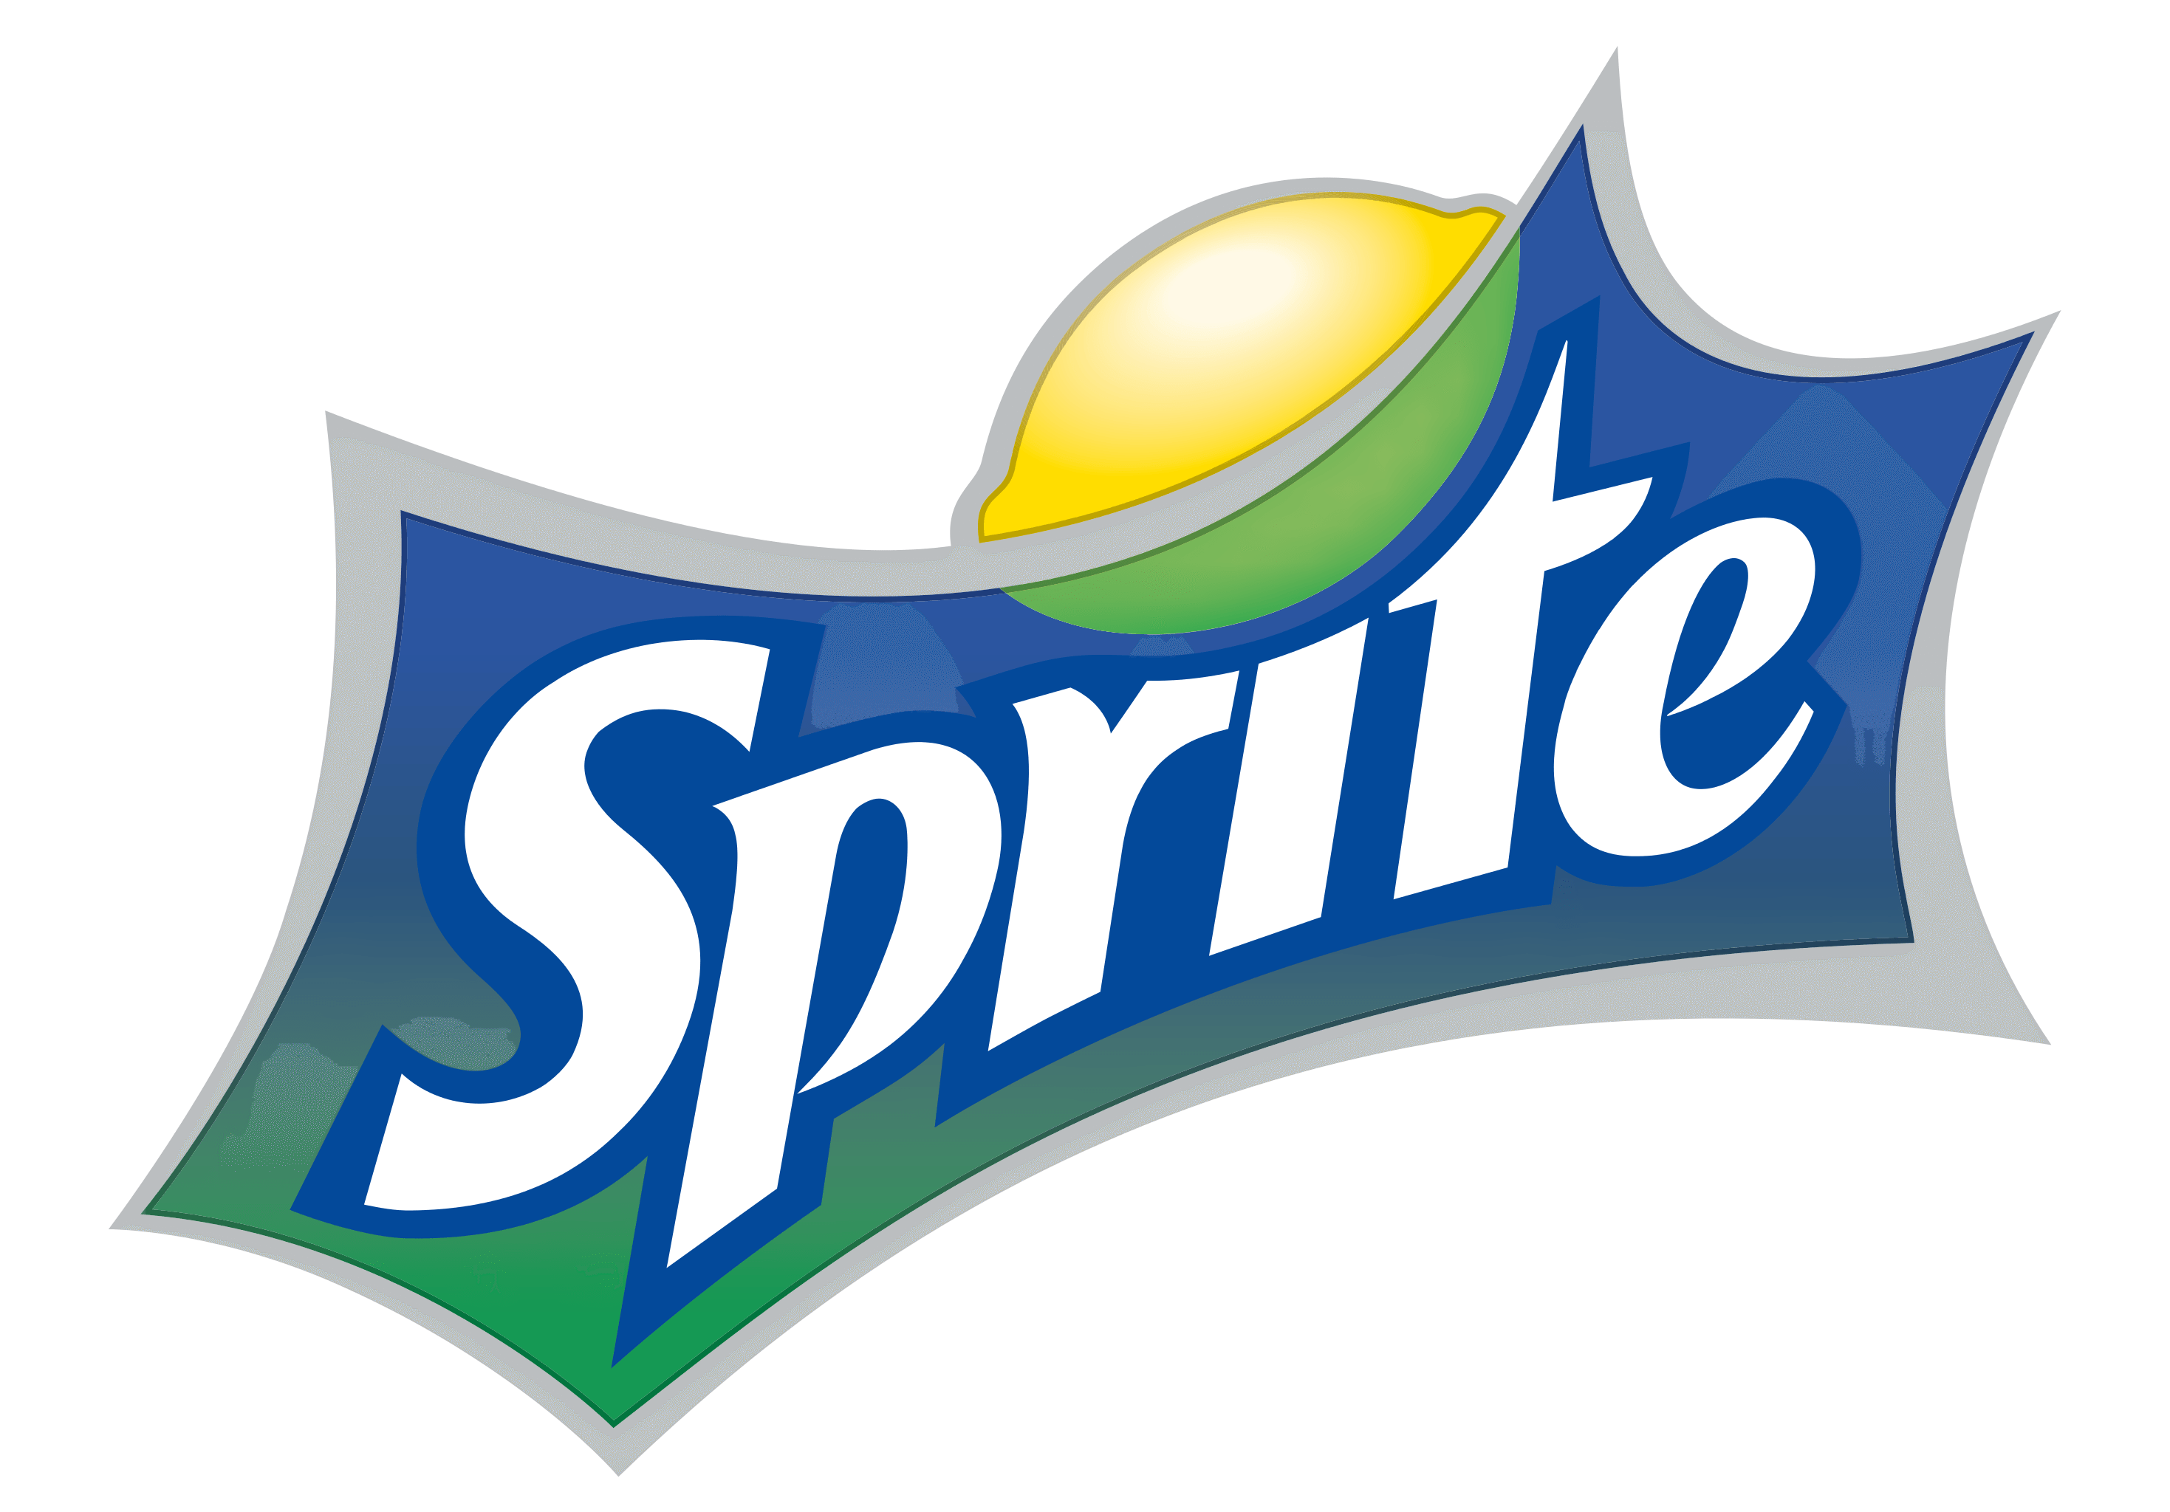
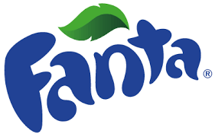
What is this drink?
Juice
Soda
Milk

Slide 16
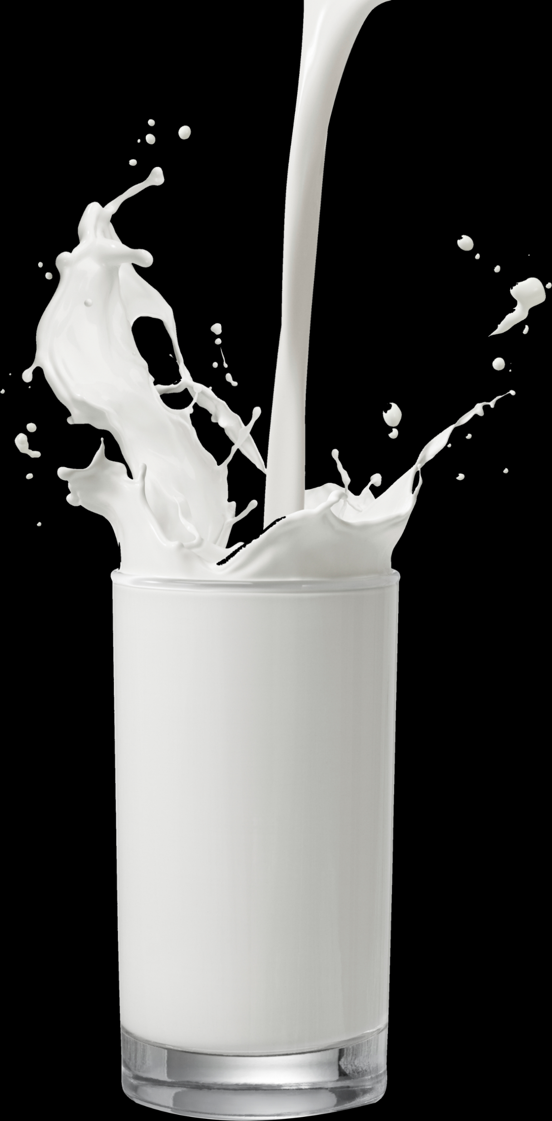
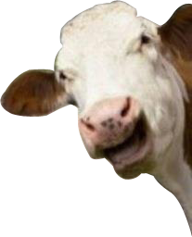
What is this drink?
Milk
Coffee
Tea

Slide 17
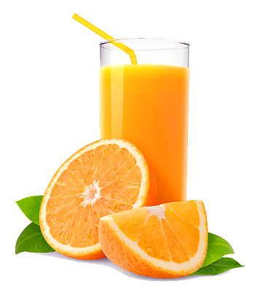
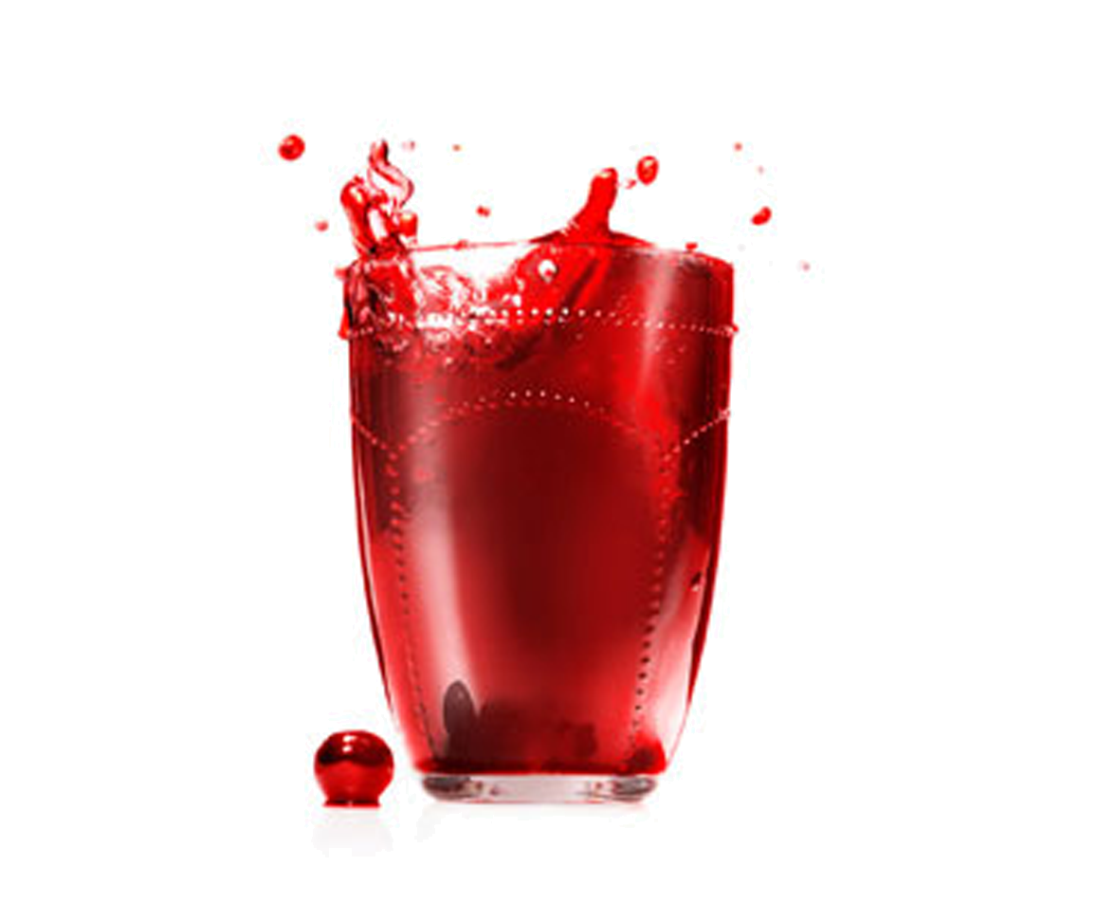
What is this drink?
Tea
Soda
Juice

Slide 18
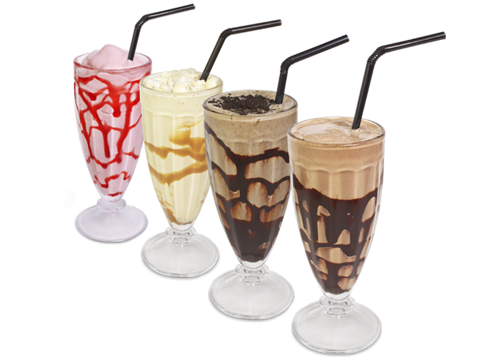
What is this drink?
Coffee
Soda
Milkshake

Slide 19
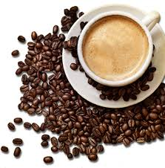
What is this drink?
Coffee
Juice
Milk

Slide 20
CONGRATULATIONS ! YOU’VE FINISHED THE TEST

Slide 21
Bibliography
Pictures and GIFs used in this presentation were all downloaded using Google Pictures

Slide 23
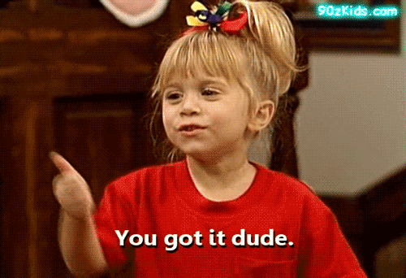

Slide 27
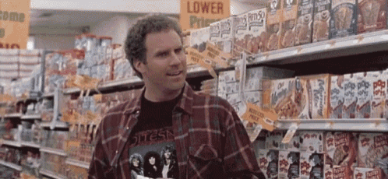

Slide 29
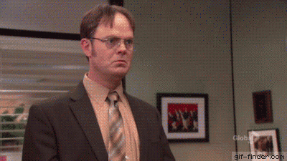

Slide 30
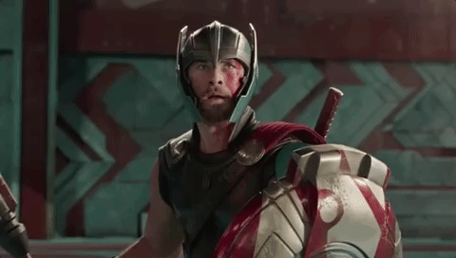

Slide 31
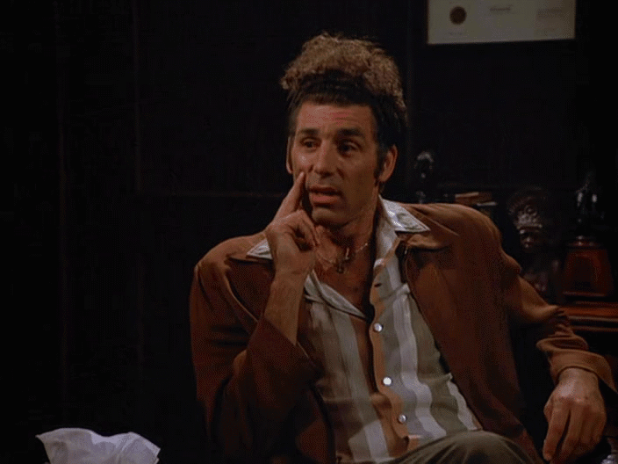

Slide 32
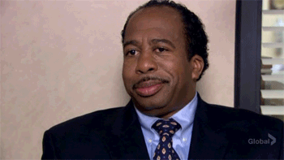

Slide 35
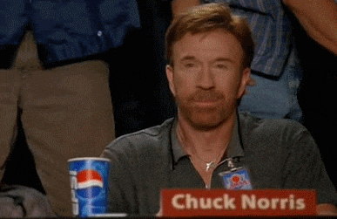

Slide 38
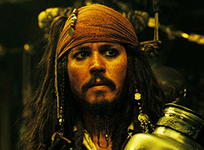

Slide 39
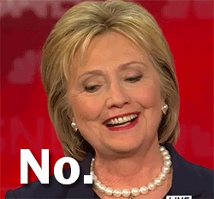

Slide 40
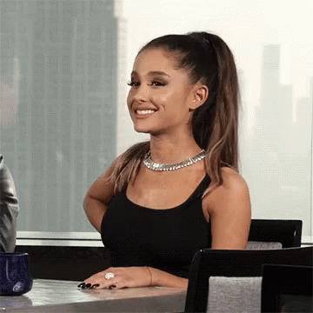

Slide 43
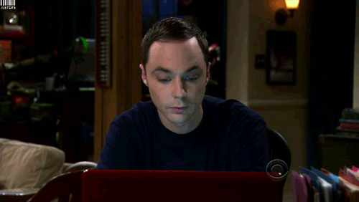

Slide 44
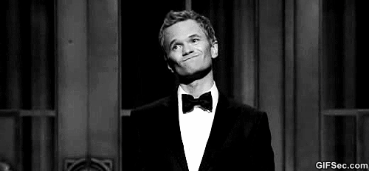

Slide 45
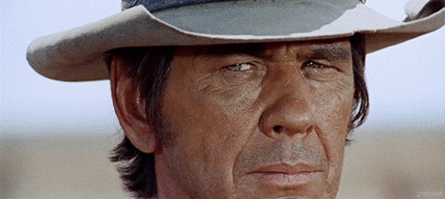

Slide 46
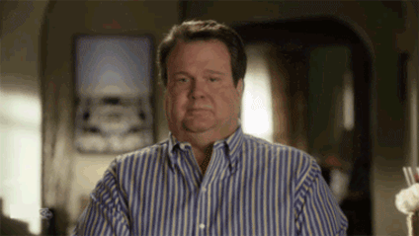

Slide 47
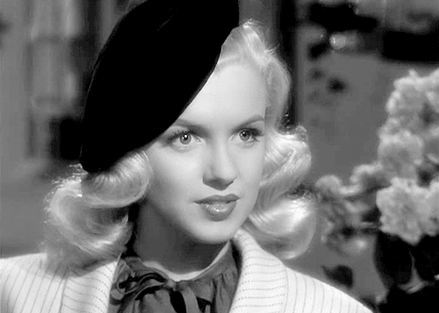

Slide 48
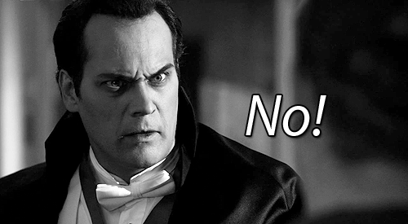

Slide 49
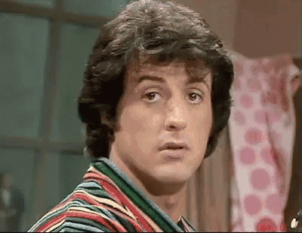

Slide 53
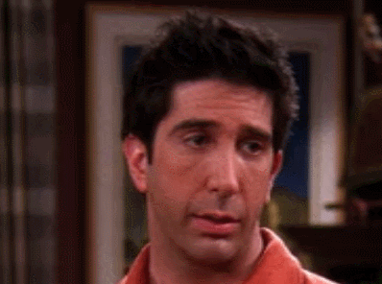

Slide 54
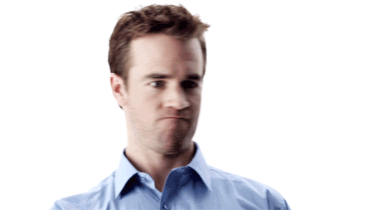

Slide 57
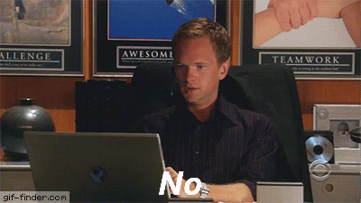

Slide 58
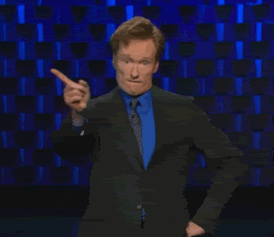

Slide 59
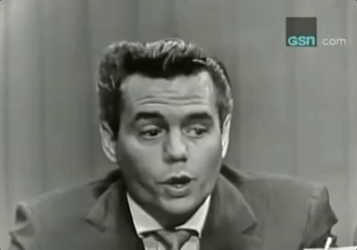

Slide 64
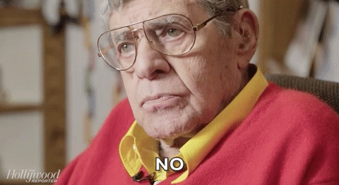

Slide 66
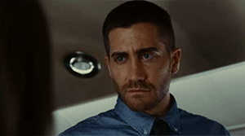

Slide 67
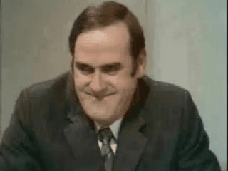

Slide 68
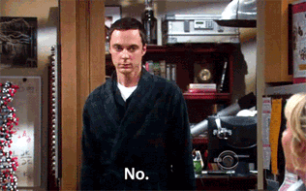

Slide 69
