Slide 1
Figurative Language
Made Easy!
With Mr. Burton!

Slide 2
Learning Objectives:
Students will be able to accurately write examples of similes, metaphors, symbolism, and personification following the rules of each.
Students will be able to correctly identify examples of similes, metaphors, symbolism, and personification based on prior lessons reinforced with explanations on this PowerPoint.
Next!

Slide 3
Cultural Relevance:
Figurative language is one aspect of language that may be understood only if you understand traditions or customs based on the region where they are spoken or written.
Interpreting figurative language therefore requires a demanding level of reading or listening comprehension in a language, along with an understanding of cultural references. This practice exercise includes various American pop-cultural references.
Next!

Slide 4
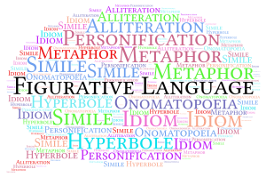
Table of Contents:
Similes
Metaphors
Symbolism
Personification
Begin assessment

Slide 5
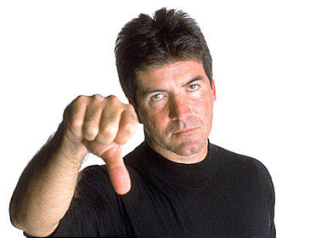
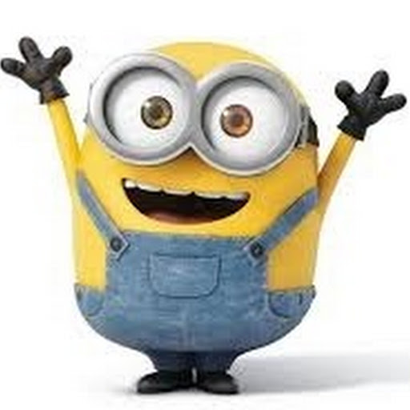
Bryon: “He smiled, like an innocent lion.”
In this scene where Bryon compares Mark to a lion, S.E. Hinton uses:
Symbolism
Personification
Metaphor
Simile
Next!

Slide 6
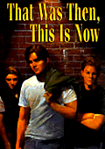
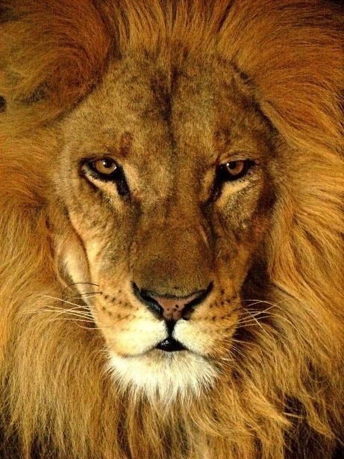
Explanation:
Back to Table of Contents
Bryon: “He smiled, like an innocent lion.”
In this example, Bryon compares his best friend, Mark to a lion.
In order to tell if a comparison is being made, see if you can replace the word “like” with an equal sign (“=“). This means that the example is a comparison, otherwise known as an analogy.
Similes and metaphors are both analogies. However, this example is NOT a metaphor because the word “like” or “as” is used while making the comparison.
This simile relates back to Hinton’s use of the “lion” as a motif in the story.
Mark

Slide 7
“Love is a rose.”
This analogy is an example of:
Symbolism
Personification
Metaphor
Simile
Next!

Slide 8
“Love is a rose” is like saying “Love = rose”
Back to Table of Contents
“Love is a rose.”
Explanation:
This analogy is an example of a metaphor.
Why?
However, “like” and “as” are not used here, making this analogy a metaphor. A metaphor is a comparison of two unlike things, but with some commonalities, such as how roses and love share beauty and also harshness with thorns.
Next!

Slide 9
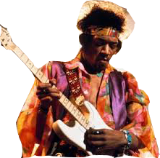
Jimi Hendrix sang to the crowd: “And the wind whispered Mary”. This is an example of: _____________
In this scene Hendrix uses:
Symbolism
Personification
Metaphor
Next!
Simile

Slide 10
“And the wind whispered Mary”
Back to Table of Contents
Explanation:
“And the wind whispered Mary”
This analogy is an example of personification.
Why?
Wind, a non-human noun, can not “whisper”. Therefore, the wind is given humanlike characteristics to enhance imagery in writing.
Next!

Slide 11
Throughout Speak, Laurie Halse Anderson uses a description of a tree to show Melinda’s growth.
In this scene the tree is an example of:
Symbolism
Personification
Metaphor
Simile
Next!

Slide 12
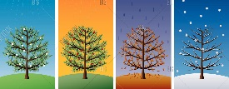
Back to Table of Contents
Explanation:
Throughout Speak, Laurie Halse Anderson uses a description of a tree to show Melinda’s growth.
This is an example of symbolism.
Why?
Trees reflect each of the 4 seasons. Often times in literature, trees reflect life stages:
-Spring = birth/beginning -Summer = youth/happiness
-Fall = middle-aged/slowing down -Winter = death/dormancy
Next!

Slide 13
Try again!

Slide 14
Yes! Good Job!!!

Slide 15
In Conclusion:
A review of figurative language!
Next!

Slide 16
Your Turn:
Back to Table of Contents
Given what you have learned about these four figurative language devices, try writing an example of each on your own. When you are finished, give Mr. Burton your responses.
Print this page and complete the spaces below. You must have at least 4 sentences total:
1 sentence showing a simile
1 sentence showing a metaphor
1 sentence showing a personification
1 sentence showing a symbol
Simile:
Metaphor:
Next!
Personification:
Symbolism:

Slide 17
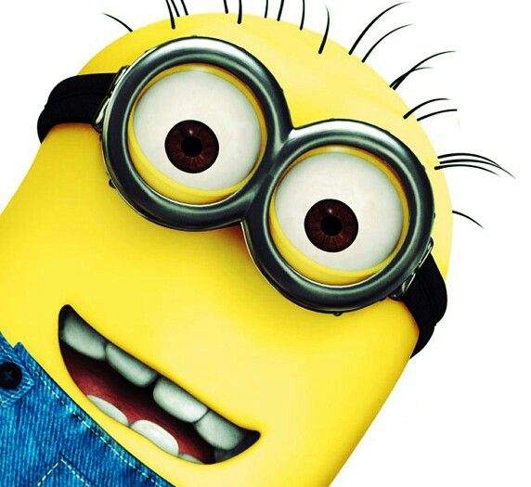
Works cited/Additional resources:
Back to Table of Contents
Great job!
All images courtesy of Google Image, some edited by me using Photoshop.
literary elements: the basic six - TeacherWeb
Review of All Literary Elements
I'm finished!

