Slide 1
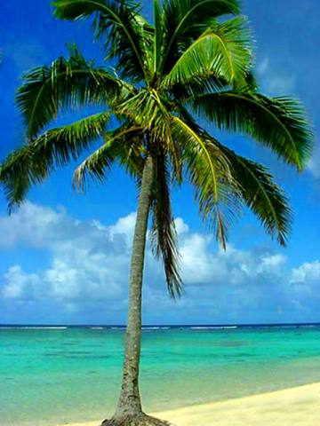
Welcome to Planet Paradise
Created By Kara, Jenna, Megan and Greg

Slide 2
Planet Paradise

Slide 3
About Planet Paradise
Planet Paradise is the perfect place to go to get away and take a well needed vacation. Although it is located 798,432 miles away from earth, it’s the ONLY place to get the relaxation you need !!
This self sustaining planet allows you to leave all your worries behind but still keep contact with Earth.

Slide 4
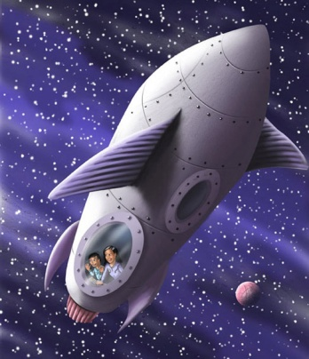
Planning your vacation
Wondering what to pack ?
The temperature of our planet is constantly 95 degrees with no humidity. This allows you to either enjoy the sun and heat by using the pool facilities or sit inside and relax in the air conditioning. Make sure you pack
Swimwear, proper footwear, shorts, tank tops, t shirts toiletries, money, towels, and id
Cost of the Vacation: The cost of the 4 night 5 day vacation is only 5,000 dollars per person with everything included.
Transportation: To get to our fabulous resort, you will
be taking the space shuttle that our resort provides.

Slide 5
What does Planet Paradise offer ?
Planet Paradise has everything you could ever want to completely relax!!
Swim up Tiki bar offering almost every choice of beverage
Beach areas with picnic tables for dining
Hammocks for complete relaxation !!
Raft rentals so you can lay out in the pools and get some sun
State of the art Tiki hut that offers souvenirs, necessities you might have forgotten to pack, an ATM machine, and basic beach food.
Restaurant offering the best cuisine you could ever want – food is transported weekly from earth ensuring freshness.
Individual luxurious bungalows over the water to give you complete privacy
Pamper yourself with our Day Spa that offers facials, manicures, pedicures, massages, mud baths, and wraps.

Slide 6
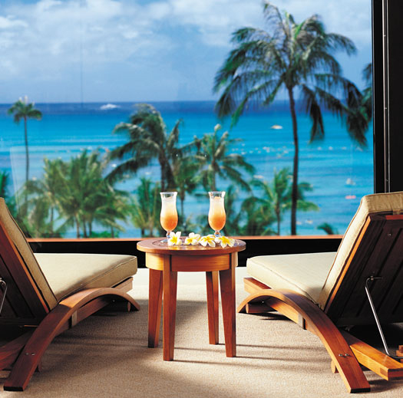
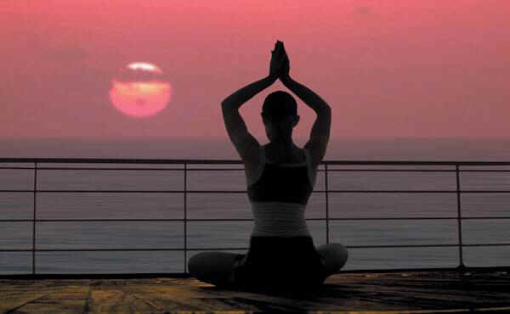
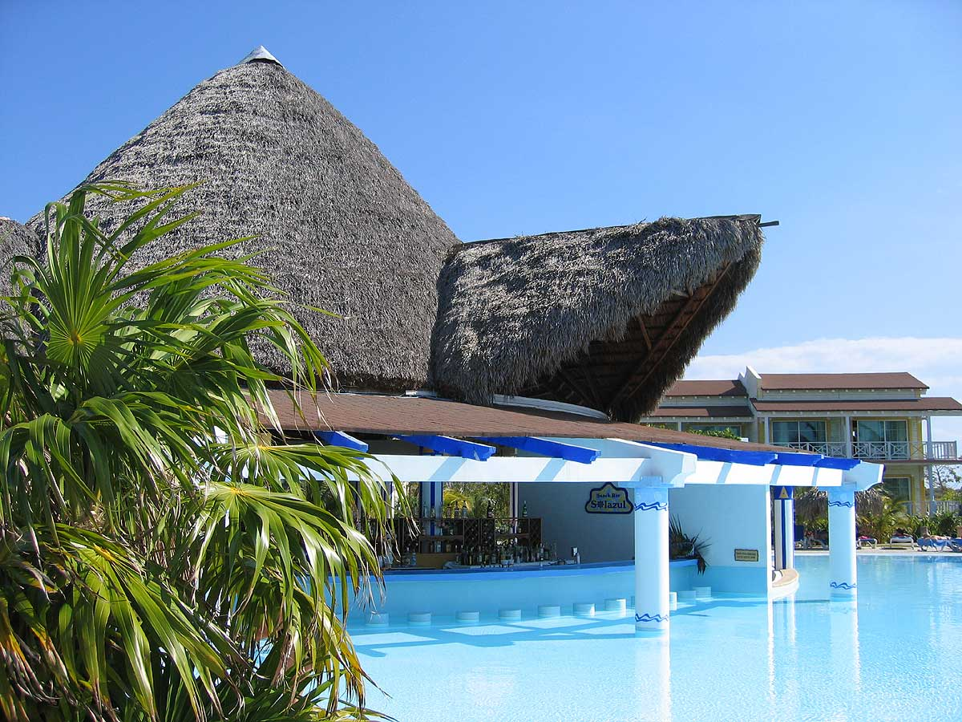

Slide 7
How we run successfully
Our resort was created on this planet because it is fully self-sufficient. Since the planet it made of ice, we filter in ice and melt it in order to make keep our pools and beaches full and clean. The ice provided by the planet is also used for our sanitation system.
The sanitation/waste system is based on recycling. The waste from the resort is recycled and filtered through a special septic tank underground that uses chlorine and screens to successfully clean the water so that it can be reused. There are special chemicals in the ground so that ensures that all of the filtered out waste becomes biodegradable.
In order to restock our supplies that aren’t provided by the planet, we have a shuttle coming in and out every Monday after our guests leave. Some of the supplies that we bring in are fresh drinking water, food, and materials required to successfully meet our guests needs.

Slide 8
Hopefully we’ll see you soon…
…at Planet Paradise

