Slide 1
WELCOME TO THE Bub n’ Shrub Resort on PLANET BAK2!
By: Amber Coulthart, Kristin Stoughton, Kristin Kashuba, and Bobbie Lansdowne

Slide 2
PLANET BAK2
Hello ladies and gentleman! Welcome to PLANET BAK2. On this planet you will find many wonderful vacation spots as it is a resort! Planet BAK2 contains three different sections including a:
-No gravity zone
-Tree house village
-Under water city
Within each section, there are three different resorts with several different activities for you and your family to do!

Slide 3
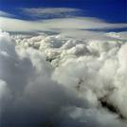
NO GRAVITY ZONE
This no gravity zone is the first thing that vacationers are exposed to on this planet! As you come into Planet BAK2, be prepared to float out of your seat! Don’t worry though, you won’t be here for long, unless you want to be. There are tubes and special suits that will connect you to the actual planet, where there is gravity!

Slide 4
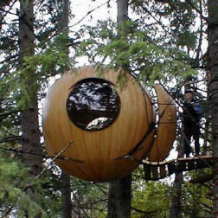
Tree House Resort
This resort connects to the “Above and Below Inn” which is part of the casino. You can also find luxurious tree houses that you may stay in for a night before you head down into the amusement park and casino!
This resort offers a peaceful stay, which pleases both fancy and laidback personalities.

Slide 5
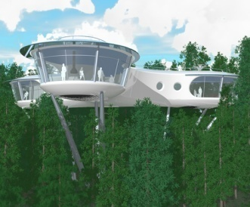
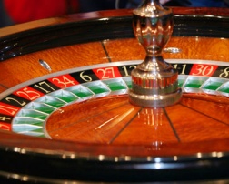
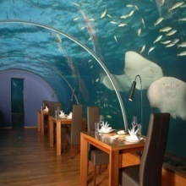
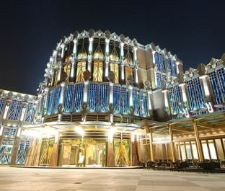
“Above and Below Casino”
This is what the casino looks like above water!
This resort contains many attractions including:
-eateries: adult bar & grill
-family entertainment: bands, concerts, games, movies
-hotels: “The Bub and Shrub”
This casino features two major attractions with half of the casino above the water and half of it below. You can get the best of both worlds by experiences both land and water habitats.

Slide 6
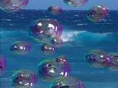
Under Water Resort
This resort is very unique and different, yet refreshing! There are many attractions including “Bubble Beach” and “Bubble Amusement Park” for you and your family to experience. As you head into the water resort, you will enter through tubes that contain oxygen and the attractions are in gigantic bubbles filled with lots of fun! Enjoy!!

Slide 7
Bubble Beach
This resort features a beach “hide-away” underneath the water. It doesn’t get any better than this! You have access to little huts on the beach filled with white sand, palm trees, salt water, and beautiful under-life creatures surrounding you. Come here to have a relaxing day, building sand castles, spending time with your family, and working on your tan, while experiencing under-water wild life!

Slide 8
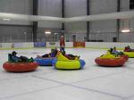
Bubble Amusement Park
Come here if you want to experience something completely different and fun! This park contains rides/games like:
-Bubble bungee
-Bubble cars
-Bubble games
-Bubble coaster
-Bubble bounce
-Whale ride (go inside a real whale and exit out the blow hole!)

Slide 9
The End
Hope you enjoyed your virtual field trip!!!
By: Amber Coulthart
Bobbie Lansdowne
Kristin Kashuba
Kristin Stoughton

