Slide 1
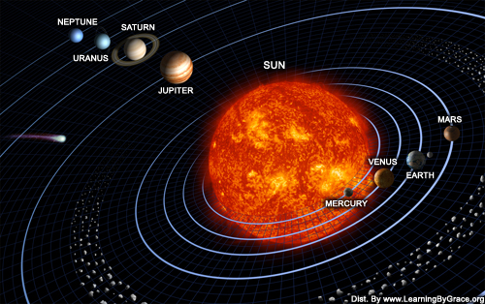
The Solar System
NEXT

Slide 2
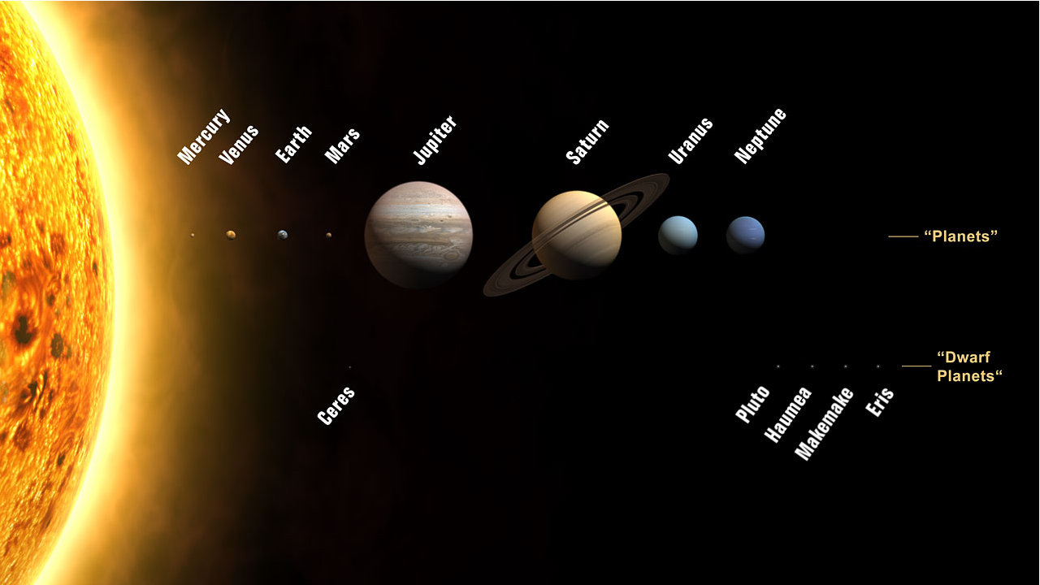
These are the planets in order from the sun.
NEXT

Slide 3

Click below to hear about the solar system.
Then, take the quiz.
Remember to listen carefully!
Take the Quiz

Slide 4
Click below to listen again.
Go back to the quiz

Slide 5
I am the furthest planet from earth.
Listen again

Slide 6
GOOD
ANSWER!

Slide 7
I am the largest planet.
Listen again

Slide 8
CORRECT!

Slide 9
I have rings.
Listen again

Slide 10
AWESOME!

Slide 11
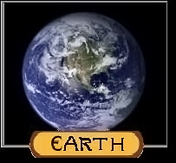
I am the smallest planet.
Listen again

Slide 12
YOU GOT IT!

Slide 13
I am called the “red planet”.
Listen again

Slide 14
SUPER!

Slide 15
I am the closest planet to the sun.
Listen again

Slide 16
GREAT!

Slide 17
I am the coldest planet in the solar system.
Listen again

Slide 18
BRRRR!

Slide 19
I am the closest planet to Earth.
Listen again

Slide 20
HELLO NEIGHBOR!

Slide 21
I am the planet furthest from the sun.
Listen again

Slide 22
YOU DID IT!

Slide 23
I am the hottest planet in the solar system.
Listen again

Slide 24
TRY AGAIN!

Slide 25
GREAT
ANSWER!

Slide 26
Great Job!
If you want more information about the solar system, click on the link below.
http://www.kidsastronomy.com/solar_system.htm

