Slide 1
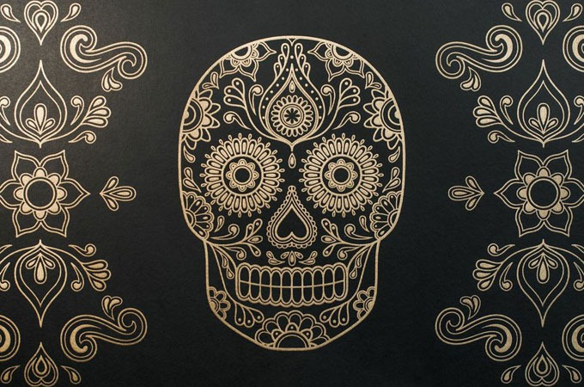
Día de los muertos
Los Objectivos
Información
Un vídeo
Las fotos
Prueba de información
Day of the dead
El Vocabulario
El juego del vocabulario
El proyecto final
Mi proyecto

Slide 2
Los Objetivos
Students will be able to recognize and translate specific terms into the target language.
Students will be able to verbally pronounce activity-specific vocabulary terms in the target language.
Students will be able to demonstrate an understanding of the basic concepts of día de los muertos.
Students will be able to create an original alter for someone in their life who has passed, using concepts learned throughout the activity.
Students will be able to label items on their project in Spanish using the vocabulary presented to them in the vocabulary activity.
Students will be able to make cross-cultural comparisons on the regards of death between each culture.
HOME

Slide 3
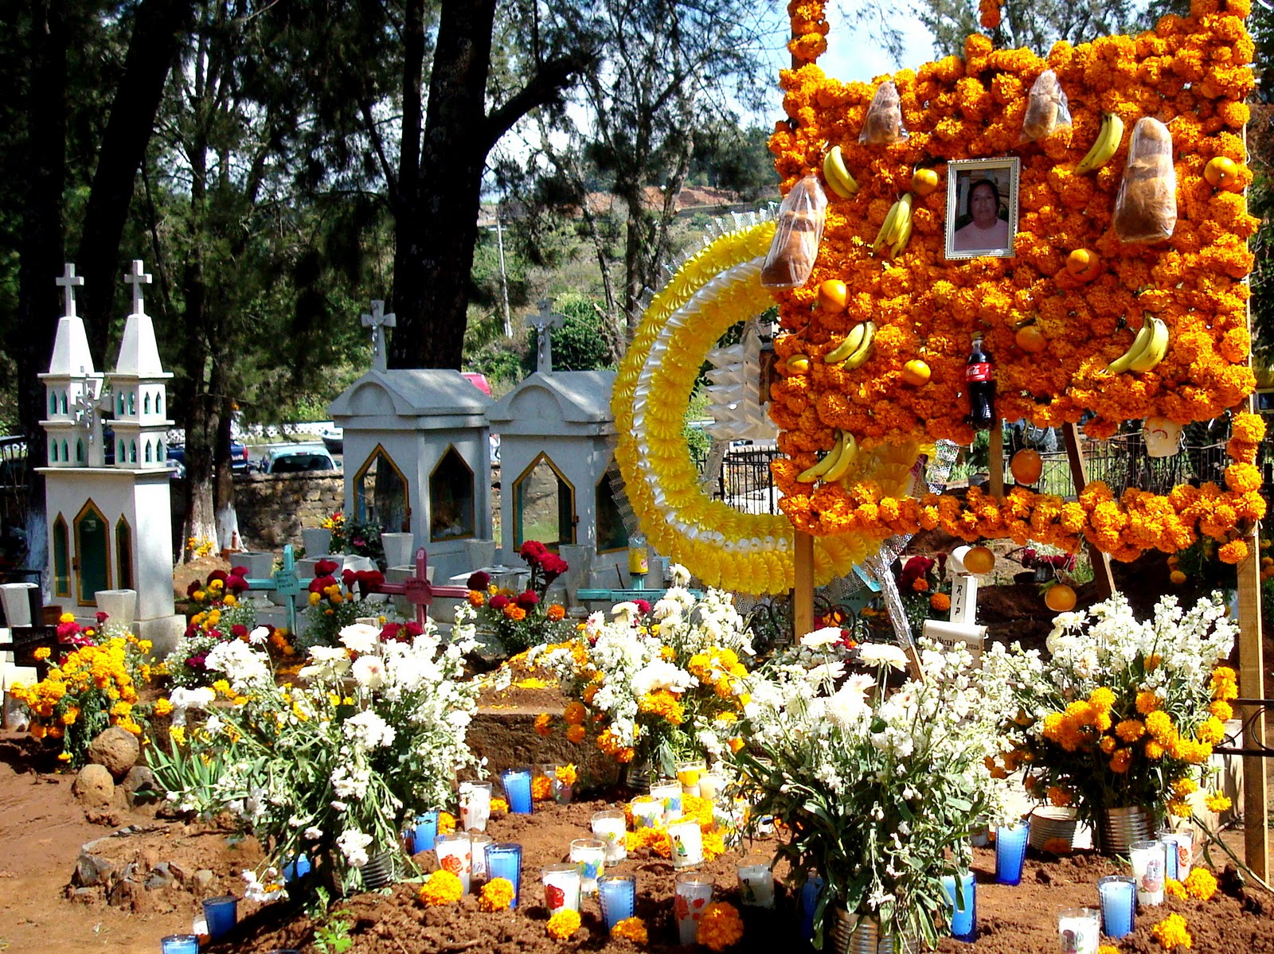
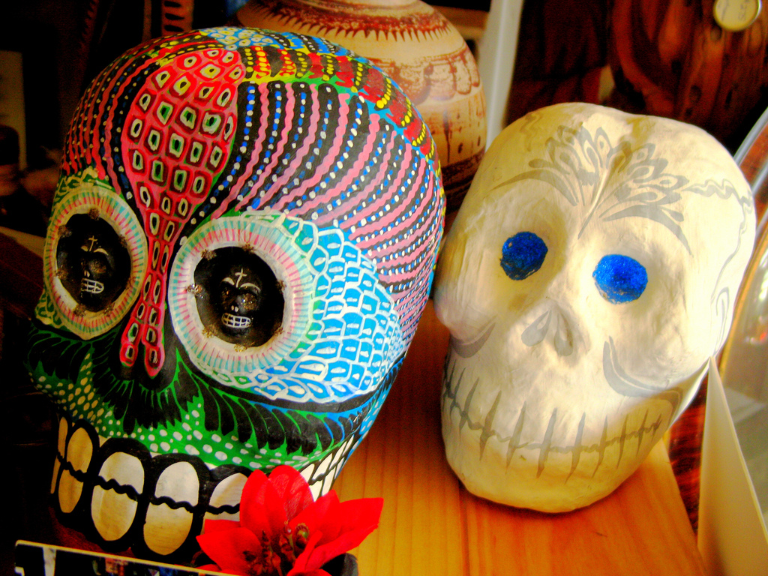
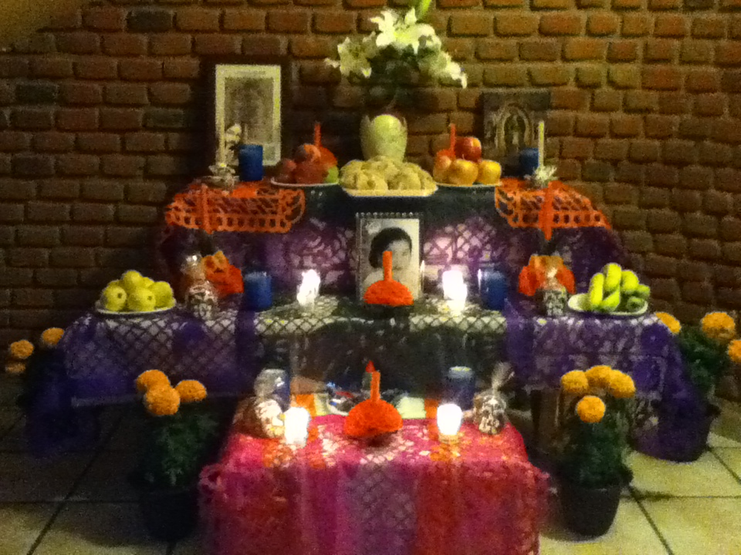
Qué es? What is it?
Información
Day of the Dead is a Mexican holiday that is celebrated to honor loved ones who have passed.
It is celebrated on November 1st and November 2nd.
People visit deceased loved ones at the cemetery to decorate their graves with flowers and other items.
People also create alters or ofrendas within their own homes to remember the life of a deceased relative.
These alters are decorated with flowers, photographs, candies and the infamous bread of the dead.
HOME

Slide 4
Un Vídeo
While Watching Video:
What are some things that you see and/or hear that are interesting to you? What are some things that see and/or hear that surprise you? How would you describe this culture’s feelings on death? How do these rituals/activities compare to ours here?
HOME

Slide 5
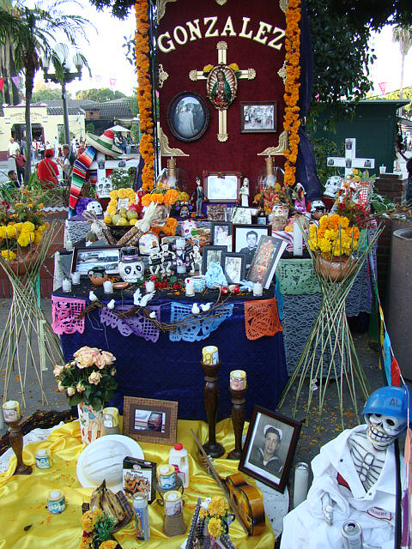
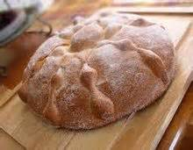
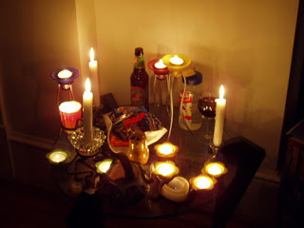
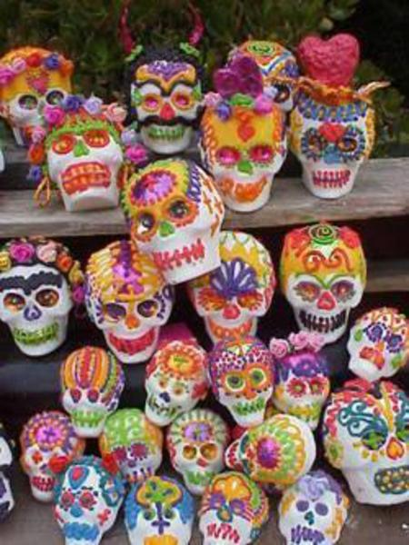
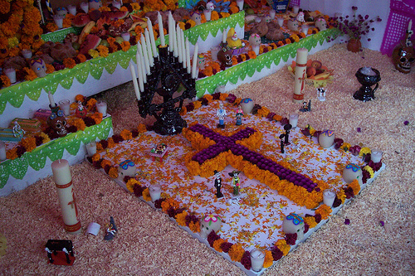
Las Fotos
HOME

Slide 6
When does Day of the Dead occur?
October 31st
November 1st & 2nd

Slide 7
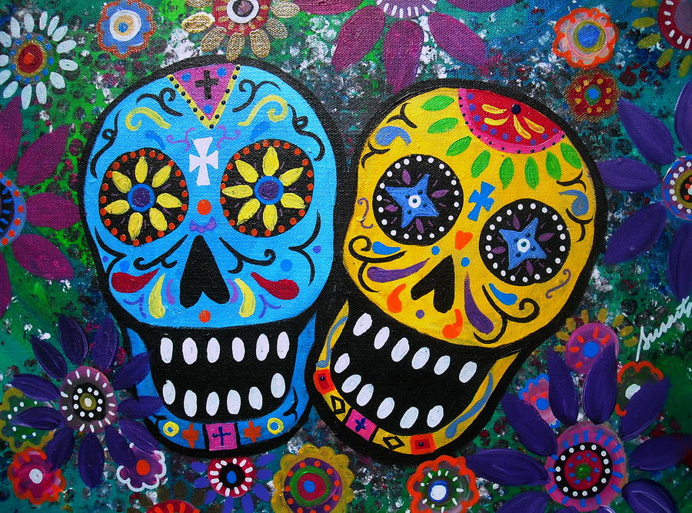
¡Muy bien!

Slide 8
No.

Slide 9
What type of holiday is Día de los Muertos?
European
Mexican

Slide 10
¡Muy bien!

Slide 11
No.

Slide 12
Cierto o Falso: People visit the graves of their loved ones and decorate them on día de los muertos.
Cierto
Falso

Slide 13
No.

Slide 14
El Vocabulario
Español | Inglés
la guitarra | guitar
la mascara | mask
el pan de los muertos | bread of the dead
las flores | flowers
la cruz | cross
los dulces | candy
el cementario | cemetery
la calvera de azucar | sugar skull
HOME

Slide 15
How do you say “sugar skull” in Spanish?
la calvera de azucar
la guitarra
las flores
HOME

Slide 16
Sí

Slide 17
No

Slide 18
How do you say “cross” in Spanish?
la cruz
las flores
los dulces
HOME

Slide 19
Sí

Slide 20
No

Slide 21
How do you say “mask” in Spanish?
la cruz
la mascara
el cementario
HOME

Slide 22
Sí

Slide 23
No

Slide 24
How do you say “cemetary” in Spanish?
el pan
la guitarra
el cementario
HOME

Slide 25
Sí
Home

Slide 26
No

Slide 27
El proyecto final
It is now time for you to create your own alter!
Using everything you have learned from this lesson, create a list of items you would put on an alter for a loved one in your life who has passed on.
Your project must include:
A person who has passed and their relation to you (Title)
At least 6 items (labeled in Spanish) that you would put on their alter to represent them/their life
The correct use Spanish vocabulary
At least 6 colorful images to represent your items
Un ejemplo
HOME

Slide 28
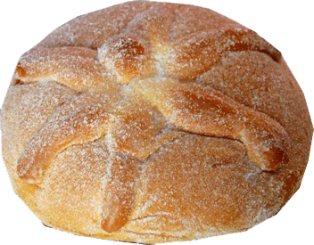
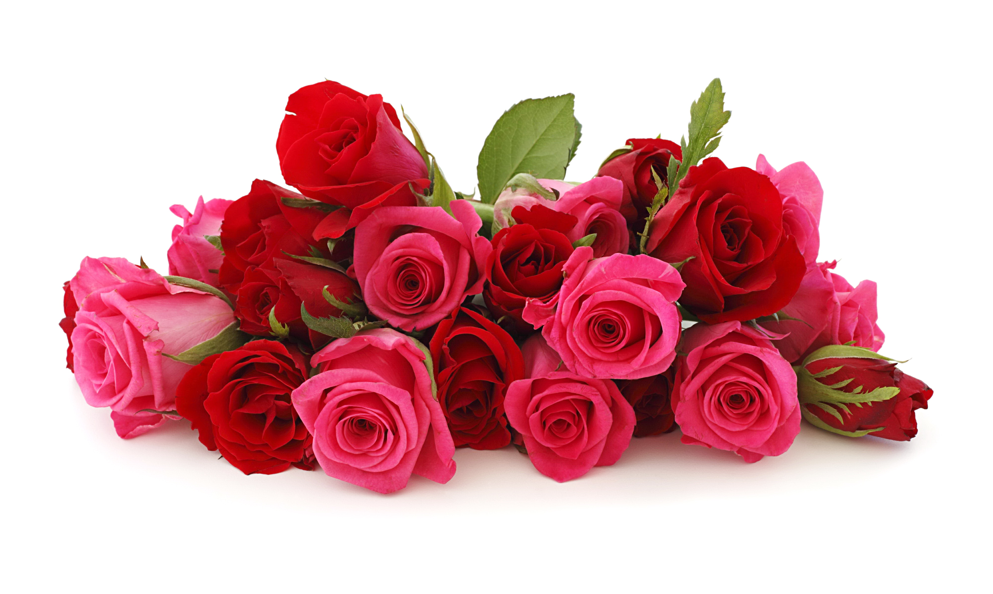
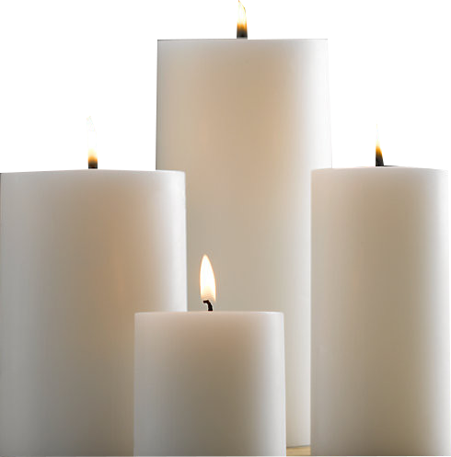
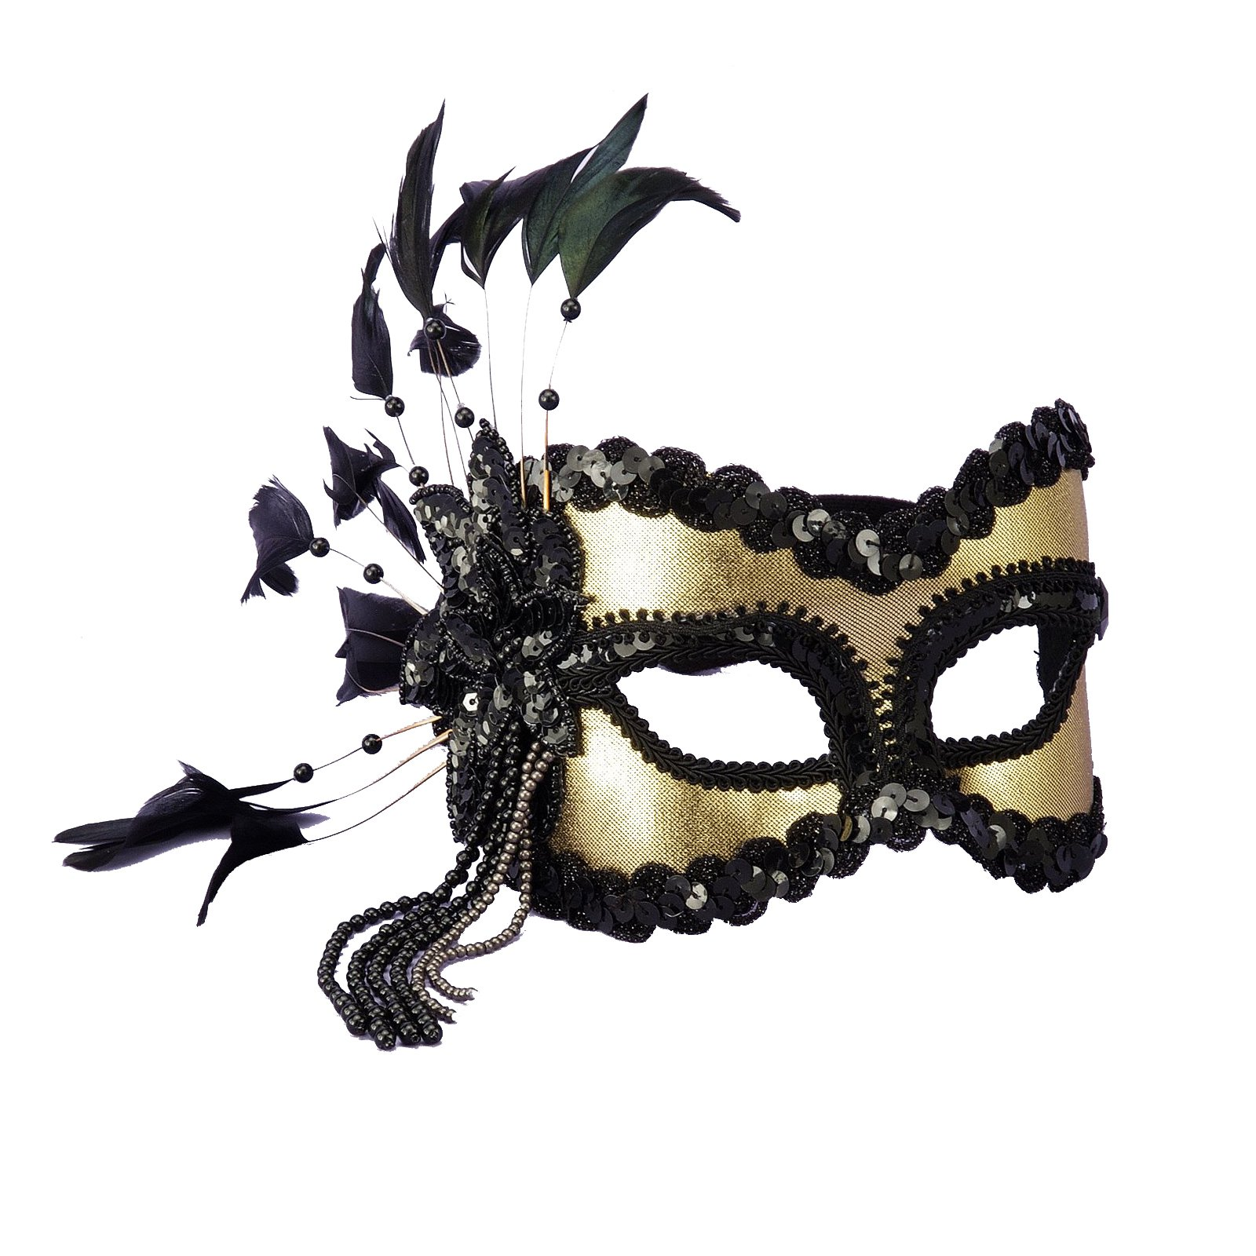
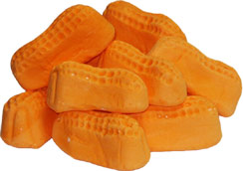
Mi proyecto
Florence Willis
las flores
Mi abuela
el pan de los muertos
las velas
los dulces
la mascara
El projecto
HOME

