Slide 1
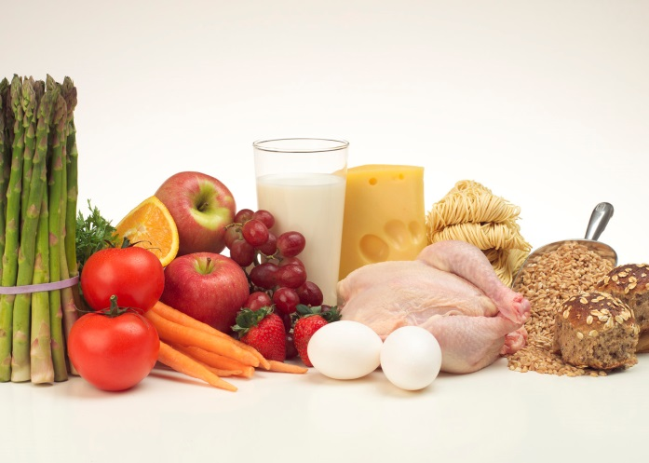
Condicional y cómo pedir para la comida
Ordering in restaurants
Condicional
Menú de España
Quiz 1
Quiz 2
La comida de España
Read about food from Spain
Objectives: SWBAT…
Bebidas
Actividad Final
Otras frases
La tarea

Slide 2
Main page
1: Students will be able to listen to, speak and understand the different forms of gustarse in the conditional form and why they are used when ordering food in Spanish.
2: Students will be able to pinpoint similarities and differences for ordering in restaurants in Spain and in the United States.
3: Students will be able to speak and understand the new food, drinks and other phrases vocabulary.
4: Students will be able to look at a menu in Spanish and understand what certain foods from the menu.
5: Students will be able to listen to and read quiz questions in Spanish and choose the correct answer based on the conditional tense and new vocabulary learned.
6: Students will be able to research and describe different Spanish foods from Spain.
7: Students will be able to create their own written sentences, based on food from Spain, using the conditional form and new vocabulary they have learned in class.

Slide 3
Talk about ordering in restaurants
How do we order food when we are at a restaurant in the United States?
Compare to how food is ordered in Spain.
Main page
Notes:
The teacher will talk about ordering customs in the US and in Spain: tense, politeness, appropriate phrases

Slide 4


Condicional
me gustaría
te gustaría
le gustaría
nos gustaría
les gustaría
I would like
You would like
He/She/you formal would like
We would like
They would like
Main page
Quiz 1
Quiz 2
Actividad Final
Notes:
Tomen notas. How do we make “gustaría” plural when we are talking about ordering multiples of a food item? Add an “n”.

Slide 5
Quiz!
Answer the questions by clicking on the correct answer.
Main page

Slide 6
¿Qué significa “me gustaría”?
They would like
No
She/he would like
No
I would like
Sí!
Main page
Condicional

Slide 7
¿Qué significa “le gustaría”?
They would like
No
She/he would like
Sí!
I would like
No
Main page
Condicional

Slide 8
What do we do to make “gustaría” plural?
Add an “s”
No
Add an “i”
No
Add an “n”
Sí!
Main page
Condicional

Slide 9


La comida de España
Paella
Pescado
Ensalada
Naranja
Bocadillos
Pan
Calamares
Chorizo
Papas fritas
Sopa
Fresas
Plátanos
Jamón
Queso
Arroz
Pollo
Flan
Helado
Churros con chocolate
Main page
Bebidas
Otras frases
Quiz 2
Actividad Final

Slide 10
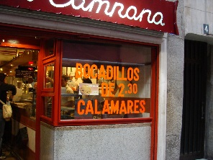
Picture I took from La Plaza Mayor in Madrid, Spain. They are famous for their calamari sandwiches.

Slide 11
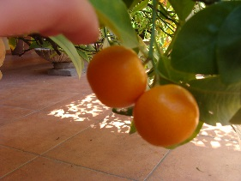
Picture I took in Cordoba, Spain. Oranges and clementines can be found on many trees throughout Spain.

Slide 12
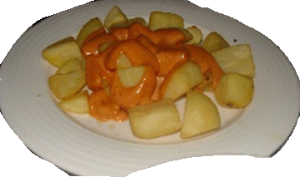
Picture I took in Barcelona, Spain. These are patatas bravas, however they are very similar to french fries. They are usually served with an aioli sauce.

Slide 13
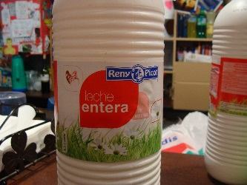

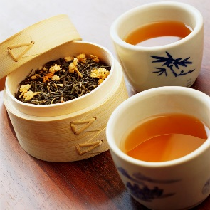
Bebidas
Café
  con leche
  con azúcar
Chocolate caliente
Té
Jugo de naranja
Agua
Leche
Main page
La comida de España
Otras frases
Actividad Final

Slide 14
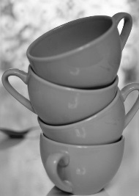
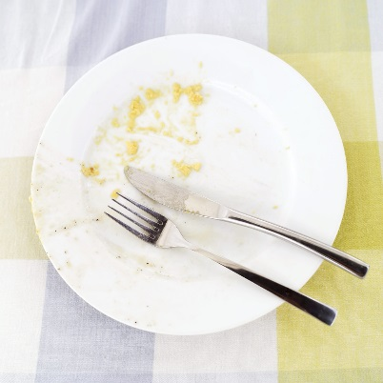
Otras frases
Hola
Gracias
Por favor
Me gustaría
  un café
  una ensalada
una taza
un cuenco
un plato
Main page
La comida de España
Bebidas
Actividad Final

Slide 15
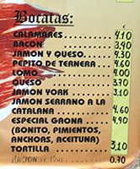
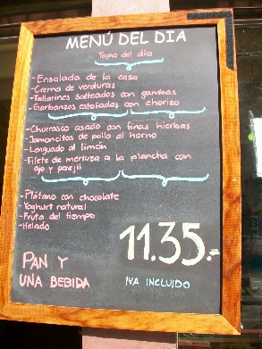
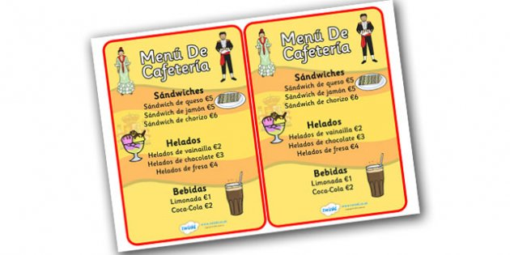
Menú de España
When I was in Spain…
cafeandte
Main page
Actividad Final
La tarea
Notes:
In these pictures, students can see types of food from Spain and their costs, some foods we have already talked about in the vocabulary part of the lesson. By clicking the link, students can see a website and menu from Café y Té. This was a restaurant that I went to many times when I was in Spain. You can go in to get a drink and something quick to eat.

Slide 16
Quiz!
Answer the questions by clicking on the correct answer.
Main page

Slide 17
¿Qué significa “un bocadillo”?
an orange
No
a salad
No
a sandwich
Sí!
Main page
La comida de España

Slide 18
¿Qué significa “un cuneco de sopa”?
a bowl of soup
Sí!
a plate of fish
No
a cup of orange juice
No
Main page
La comida de España

Slide 19
¿Qué significa “pescado”?
bread
No
fish
Sí!
custard
No
Main page
La comida de España

Slide 20
¿Qué es el español de “I would like a cup of coffee”?
Le gustaría un cuenco de café.
No
Te gustaría un plato de café.
No
Me gustaría una taza de café.
Sí!
Main page
Condicional
Bebidas

Slide 21
¿Qué es el español de “She would like a plate of Spanish rice”?
Le gustaría un plato de calamares.
No
Le gustaría un plato de paella.
Sí!
Le gustaría un plato de ham.
No
Main page
Condicional
La comida de España

Slide 22
¿Qué significa “Les gustarían unas tazas de jugo de naranja”?
They would like some cups of orange juice.
Sí!
We would like some cups of orange juice.
No
He would like some plates of sandwiches.
No
Main page
Condicional
Bebidas

Slide 23
¿Cúal es la frase para mostrar el respeto al camarero/a?
¡Gracias!
Sí!
Por favor, me gustaría…
Sí!
¡Hola!
Sí!
Main page
Condicional
Otras frases

Slide 24
Click on Spain to read more about their food!
Main page
Actividad Final

Slide 25

Actividad Final
Ustedes van a crear unas frases para demostrar la comida que les gustaría pedir si estarían en un restaurante.
  4 frases
  Dos frases que usan el plural
  Usar los menus de España y el vocabulario
  Usar los links ↓↓↓
Después, van a presenter sus frases a la clase.
Main page
Condicional
La comida de España
Bebidas
Otras frases
Menú de España

Slide 26
La tarea
Ustedes van a investigar sobre una comida de España. Tomen notas.
La siguiente clase…
  Van a compartir sus notas.
EXTRA!!!
  Para aumentar la nota:
    Crear un menú en Español.
Main page
Read about food from Spain
Menú de España

