Slide 1
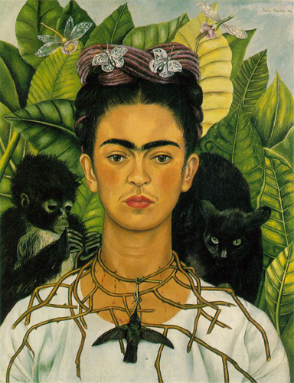
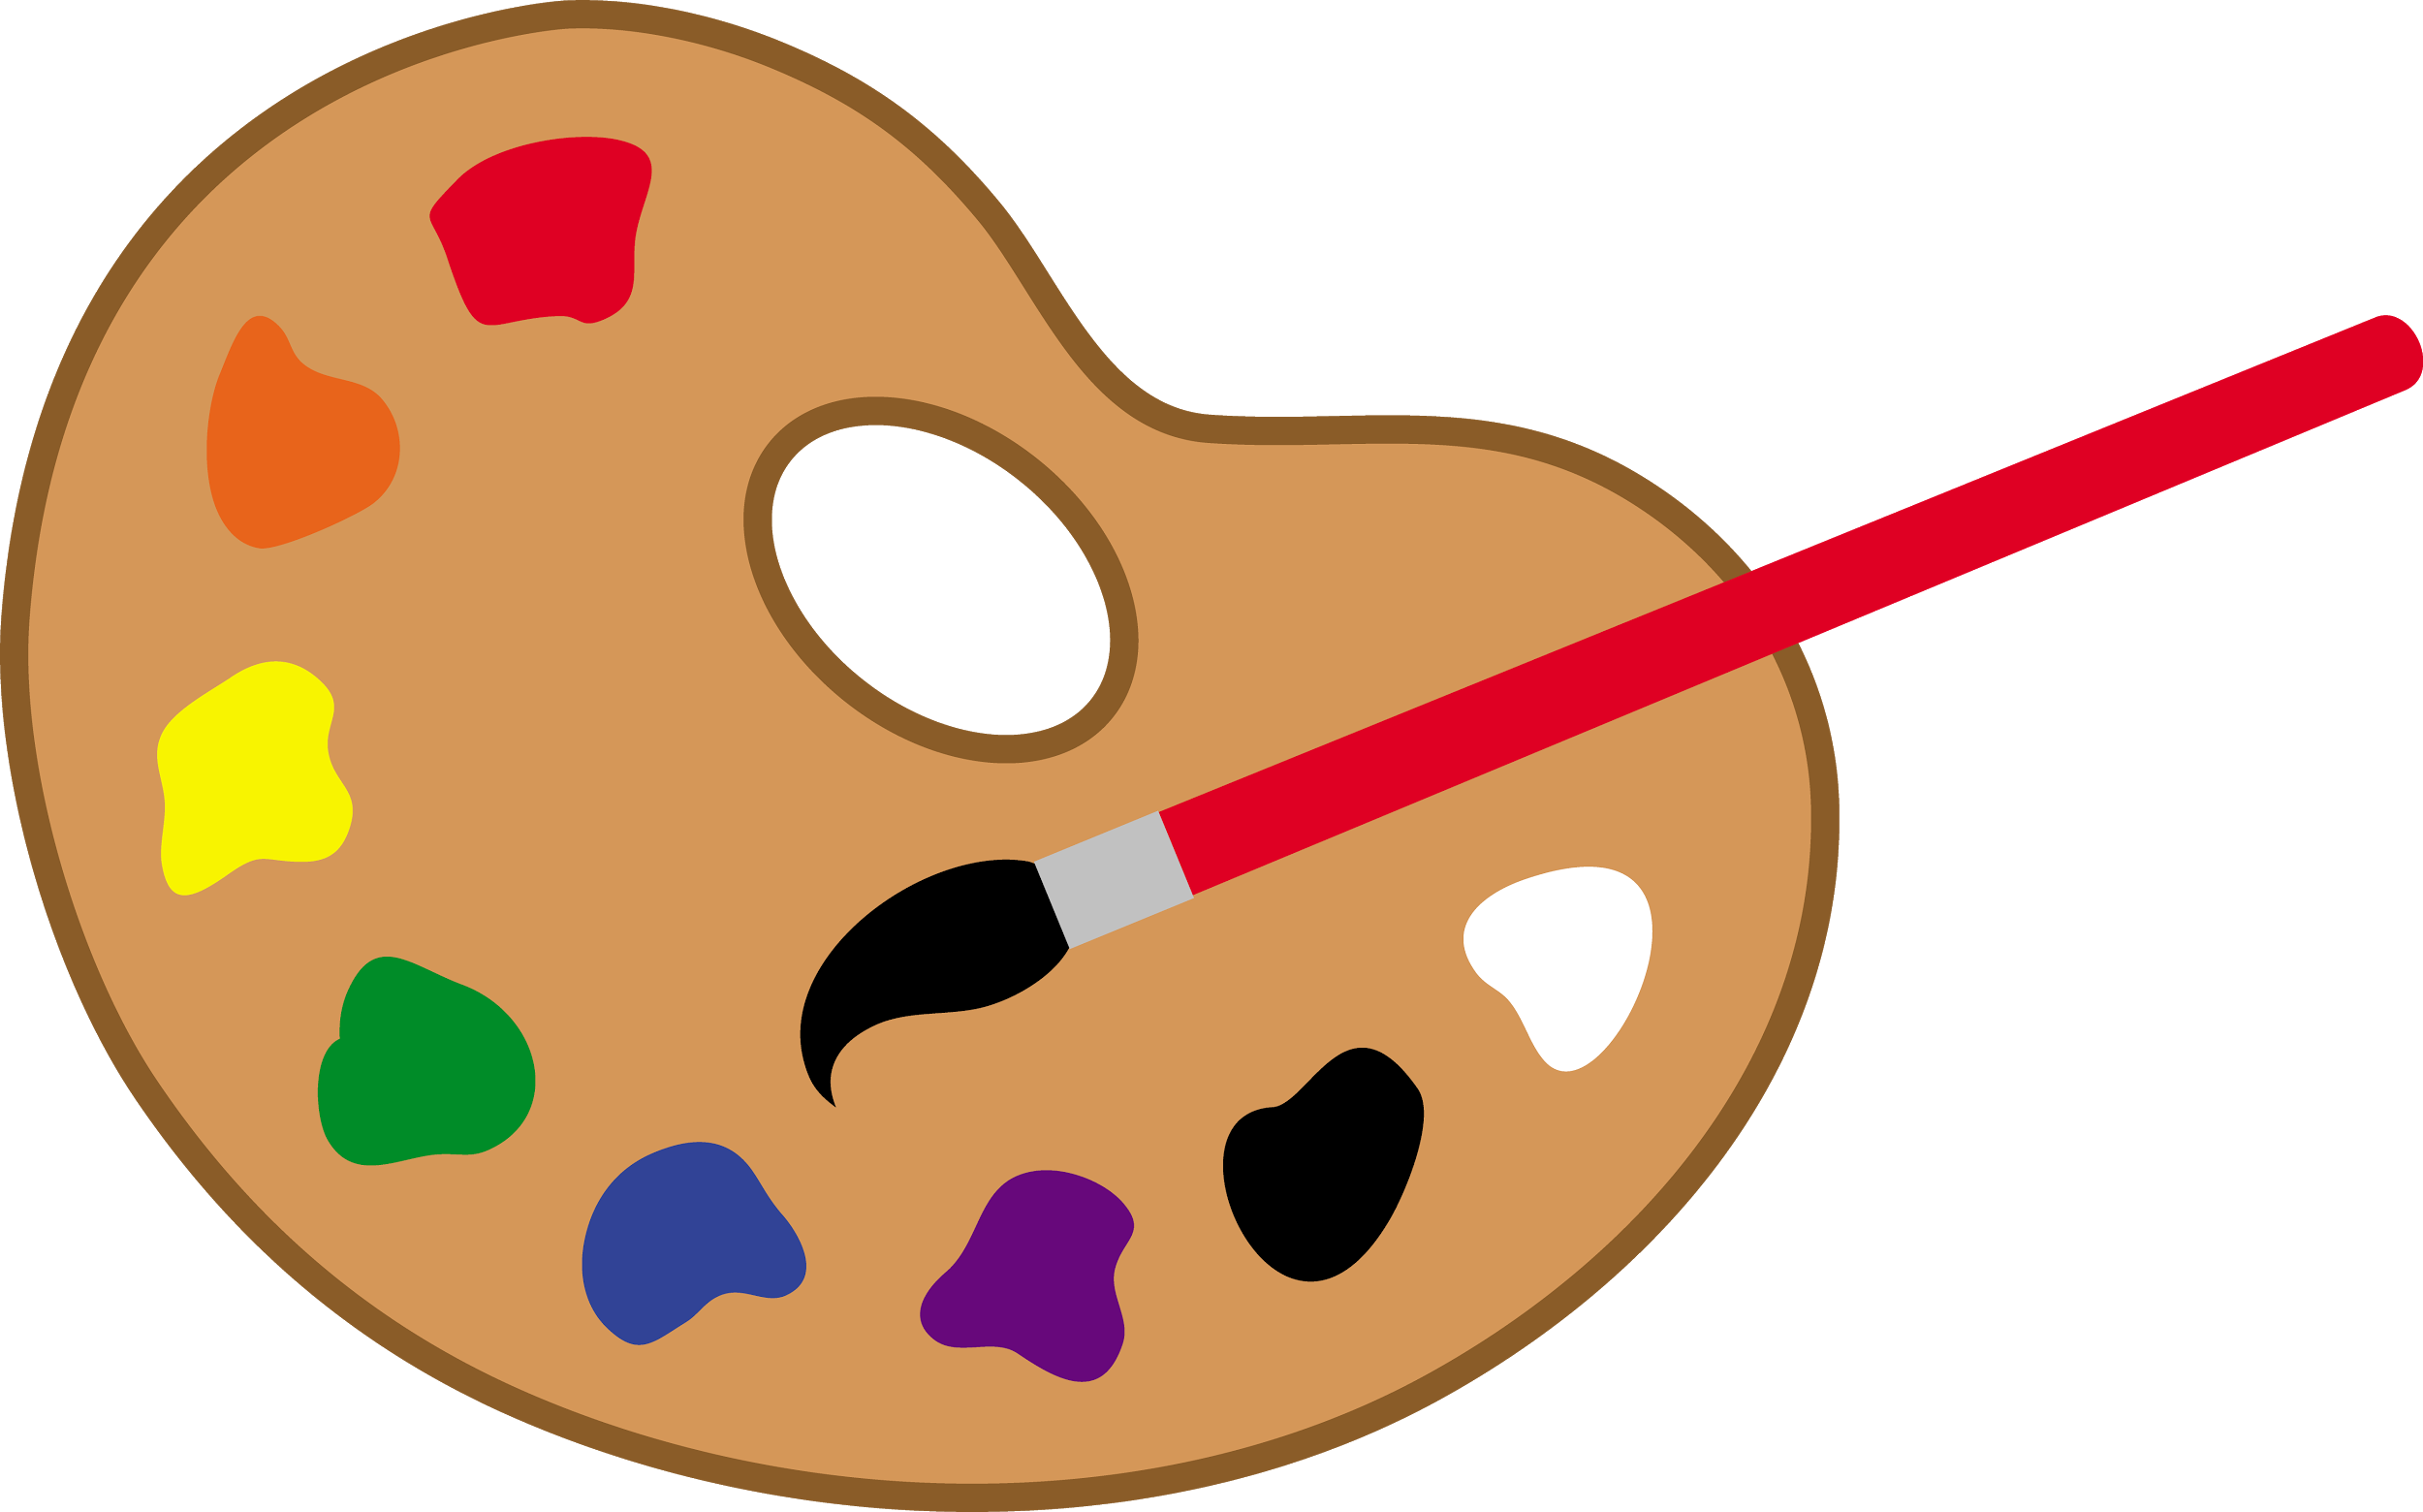
La vida dramática
de Frida Kahlo
1907-1954
“Nothing is worth more than laughter. It is strength to laugh and to abandon oneself, to be light. Tragedy is the most ridiculous thing.”

Slide 2
Su niñez
-born on el 6 de julio de 1907 in Mexico City, Mexico
-cuando tenía 6 años, she contracted polio which caused her to be bedridden for nine months
-While she did recover from la enfermedad, she limped when she walked because the disease had damaged her right pierna y pie
-Su padre encouraged her to jugar fútbol, nadar, and even wrestle -- highly unusual activities for a girl at the time -- to help her recover

Slide 3
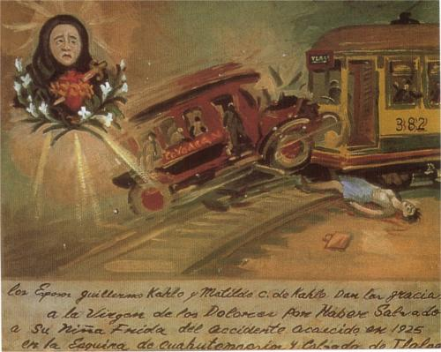
La formación y su accidente
-In 1922, Kahlo enrolled at the renowned National Preparatory School. She was one of the few alumnas to attend the school
-On el 17 de septiembre de 1925, Kahlo and Gómez Arias were traveling together on un autobús when the vehicle collided with a streetcar. Kahlo was impaled by a steel handrail, which went into her cadera and came out the other side causing fractures in her spine and pelvis.
Notes:
known at the school for her jovial spirit and her love of traditional and colorful clothes and jewelry
(Gómez=someone she was dating)

Slide 4
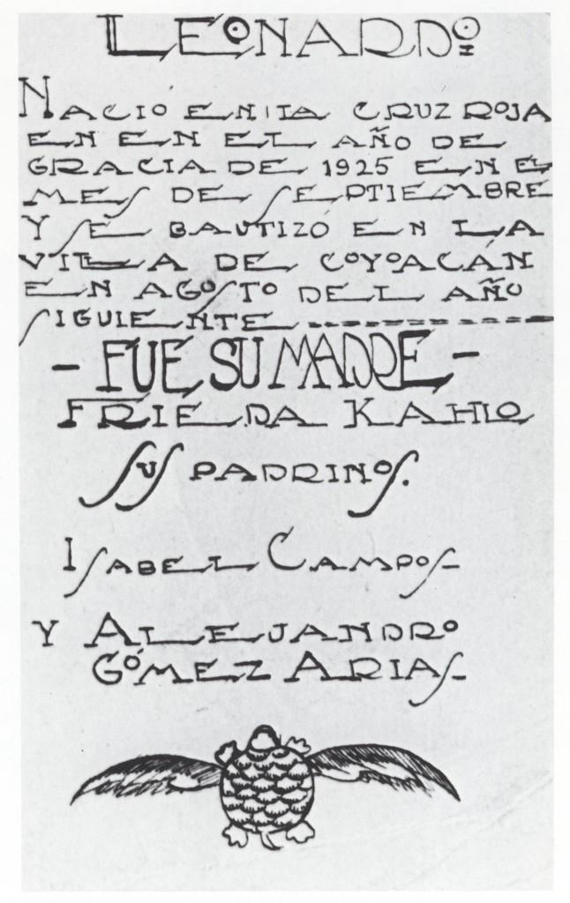
Algo interesante: ¿Un bebé?
1926:
While in recovery, Frida learns that she will never be able to have hijos. She creates a birth certificate for an imaginary hijo that she gave birth to after suffering her accident. She writes that her son, "Leonardo", was born in September of 1925 at the Red Cross Hospital [where Frida was treated after the accident]

Slide 5
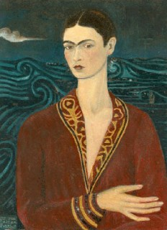
Su recuperación y las políticas
-Went home to recuperate and she began pintar during her recovery and finished her first autorretrato
-Becoming more politically active, Kahlo joined the Young Communist League and the Mexican partido comunista
Autorretrato con traje de terciopelo (1926)

Slide 6
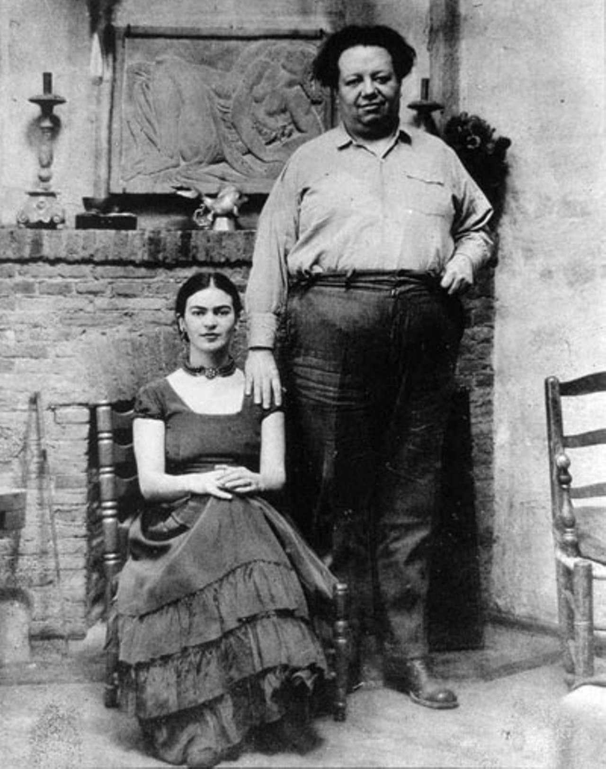
El amor
Kahlo reconnected with Rivera in 1928. He encouraged her artwork, and the two began a relationship
The couple married the next year. Diego tenía 42 años, Frida tenía 22 años
Notes:
Deigo weighed 300 pounds when they got married. Friday weighed 98. 20 year age difference- her parents (Especially mom) didn’t like

Slide 7
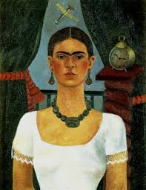
Un estilo nuevo
vs.
Autorretrato con traje de terciopelo (1926)
El tiempo vuela (1929)
Notes:
http://www.fridakahlofans.com/c0040.html

Slide 8
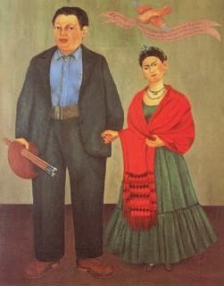
El aborto
-During their early years together, Kahlo often followed Rivera based on where the commissions that Rivera received were. In 1930, they lived in California.
-In 1930, ella tuvo que provocarse un aborto because the fetus was incorrectly positioned due to her fractured pelvis
Frieda y Diego Rivera (1931)

Slide 9
Amantes y Tristezas
-Back in Mexico, Frida met the Hungarian born photographer Nickolas Muray who was vacationing in Mexico. They engage in a secret "on-again/off-again" love affair that lasted nearly diez años.
-In 1932, Frida has another aborto natural and shows some signs of depression, especially in her work “La cama volando”
-In 1934, Frida has yet another aborto as well as an operation on sus dedos del pie
Notes:
an operation on her right foot to remove the ends of her toes.

Slide 10
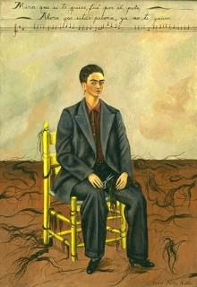
Problemas en el Paraíso
"See, if I loved you, it was for your hair, now you're bald, I don't love you any more."
-Frida discovers Diego is having an affair con su hermana menor and they separate
-In response to this Frida cuts off most of her long dark pelo
-After about a year they reconcile but Frida continues to be unfaithful to Diego
Autorretrato con el pelo corto

Slide 11
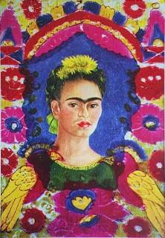
Autorretrato- El marco (1938)
-The self portrait of Frida and the background azul are painted on a sheet of aluminum
-the border of pájaros y flores is painted on the back side of a glass that lays on top of the portrait
-this painting became the la primera obra by a 20th century Mexican artista to be purchased by the Louvre.

Slide 12
Drama, drama, drama...
-Frida and Diego get divorced in late 1939
-Los problemas de salud de Frida return, una infección en su mano y dolor severo en su columna
-These enfermedades lead her to start heavily drinking

Slide 13
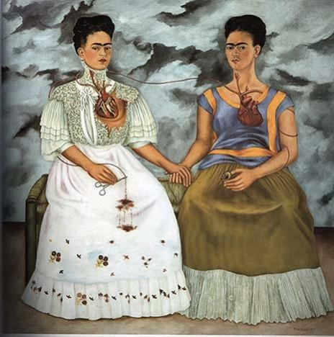
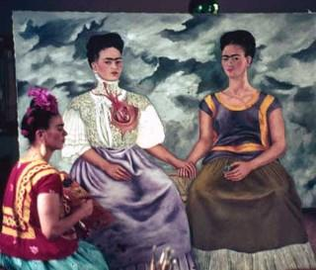
Las dos Fridas (1939)
Notes:
How she felt about her marriage ending and all her conflicting thoughts with it.

Slide 14
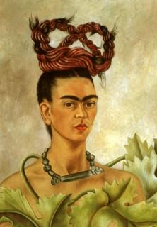
Autorretrato con trenza (1941)
-Remarries Diego Rivera in late 1940
-Strands of hair previously cut off are now put into a trenza in the shape of an endless loop, perhaps a símbolo de “the eternal circle of time”
-Reclaiming her previously denounced femininity
Notes:
http://www.fridakahlofans.com/c0390.html

Slide 15
Autorretrato con collar de espinas
(1940)
El simbolismo
Christ’s crown of thorns digging into her neck | pain she still feels over divorce from Diego
dead hummingbird (echo her eyebrows) | Used as charms to bring luck in love
black cat (waiting to pounce on hummingbird) | bad luck and death
pet monkey | symbol of devil
butterflies | Resurrection

Slide 16
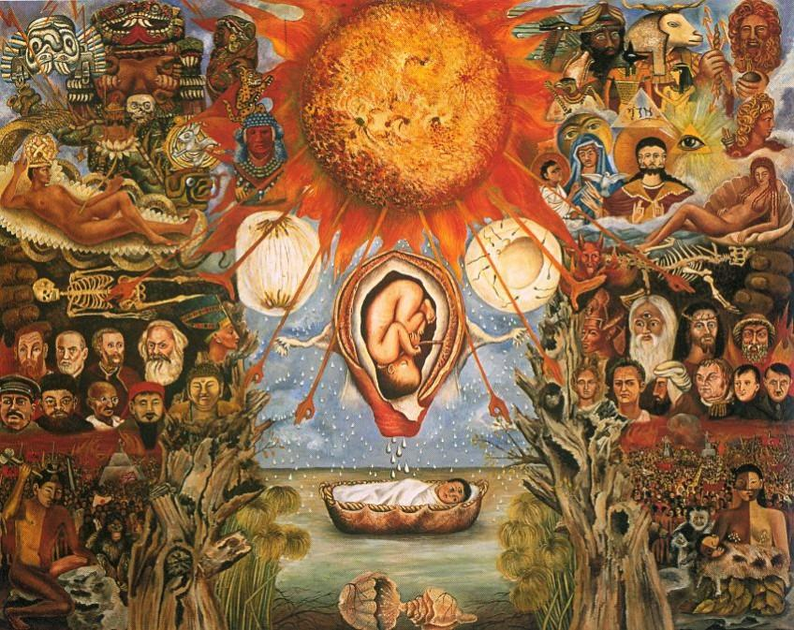
1944-1946
-La salud de Frida declines, el médico receta morfina para el dolor and develops anemia
-Ella enseña a algunos alumnos desde su casa
-After reading a book by Freud “Moses and Monotheism” Frida produced this work se tituló “Moses”

Slide 17
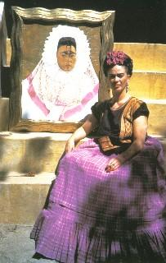
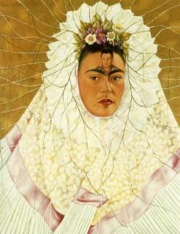
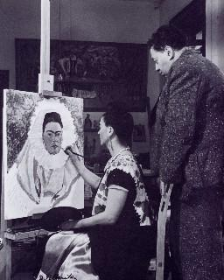
Autorretrato como tehuana (1943)
-also known as Pensando en Diego y Diego en mis pensamientos
-Frida began this painting in 1940 (el ano en que se divorciaron)
-Shows her obsession with Diego
-roots in leaves look like a spider’s web into which she can trap her prey
-Dressed in traditional Tehuana outfit that Diego loved

Slide 18
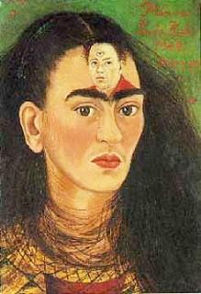
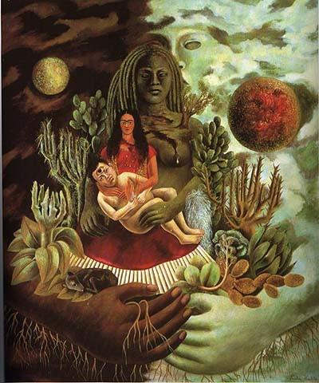
Más obras
The Love Embrace of the Universe, the Earth (Mexico), Me, Diego, and Mr. Xólotl
Diego y yo

Slide 19
1950 hasta la muerte
-La salud de Frida empeora, she’s put on bedrest and in a wheelchair. Eventually they have to amputate one of her piernas from the rodilla down.
-Frida contracted pneumonia and dies in 1954. It is suspected she committed suicidio but it was not confirmed. Her last diary entry said:
“Espero alegre la salida,- y espero no volver jamás”
“I hope the exit is joyful and I hope never to return.”

Slide 20
Un video

Slide 21
Video con Diego
http://www.biography.com/people/groups/frida-kahlo-and-diego-rivera

Slide 22
Repasamos!
Frida Kahlo was born en el año 1907.

Slide 23
Repasamos!
Frida contracted polio when she was 6 years old.

Slide 24
Repasamos!
Frida gets hit by a train and can never walk again.

Slide 25
Repasamos!
Frida has a son named Leonardo.

Slide 26
Repasamos!
El esposo de Frida se llama Diego Rivera.

Slide 27
Repasamos!
Diego had an affair with Frida’s hermana menor.

Slide 28
Repasamos!
Frida never painted an autorretrato.

Slide 29
Correcto!

Slide 30
Incorrecto

Slide 31
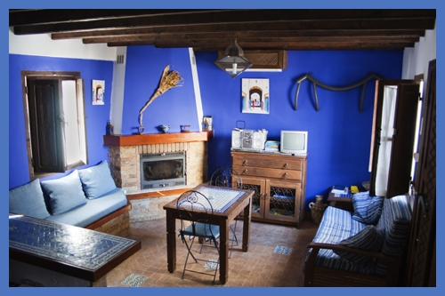
Take a virtual tour!
Use the link to go on a tour of La casa azul where Frida lived.

Slide 32
El fin!

Slide 33
Bibliografía
http://www.fridakahlofans.com/chronologyenglish.html
http://www.biography.com/people/groups/frida-kahlo-and-diego-rivera

