Slide 1

Welcome to:
Planet Gemstar
Presented by:
Katie
Danielle
Vera
&
Sherry
Hope you enjoy the tour!!!!

Slide 2
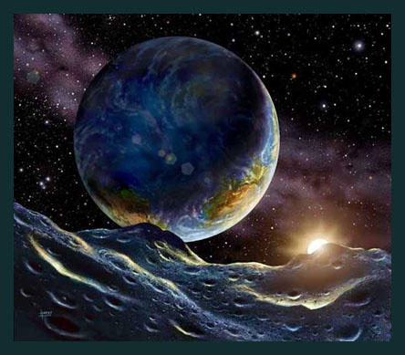
Planet Gemstar
Features:
Silver water
Mountains
Valleys
Windy planet (on dark side)
Faces the sun

Slide 3
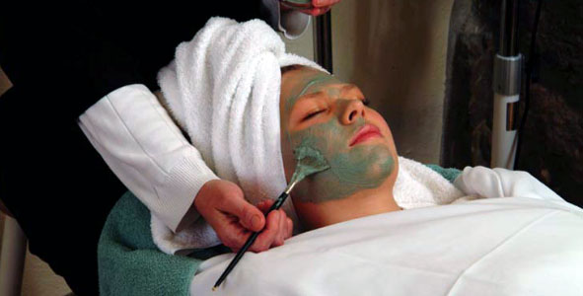

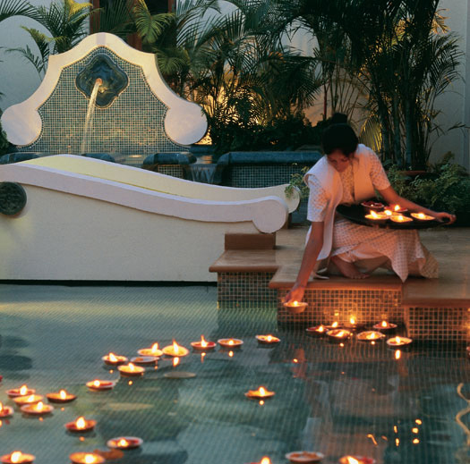
Gemstar Offers You With:
More oxygen to make you feel healthier!
Spa treatments to make you look years younger!
Feel more energized!
Natural Botox

Slide 4

Exotic Animals
Herbivores
large in size
Dinosaur-like
Friendly towards each
other and visitors
***safari

Slide 5
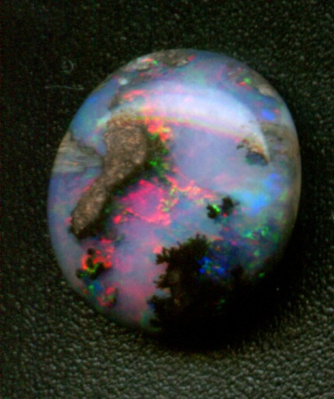
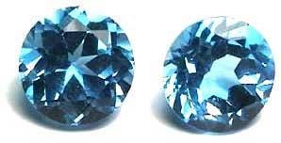
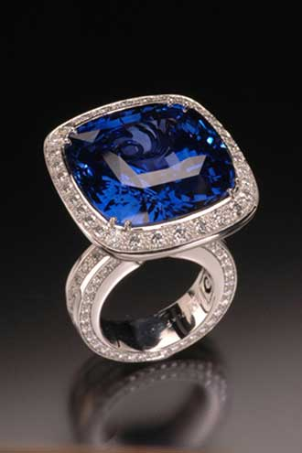
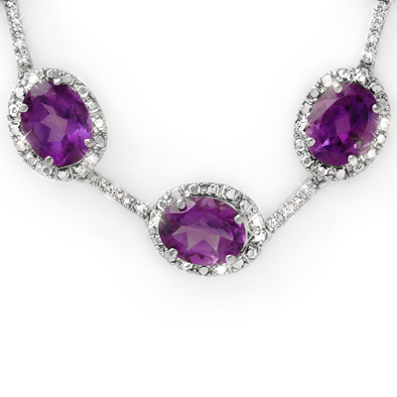
Rare Gems
GEMS THAT ARE RARE AND BEAUTIFUL
You can only get them here!
Necklaces
Earrings
Bracelets
rings

Slide 6
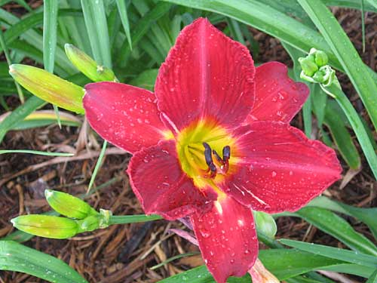
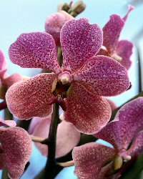
Plant Life
Wide variety of plant life
Beautiful in color
Medicinal plants for Stress relieving
Green friendly planet

Slide 7
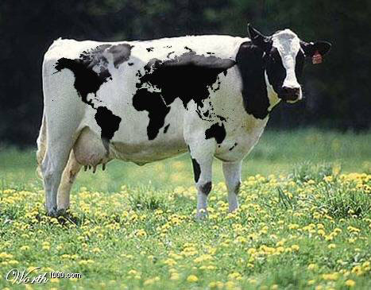
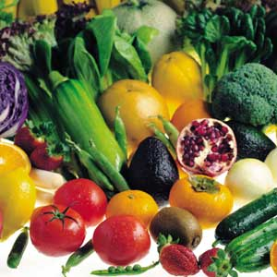
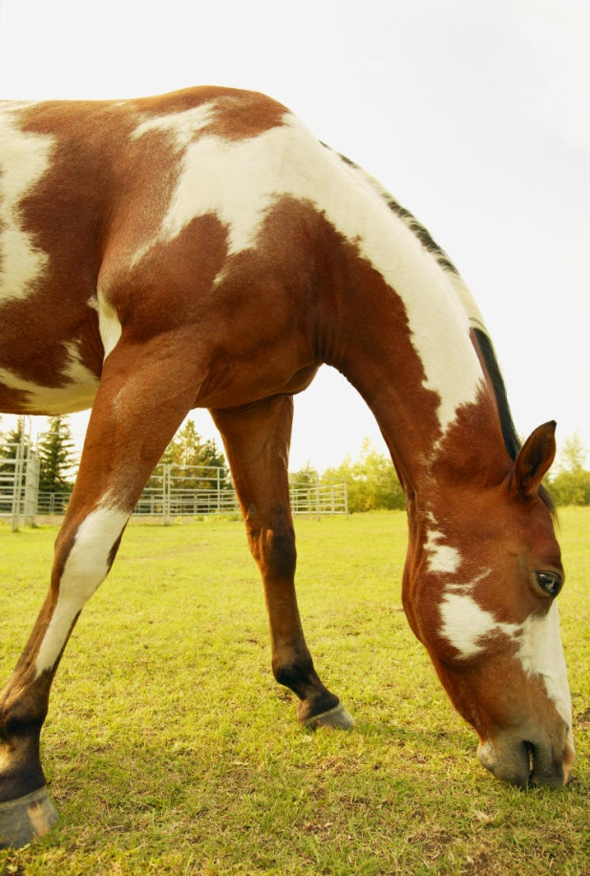
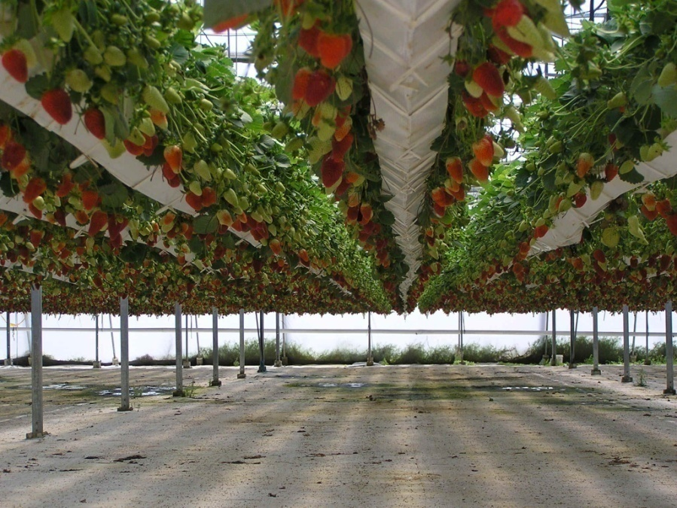
Food Sources
Hydroponics lab
to Grow our own delicious fruits and veggies
Which are All organic
farm
Cows-milk

Slide 8
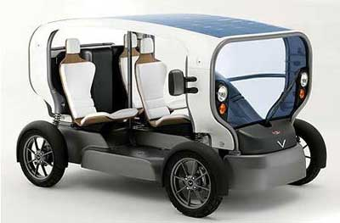

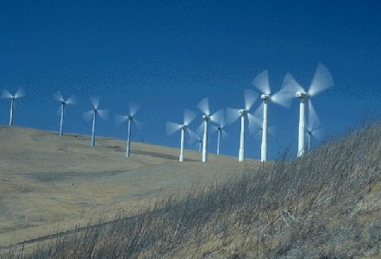
Energy
Solar energy- from the sun
Waterfall- power
Wind mills outside dome
Solar powered/electric vehicles
Horses for transportation
Most attractions will be walking distance

Slide 9
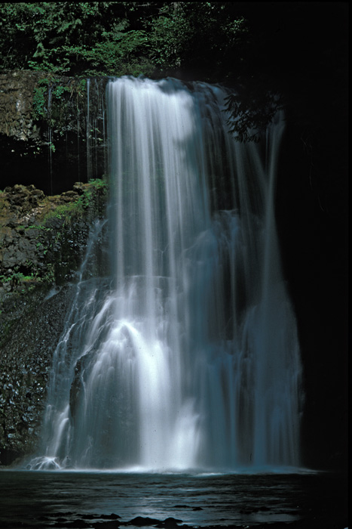
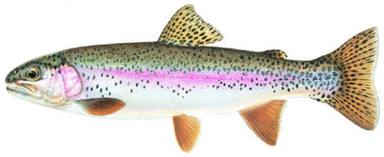
Lake & waterfall
Silver lake:
Rejuvenating for the body
Full of delectable
shrimp and
Salmon

Slide 10
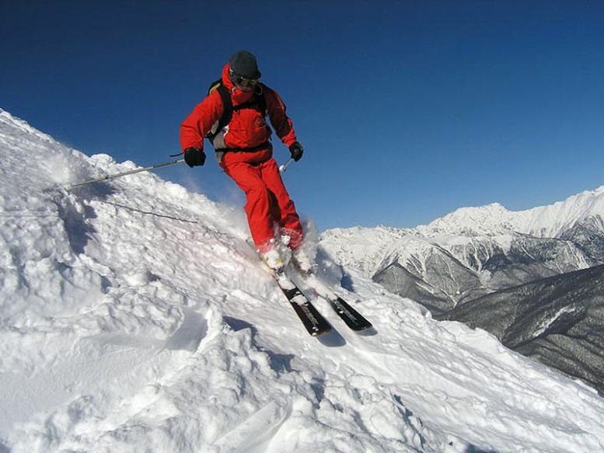

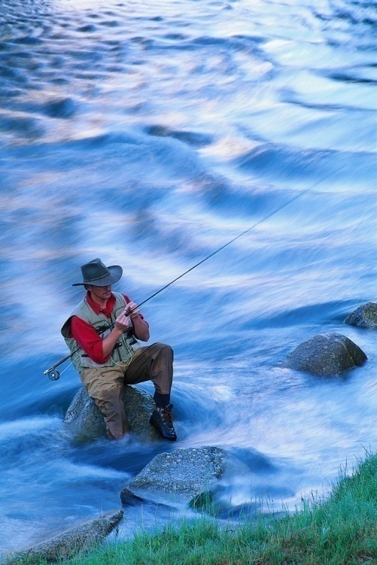
Attractions
Best of both worlds!!!!
High and low elevation
Skiing
Different gravity
Fishing
Boating

Slide 11
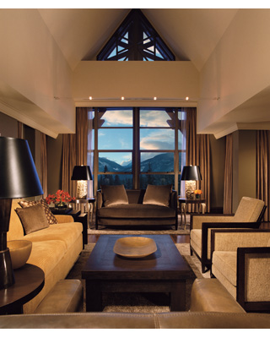
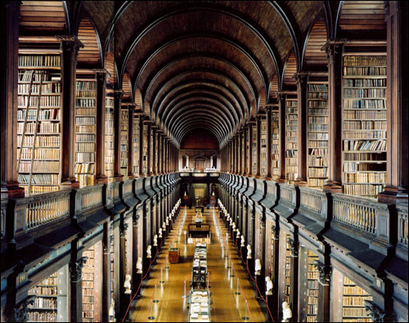

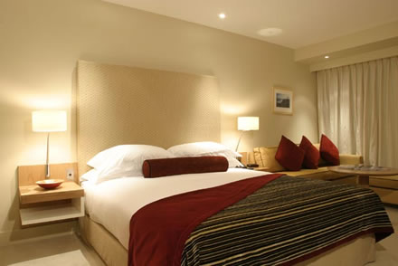
Hotel
5 star
Fine dining
Vast library- biggest ever built
Luxurious rooms overlooking scenery
Gift shop

Slide 12
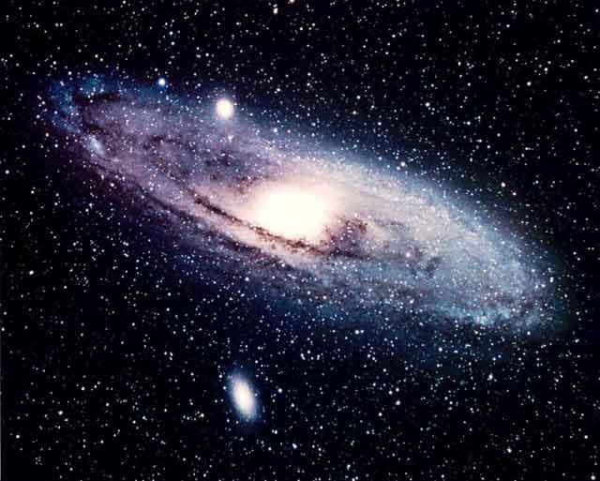
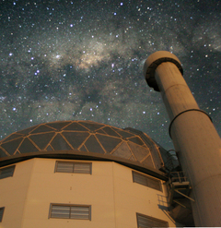
Telescope
Largest in the universe
Overlooking space
(You can see earth!)
See the stars and the milky way
up-close
A sight you must see!!!
unforgettable

Slide 13
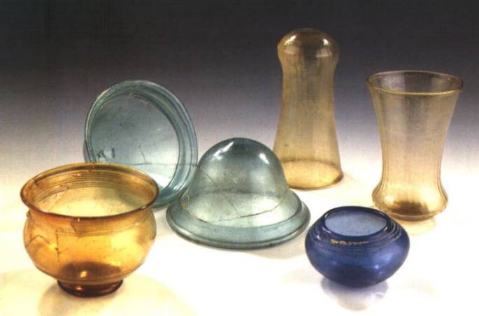

Waste Management
Composting
Air filtration
No Styrofoam, paper products, and plastic (helps eliminate paper waste)
Everything will be glass and washable
Recycled water for irrigation
Compost will be used to make our own dirt and to help recycle
Composting

Slide 14

The End
Hope you enjoyed our planet!
Come again soon

