Slide 1
Prepositions in English language

Slide 2
Goals
SWBAT use prepositional phrases in sentences.
SWBAT recognize common prepositions.
SWBAT use prepositions in writing.

Slide 3
About prepositions
Approximately 80 to 100 prepositions in English language
Used to introduce information to the reader
Where something takes place (such as 'at' the store)
When or Why something takes place (such as 'before' dinner) General descriptive information (such as the girl 'with' the cool tattoo).
http://study.com/academy/lesson/what-is-a-preposition-definition-uses-examples.html

Slide 4
Examples of preposition
About Above Across After Among Along Behind
Below Beneath Beside Besides Between Down During Except For From In Off On Onto Opposite Out Outside To Toward Under Until Underneath With Within Without

Slide 5
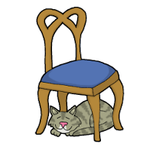
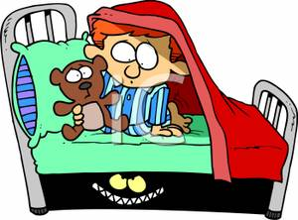
examples of prepositional phrase
On the bed In the classroom Under the chair With a pen and a note

Slide 6
Practice 1
Where is the cat?
The cat is __________________.
1. in the cushion
2. on the cushion
3. under the cushion

Slide 7
Try again!!

Slide 8
Great!!!!

Slide 9
Practice 2
Listen and Click on the prepositional phrases in the sentences.
A mouse went into a box. The box was between a basket and a book shelf. The mouse in the box ate a piece of cheese. Soon, a cat also went into the box where the mouse was. Right after, the mouse ran out of the box and the house. Then, the cat slept in the box.

Slide 10
Try again!!

Slide 11
Great!!!!

Slide 12
Thank you!!!

