Slide 1
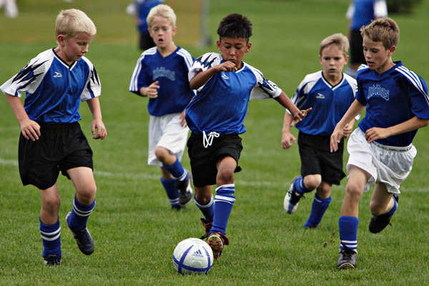
The Gerund (-ing) Form of Verbs in English
By: Perry Crain

Slide 2
The Gerund Form of Verbs…
The gerund form of a verb has the letters “-ing” at the end of the verb.
The gerund form of verbs is used to show actions that are happening right now.
To use the gerund form of the verb, you have to use the verb “to be” + “verb” + “-ing”
Example: The girl is eating some soup.
“is” is the verb “to be” in the singular tense, and “eating” is “to eat” + “-ing”

Slide 3
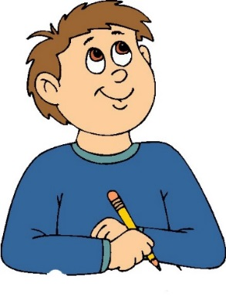
Examples of the Gerund:
The boy is swimming.
I am writing.
They are laughing.

Slide 4
Now you try! -Pick which sentence below uses the gerund (-ing) form of the verb correctly. Click on the sentence to see if you are correct
The boy walking to school.
The girl is using a pencil.
We are walk home.

Slide 5
Incorrect!
In this sentence, the boy cannot “walking” home.
You need to remember to include the verb “to be” before “walking”
So, the sentence should be: “The boy is walking home.”
Go Back

Slide 6
Correct!
This sentence used the gerund correctly.
It has the “-ing” form of the verb and it uses the verb “to be” (is using) before “using”
Continue to next exercise

Slide 7
Incorrect!
This sentence does not have the “-ing” form of the verb “to walk”
The sentence says “walk” and not “walking”
Go Back

Slide 8
Identifying the Gerund Form of a Verb when Listening
Listen to these sound clips of me speaking. Pick the one that uses the gerund form of the verb correctly.
Sentence 1
Sentence 2
Sentence 3

Slide 9
Incorrect!
This sentence is missing the verb “to be” before the verb
Go Back

Slide 10
Incorrect!
This sentence does not have the verb “to go” in the gerund (-ing) form.
It should say: “Are you going to the movies tonight?”
Go Back

Slide 11
Correct!
This sentence has the verb “to be” and it has the verb “to play” with the gerund form “-ing” at the end. Awesome!
Next exercise

Slide 12
Conclusion: Picking the Grammar Rules that go with the Gerund Form of Verbs
Directions: On the next slide, there will be lots of grammar rules. It is your job to select all of the rules that go with the gerund form of verbs.

Slide 13
The gerund form of verbs uses “-ed” endings
The gerund form is used to show actions that are happening now.
The gerund form uses the verb “to be” + “-s”
The gerund form uses the verb “to be” + “-ing”
To put a verb into the gerund form, you add “-er” to the ending.
To put a verb into the gerund form, you add “-ing” to the ending
Incorrect!
Correct!
Incorrect!
Correct!
Incorrect!
Correct!

