Slide 1
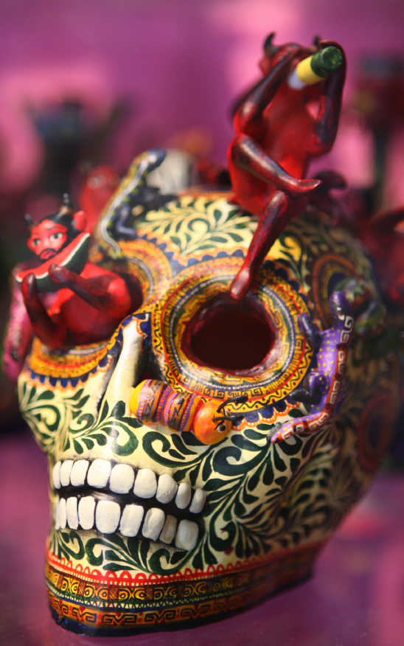
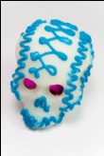
El Día de los Muertos
By: Miss Woodburn

Slide 2
Table of Contents
Slide 1 – Title Page
Slide 2 – Table of Contents
Slide 3 – Objectives of this Lesson
Slides 4 through 9 – Information about el día de los muertos
Slide 10 – Video about el día de los muertos
Slide 11 – Directions for the activity
Slides 12 and 13 – (hidden) correct/incorrect
Slides 14 through 18 – Questions based on the video
Slide 19 - citations

Slide 3
Objectives of this lesson
SWBAT explain this holiday and why it is celebrated.
SWBAT recall information about this holiday, including the
Spanish words for some of the products created for this holiday.
SWBAT identify items used to help celebrate this holiday both
by seeing pictures and descriptions.

Slide 4
What is el Día de los Muertos?
El Día de los Muertos is a holiday celebrated in Mexico.
On this holiday friends and family gather to remember friends and family that have died.
This celebration happens on November 1st and 2nd because it is connected to the Catholic holidays of All Saints Day (Nov. 1) and All Souls’ Day (Nov. 2).

Slide 5
How do people
celebrate this holiday?
There are many ways that friends and family celebrate this holiday!
We are going to take a look at some of the different things people do and make for El Día de los Muertos.

Slide 6
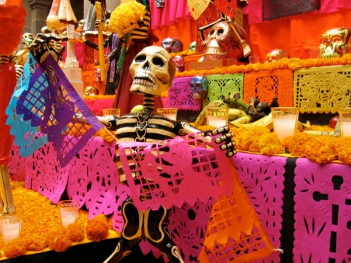
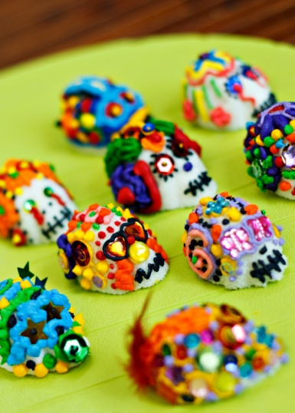
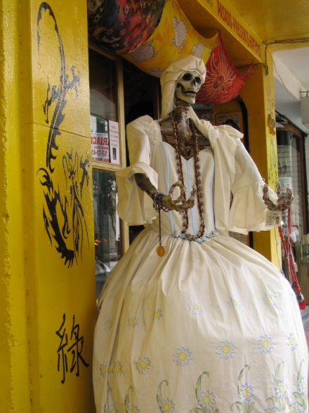
What are some things
people make for this holiday?

Slide 7
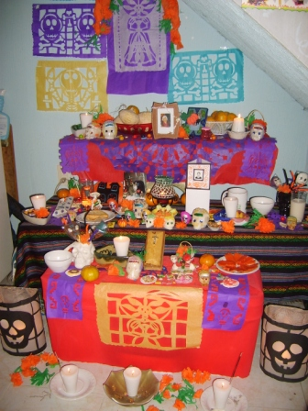
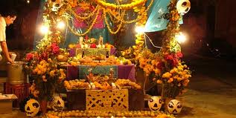
Image from: sitesmexico.com
Image from: cecyenlunallena.wordpress.com
Ofrenda – an ofrenda is an alter built to remember a specific person. An ofrenda is covered with foods that the person loved to eat, flowers, and trinkets. It is considered to be an offering to the dead.
The ofrendas are left out in the homes as a welcoming gesture for the deceased. They are not scary or sad.

Slide 8

la calavera de azúcar – sugar skull
Sugar skulls are used to adorn alters (ofrendas) and can
be eaten. They are decorated with bright colors!
The tradition of making Sugar Skulls came from the
17th century when Mexico was lacking in money,
but not in sugar. The skulls often had the name of a
loved one on the forehead and was an outward display
that showed that you hoped that person’s spirit would
come visit you.

Slide 9
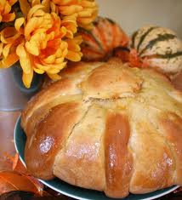
Pan de Muerto – “dead bread” or bread of the dead
It is a sweetened soft bread shaped like a bun, often decorated with bone-like pieces. It is eaten on Día de los Muertos, at the gravesite or altar of the deceased.

Slide 10
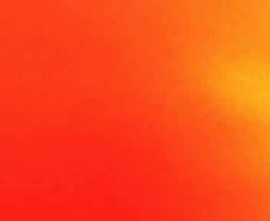
Click below to watch a short movie about
el día de los muertos
http://www.youtube.com/watch?v=sUUAgEWeYeI

Slide 11
Using the information from
the video, answer the questions
on the next few slides!

Slide 12

Awesome job!!!

Slide 13
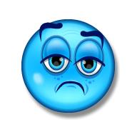
Try again!!!

Slide 14
In English, el día de los muertos means:
Halloween
The day of the dead

Slide 15
Mexicans believe that the souls of the
dead come back to:
haunt and
scare people
visit their
loved ones

Slide 16
For an extremely traditional celebration
of this holiday you should go where?
San Andreas
Mixquic
Mexico City

Slide 17
People often decorate
which of these things?
The grave of
the deceased
person
The shoes
of the deceased
person

Slide 18
Do some people dress up
to celebrate this holiday?
Yes
No

Slide 19
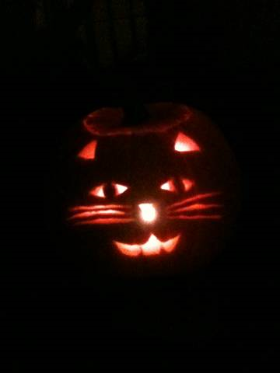
Citations:
Information for this PowerPoint Presentation comes from:
- http://www.dayofthedead.com/
- http://en.wikipedia.org/wiki/Day_of_the_Dead
- http://www.azcentral.com/ent/dead/articles/dead-history.html
Pictures come from:
- http://www.sitesmexico.com
-http://www.cecyenlunallena.wordpress.com
-and Microsoft ClipArt
The video is from:
-http://www.youtube.com/watch?v=sUUAgEWeYeI
and is courtesy of the Travel Channel
My original Clipart

