Slide 1
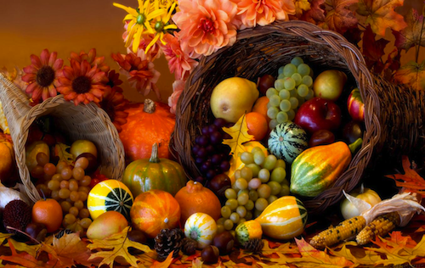
Thanksgiving
By. Alison Brady

Slide 2
Table of contents
Goals Slide 3
Video on Thanksgiving Slide 4
What is Thanksgiving? Slide 5
Who were the pilgrims? Slide 6
What do we eat on Thanksgiving? Slide 7
Dessert! Slide 8
Questions Slides 9-15
Credits Slide 16

Slide 3
Goals:
Students will be able to read what Thanksgiving is and why we celebrate it in the United States.
Students will be able to answer questions after the presentation about Thanksgiving.

Slide 4
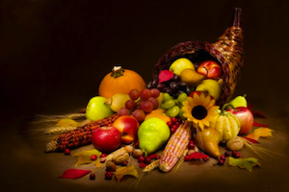
Video on Thanksgiving
Click here for video

Slide 5
What is Thanksgiving?
Thanksgiving Day is the fourth Thursday in November. It is a federal holiday, so schools, banks, post offices, and government offices are closed. Thanksgiving was the first holiday celebrated in America. It was first celebrated in the autumn of 1621 when the Wampanoag Indians and the pilgrims got together for a three-day feast and festival of fun. Today, families celebrate Thanksgiving by eating turkey, stuffing, mashed potatoes and gravy, yams, corn, cranberry sauce, and pumpkin pie. Macy's Thanksgiving Day Parade and an NFL football game are special Thanksgiving Day events.

Slide 6
Who were the pilgrims?
Pilgrims- were a small group of people who sailed to North America in order to start a new life.
They sailed on the Mayflower ship and landed on Plymouth Rock
They wanted religious freedom.

Slide 7
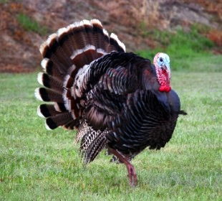
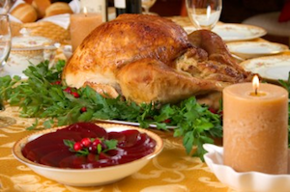
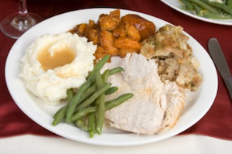
What do we eat on Thanksgiving?
Turkey!
Gravy!
Stuffing!
Yams!
Cranberry Sauce!
Green beans!
Mashed Potatoes!

Slide 8
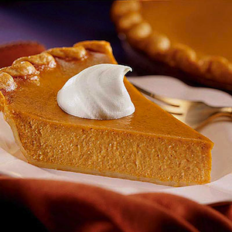
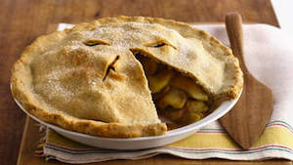
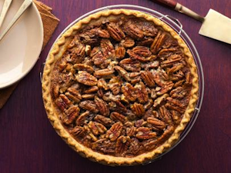
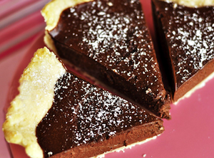
Dessert!
Pumpkin Pie
Pecan Pie
Apple Pie
Chocolate Pie

Slide 9
Let’s see what you know!
What was the small ship the pilgrims sailed on?
Santa Maria
Mayflower
A row boat

Slide 10
Try again!

Slide 11
Correct!

Slide 12
What month is Thanksgiving in?
June
March
November

Slide 13
Where did the pilgrims land?
Plymouth Rock
New York City
Binghamton

Slide 14
What day of the week is Thanksgiving on?
Monday
Wednesday
Thursday

Slide 15
What season is Thanksgiving in?
Summer
Spring
Autumn/Fall

Slide 16
Credits
Elcivics.com
All information and questions based off of website.
Thanksgiving History YouTube video by Amy Rodulfo
All pictures taken from Google images

