Slide 1
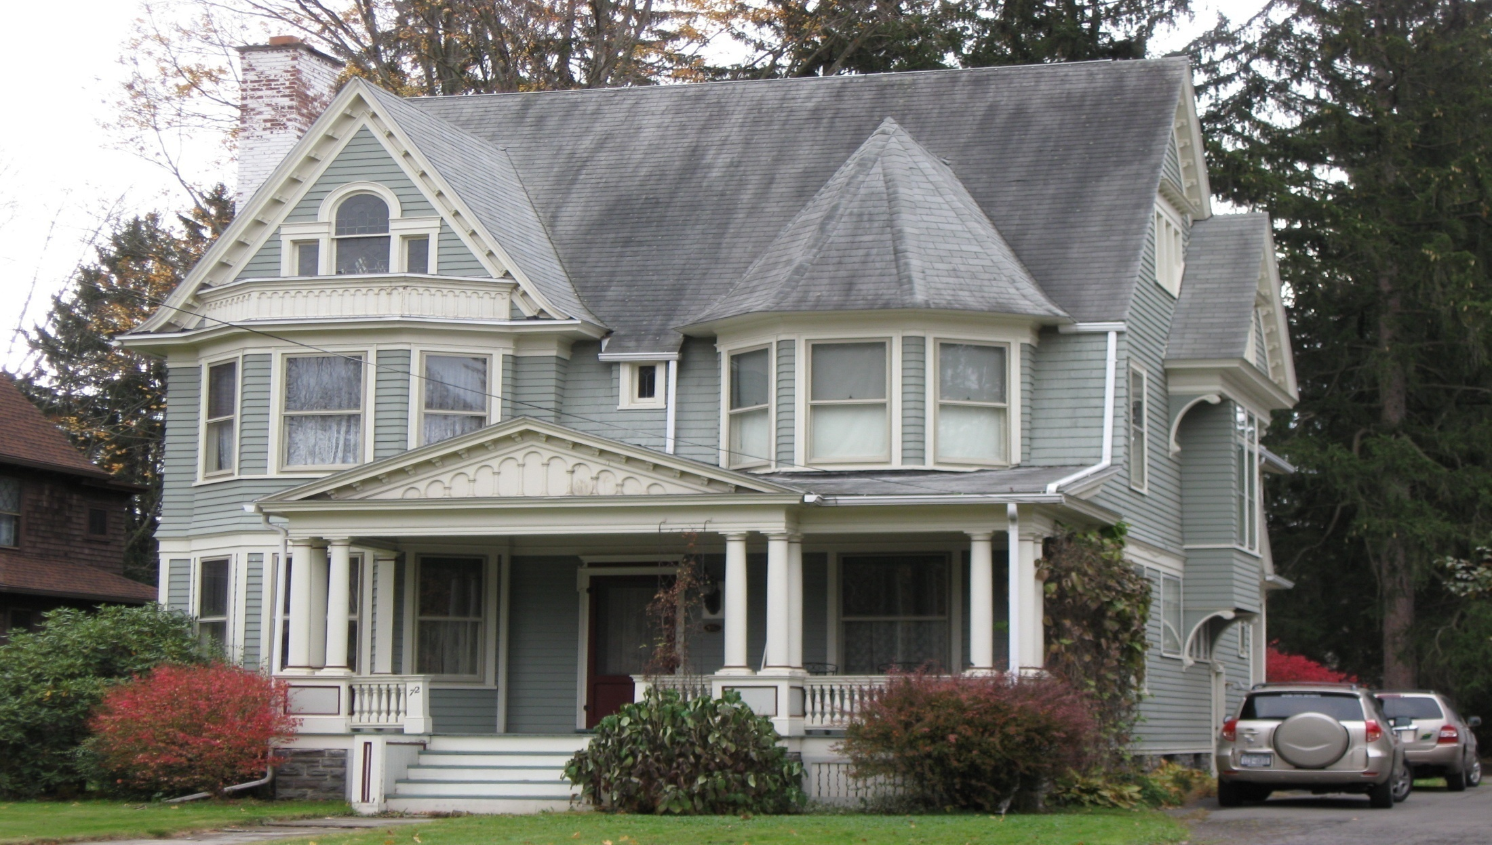
House of Shapes By: Andrea Oddo
Front Street
Owego, NY 13827

Slide 2
Have you ever noticed the different geometrical shapes that make up a house? We will explore the structure of this house and try to pick out the shapes that are hidden.
Some shapes that are most noticeable in the structure of a house are triangles (roof peaks) and rectangles (windows, doors). Did you ever think, though, that you might be able to find a trapezoid or a rhombus? Let’s take a look at this geometrically rich house to find polygons, congruent angles, acute and equilateral triangles, concave polygons and more!

Slide 3
Can you find one or more acute angles?
Acute Angle: A shape with at least one angle less than 90 degrees

Slide 4
Acute Angles
Acute Angle: A shape with at least one angle less than 90 degrees

Slide 5
How many right angles can you find?
Right Angle: A shape with one 90 degree angle

Slide 6
Right Angles
Right Angle: A shape with one 90 degree angle

Slide 7
Let’s find some obtuse angles
Obtuse angle: An angle that measures more than 90°

Slide 8
Obtuse Angles
Obtuse angle: An angle that measures more than 90°

Slide 9
Can you find any congruent angles?
Congruent angle: Angles with the same degree

Slide 10
Congruent Angles
Congruent angle: Angles with the same degree

Slide 11
Does this house have any adjacent or complementary angels?
Adjacent Angles: Two angles which share a common vertex and side but don’t overlap
Complementary Angles: Two angles with a total degree of 90

Slide 12
Complementary Angles
Complementary Angles: Two angles with a total degree of 90

Slide 13
Adjacent Angles
Adjacent Angles: Two angles which share a common vertex and side but don’t overlap

Slide 14
Can you see any Acute Triangles?
Acute Triangle: A triangle with one or more angles less than 90 degrees

Slide 15
Acute Triangles
Acute Triangle: A triangle with one or more angles less than 90 degrees

Slide 16
Now try to find an equilateral triangle
Equilateral Triangle: A triangle with all three sides of equal length

Slide 17
Equilateral Triangles
Equilateral Triangle: A triangle with all three sides of equal length

Slide 18
Do you see any rectangles?
Rectangle: A 4-sided polygon where all interior angles are 90°

Slide 19
Rectangles
Rectangle: A 4-sided polygon where all interior angles are 90°

Slide 20
Are there any parallel lines on this house?
Parallel lines: Two lines that run side by side but never intersect,

Slide 21
Parallel Lines
Parallel lines: Two lines that run side by side but never intersect,

Slide 22
Can you find any squares?
Square: A quadrilateral with four equal sides.

Slide 23
Squares
Square: A quadrilateral with four equal sides.

Slide 24
Where are the perpendicular lines?
Perpendicular Lines: Lines that meet at a 90 degree angle.

Slide 25
Perpendicular Lines
Perpendicular Lines: Lines that meet at a 90 degree angle.

Slide 26
Can you spot any polygons with more than four sides?
Any shape with more than four sides. Examples: hexagon, octagon

Slide 27
Polygon with more than four sides
Any shape with more than four sides. Examples: hexagon, octagon

Slide 28
Could you find a symmetric polygon?
Symmetric Polygon: A shape with more than 4 sides that can be split equally in half

Slide 29
Symmetric Polygon
Symmetric Polygon: A shape with more than 4 sides that can be split equally in half

Slide 30
Can you find intersecting lines
Intersecting Lines: a point where two lines meet or cross each other

Slide 31
Intersecting lines
Intersecting Lines: a point where two lines meet or cross each other

Slide 32
Do you see any Parallelograms?
Parallelogram: A polygon with two pairs of parallel sides

Slide 33
Parallelograms
Parallelogram: A polygon with two pairs of parallel sides

Slide 34
Do you see any concave polygons?
Concave Polygon: A polygon that has one or more interior angles greater than 180°

Slide 35
Concave Polygon
Concave Polygon: A polygon that has one or more interior angles greater than 180°

Slide 36
Can you spot a Non-symmetric Polygon?
Non-symmetric Polygon: A shape with many sides that cannot be divided equally in half.

Slide 37
Non-symmetric Polygon
Non-symmetric Polygon: A shape with many sides that cannot be divided equally in half.

Slide 38
Can you find a polygon composed of two or more smaller polygons?

Slide 39
A polygon made of two smaller polygons

Slide 40
Can you find a slide/translation?
Slide/Translation: “moving” one figure onto another

Slide 41
Slide/Translation
Slide/Translation: “moving” one figure onto another

Slide 42
Education Standards
This assignment meets several mathematical education standards.
3.G.1. Define and use correct terminology when referring to shapes (Circle, triangle, square, rectangle, rhombus, trapezoid, and hexagon)
3.G.2. Identify congruent and similar figures
3.G.5. Identify and construct lines of symmetry
4.G.1. Identify and name polygons, recognizing that their names are related to the number of sides and angles (triangle, quadrilateral, pentagon, hexagon, and octagon)
4.G.6. Draw and identify intersecting, perpendicular, and parallel lines
4.G.8. Classify angles as acute, obtuse, right, and straight
5.G.6. Classify triangles by properties of their angles and sides
5.G.11. Identify and draw lines of symmetry of basic geometric shapes

Slide 43
In Conclusion
Have you ever studied a structure so closely that you were able to find multiple geometric shapes in it? Geometry surrounds us in many different capacities. Shapes, angles, lines and points make up nearly everything around us including houses, signs, playgrounds and fences. The more interesting a structure is the more shapes and angles you can find in it. Without geometry would we even be able to design a basic house or playground?

