Slide 1
Curved Plywood & Edgebanding Informative Presentation
Rogers Sales Company
Premium Grade Specialists in Veneer Sales
Your Number One Stop For Everything Veneer!
Notes:
Word Art: Title Slide Master: Modified Title Text to Be Font “Copperplate Gothic Bold” and all other content text in Font “Georgia” (Self Made text boxes NOT modified)
Slide Transitions Timed Presentation (10 seconds per slide)
Saved as Webpage

Slide 2
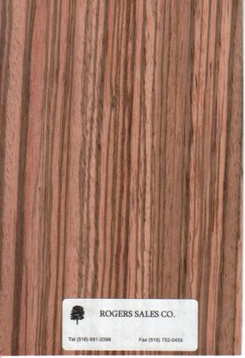
Presentation Overview
Edgebanding
Edgebanding
Curved Plywood
Curved Plywood
Exotic
Species
Custom Order
Potential Projects
Retail Customer
Info
Click to skip to a specific slide
Notes:
Action Buttons for: Exotic Species, Custom Order, Potential Project and Retail Customer Information. Picture Shape Changed

Slide 3
Exotic Species
Edgebanding
Alder
Anigre
Afromosia
Avodire
Birds Eye Maple
Beech
Bubinga
Burls
Butternut
Cedar
Chestnut
Cypress
Ebony
Eucalyptus
Fir
Gum
Kewazinga
Koa
Lacewood
Makore
Madrone
Maple Curly
Movingui
Paldao
Pearwood
Paduak
Purpleheart
Sapele
Satinwood
Sycamore
Walnut Burl
Wenge
Zebrawood
Notes:
Blank Layout with 3 columned text box (no bullets)

Slide 4
Custom Order
Edgebanding
Polyester Edgebanding
100 colors available
Pre-glued or non-glued
Small jobs only
Applied with hand held iron
Notes:
Slide Layout: Comparison (One of the subtitle/caption boxes deleted)

Slide 5
Potential Projects
Curved Plywood
Furniture components available for all of the above uses!
Equally as competent in every situation!
Notes:
Chart used

Slide 6
Retail Customer information
Curved Plywood
For already completed projects (Chairs, desks & more) visit:
http://www.rockler.com
Photo source: ClipArt
Notes:
Related Webpage hyperlink

Slide 7
Closing
Exotic Species available for edgebanding
Custom Order Polyester edgebanding in 100 colors
Numerous projects for versatile curved plywood
Retail products available through Rockler
Notes:
Picture: Recolored

Slide 8
References
All pictures and information taken from http://exoticveneers.net with permission from founder James Rogers
Related web page URL: http://www.rockler.com

