Slide 1
Why SUNY Cortland ?

Slide 2
Overview
Academic Support
Study Abroad Program
Athletics
Dorms
Dining Halls

Slide 3
Undergraduate Majors with Highest Enrollment

Slide 4
First-year Student Profile
 | Freshman | Transfer
Applications | 10,915 | 2,449
Percent Accepted | 44.50% | 39.80%
Percent Enrolled of Accepted | 24.60% | 57.60%
Mean GPA | 89.5 (Out of 100) | 3.2 (Out of 4.0)
Mean SAT | 1,090 | --
Mean ACT | 23 | --

Slide 5
Academic Support

Slide 6
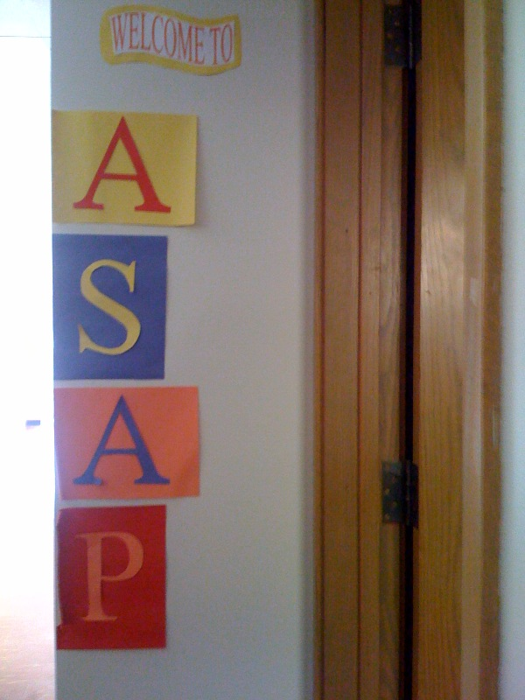
Need help in Math, Writing, Reading or Study Skills?
WHAT IS ACADEMIC SUPPORT AND ACADEMIC Program?
Professional staff and professionally trained tutors offer:
  One-on-one tutoring
  Small group tutoring workshops
  Supplemental Instruction attached to challenging courses.
Source: Katie Potter

Slide 7
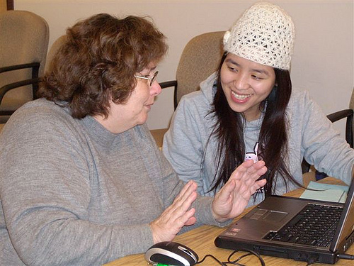
Types of Academic Support
Professional Tutoring
Online Tutoring
Source: Flicker uploaded by Brookfeild Public Library

Slide 8
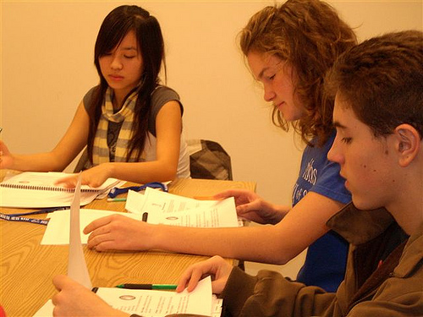
Types of Academic Support Continued
Peer Tutoring
Supplemental Instruction
Source: Flicker uploaded by Brookfeild Public Library

Slide 9
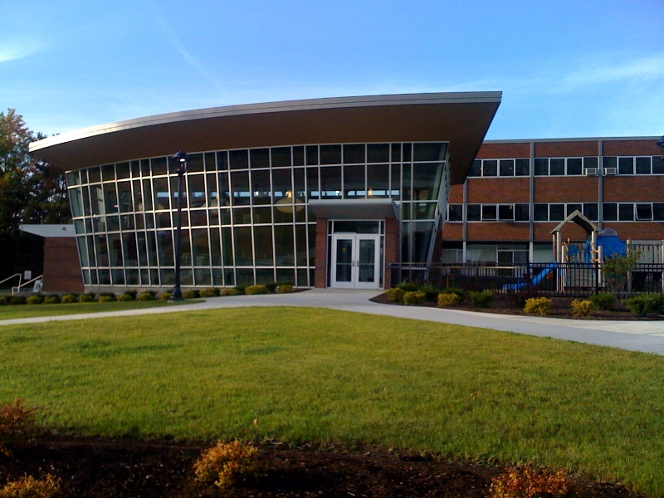
How To Get Started
Contact ASAP to make an appointment
  Mon-Thurs 8 a.m.-5 p.m and Fri 8 a.m -4:30 p.m.
  Call (607)753-4309
  Stop in Van Hoesen Hall, Room B-205
Source: Katie Potter

Slide 10

Study Abroad Program

Slide 11

Study Abroad Program
Study
Conduct Internship
Independent Research
Teach Abroad
Photo Source: Clip Art

Slide 12
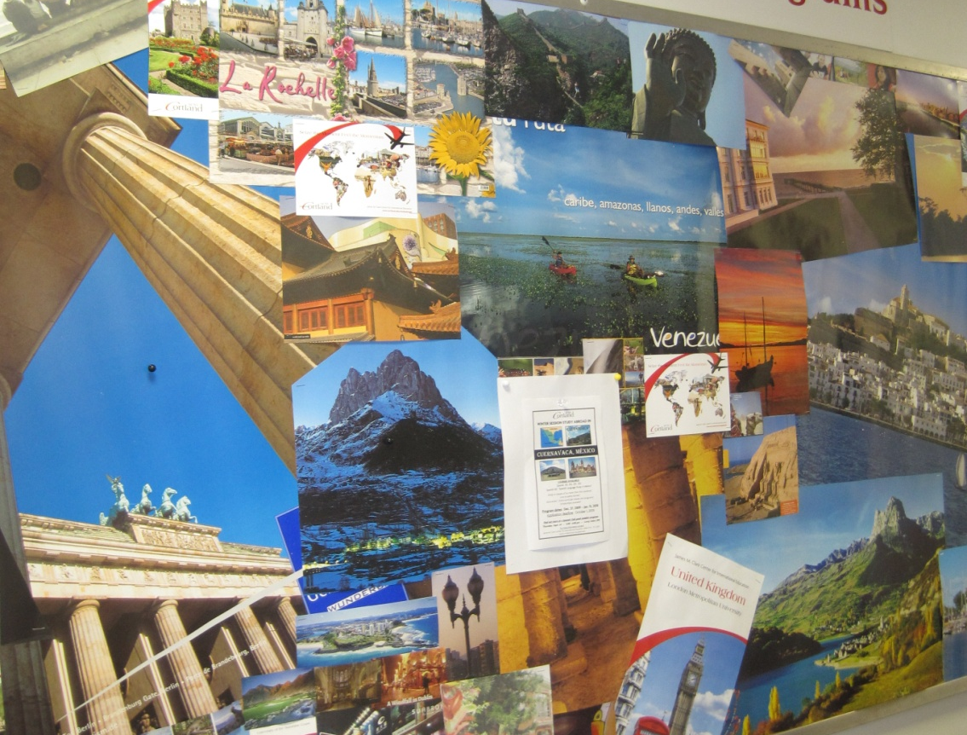
Possible Study Sites
Africa
Asia
Australia
Europe
North & Central America
South America
Picture Taken by Rebecca Aungst

Slide 13
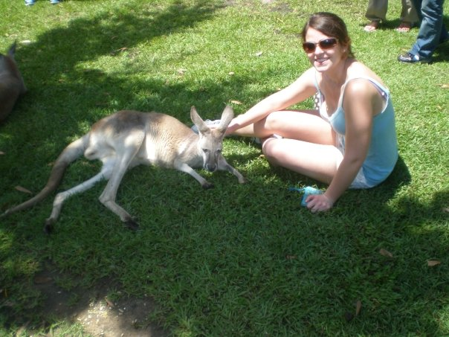
Study in Australia
Griffith University
  Fall term: July-Nov.
  Spring term: Feb.-June
Ballarat University
  Semester 1: Feb.-June
  Semester 2: July-Nov.
Photo Source: Rebecca Aungst

Slide 14
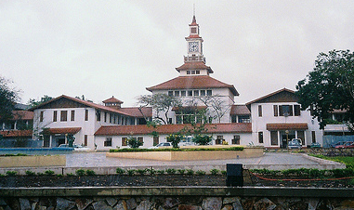
Study in Ghana
University of Ghana
  Fall term: Aug.-Dec.
  Spring term: Jan.-May
Location
  Accra, Ghana
Top 100 University in Africa
Photo Source: Creative Commons Flickr by zug55

Slide 15
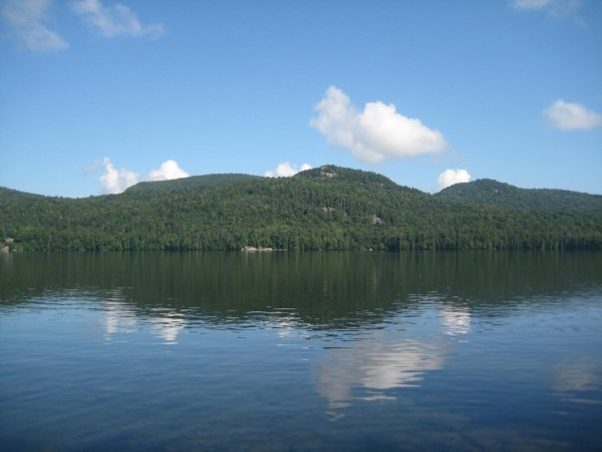
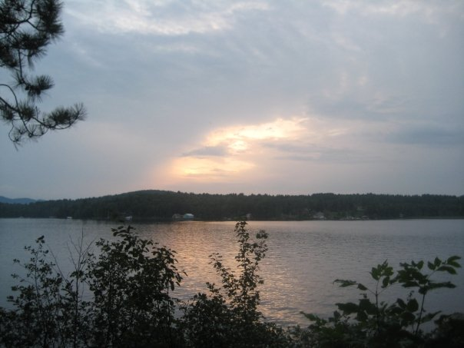

Kirby Camp
Single cabin with unique architecture
Cabin overlooks south bay of Raquette Lake
Each room has doors leading to outside.
Surrounded by beautiful wooded area
Source: Taken by Joe DeLutri
Notes:
The camp built in the late 1880's has had little settling and is structurally sound today
The interior walls of the cabin display carefully crafted logs finished with beautiful shine and luster
re-opened after a full year of renovation and cleaning
The Kirby Camp is rented on a weekly basis to alumni, faculty, and staff of the college
The camp is available from mid-June through mid-September.
Interested parties should contact the Center of Environmental and Outdoor Education's campus phone number.

Slide 16

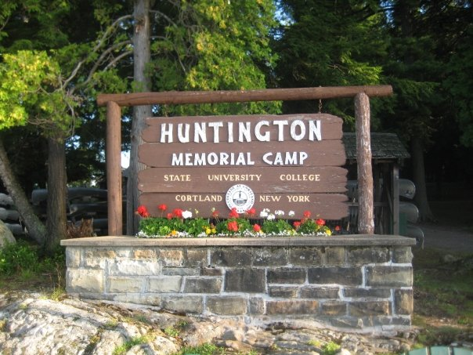
Camp Huntington
Consists of forty buildings
Represents the Adirondacks’ historical past
Accessible only by boat
Accommodates seventy participants in various dorms
Includes hiking, cross-country skiing, boating, and challenge courses

Slide 17
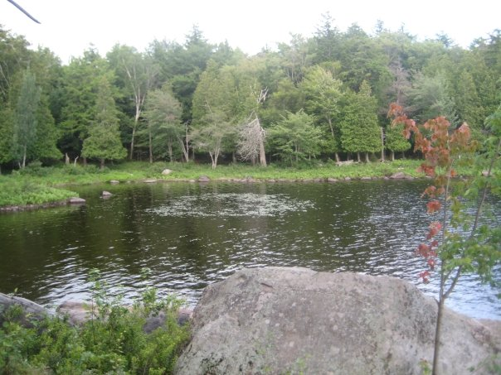
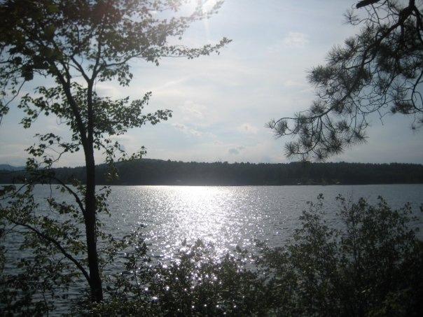
Antlers Camp
Made up of 5 main buildings including:
Recreation includes: Kayaking, Canoes, or a Beautiful Community Beach.
The Casino has access to wireless internet.
Healthy meals are provided Daily for Antler’s Campers!
Source: Taken by Joe Delutri

Slide 18

Athletics

Slide 19
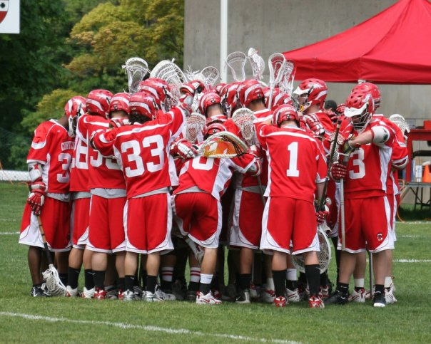
Cortland Lacrosse
Photo Source: Facebook, Becky Talbot

Slide 20
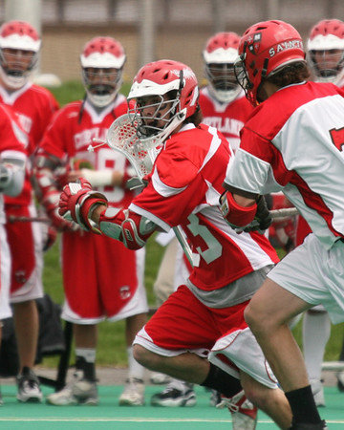
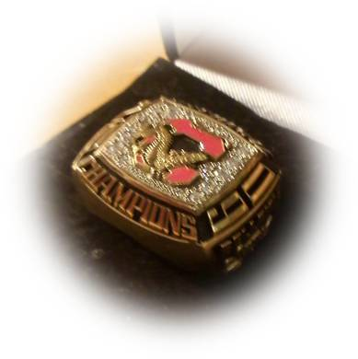
Men’s Lacrosse
Red Dragons
Defeat Gettysburg,
9-7, in NCAA
Cortland wins
National title
Photo Source: Facebook, Becky Talbot

Slide 21
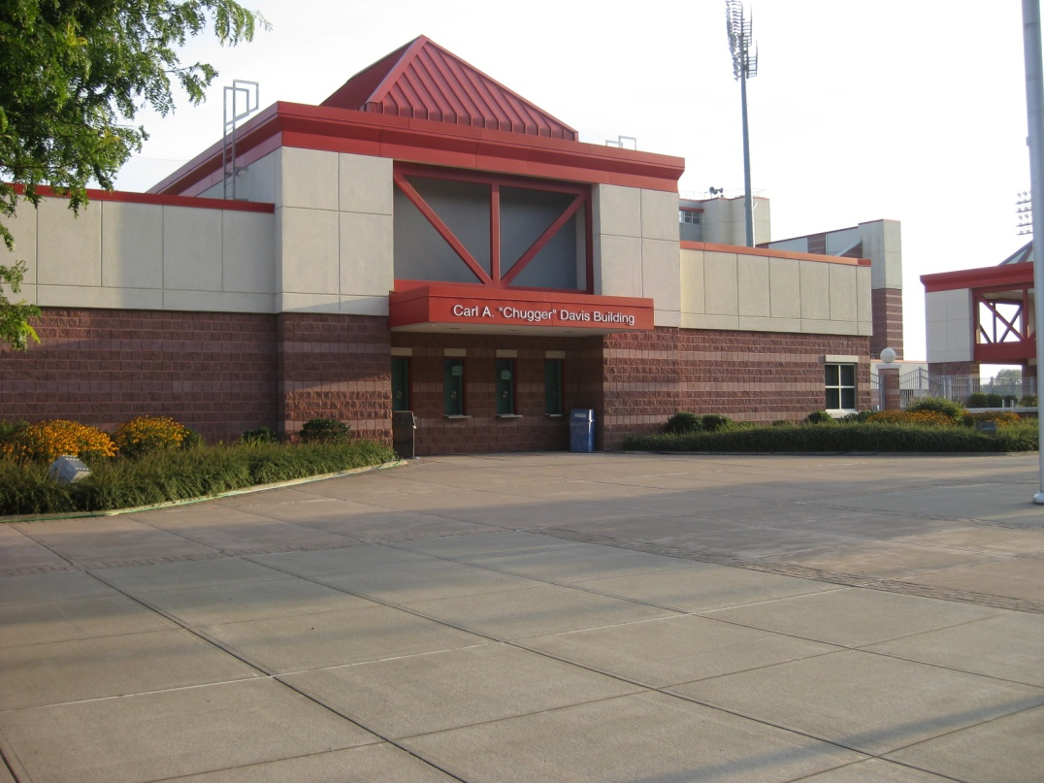
Sport Facilities On Campus
SUNY Cortland Stadium Complex
  Features two artificial surface turf fields
  Seats 6,500 spectators and 1,500 spectators
Lusk Field House
  40,000 square foot building
  Practice area for lacrosse with protective netting
Woods and Tomik Fitness Facility
Photo taken by Lauren Morgan from SUNY Cortland campus

Slide 22
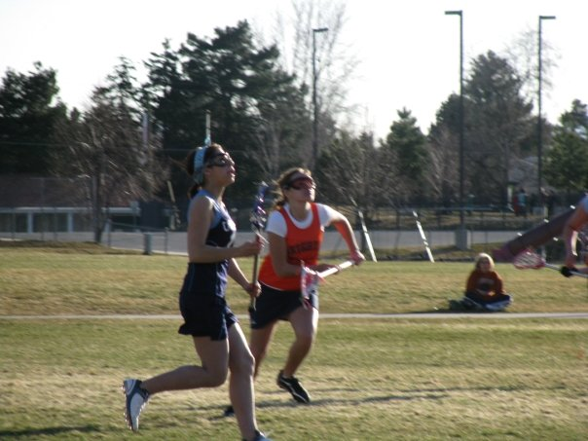
Women’s Lacrosse
Nationally ranked 16th
Played in 11
consecutive
NCAA tournaments
Photo Source: Facebook, Becky Talbot
Photo Source: clipart gallery

Slide 23
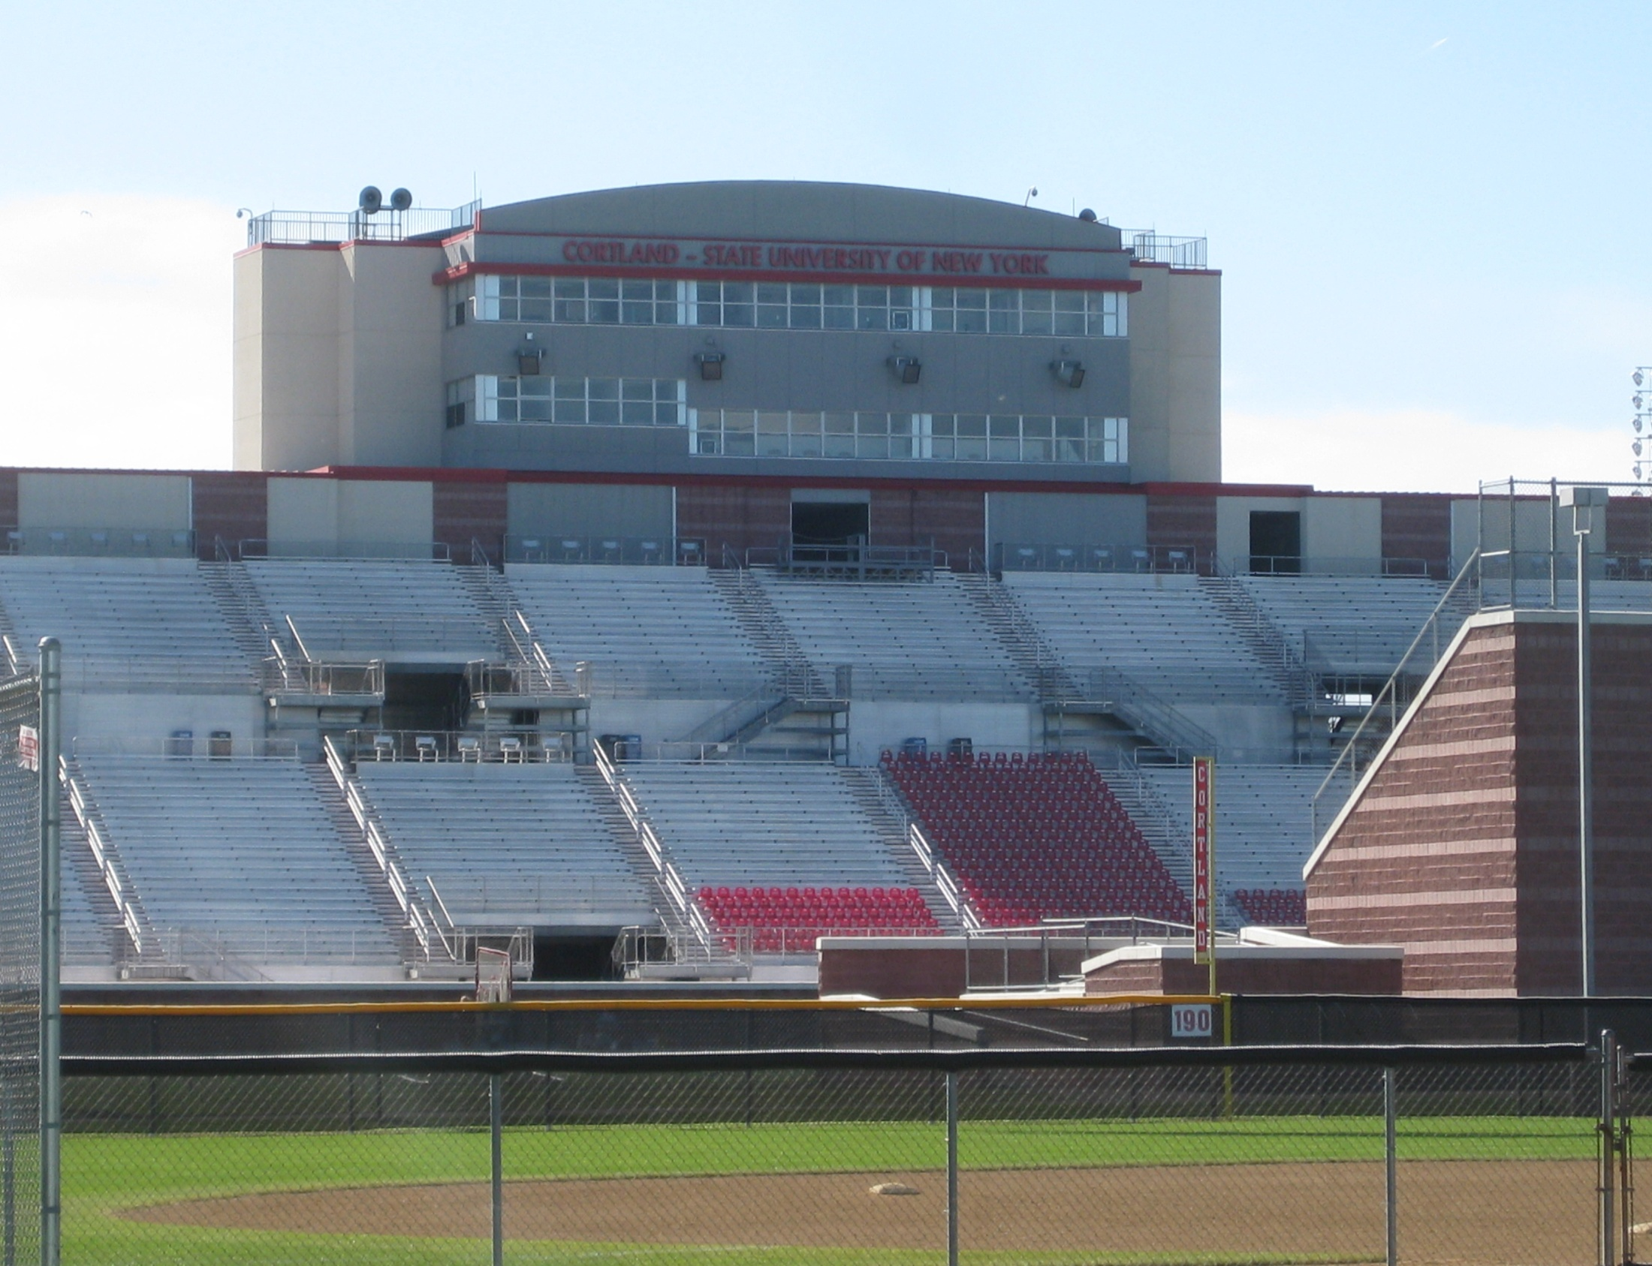
Sport Facilities
Photo Source: Taken by Lauren Morgan off of Cortland Campus

Slide 24
Dorms

Slide 25
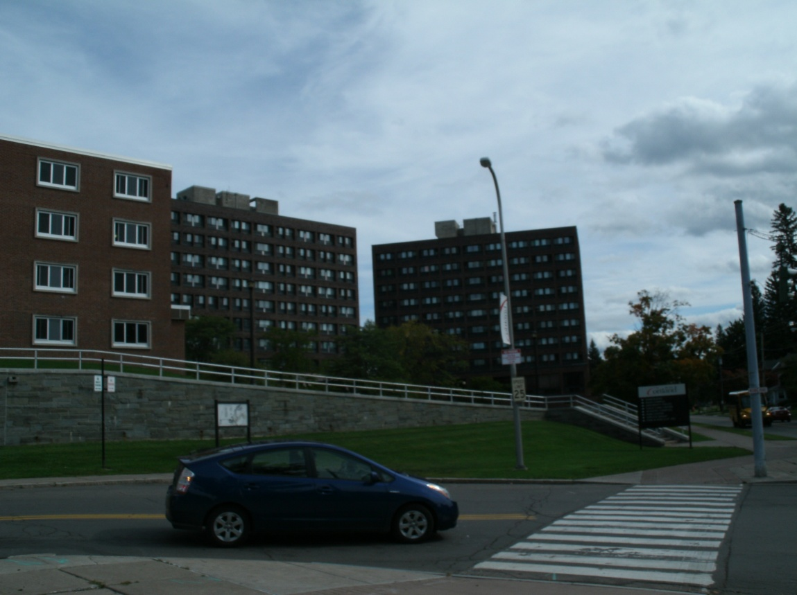
Casey and Smith Tower
Students reside on floors 3 thru 10
Each tower has a four or six person suite
Each floor has a RA (resident assistant)
1st floor
  Laundry room
  Study space
2nd floor
  Recreation lounge
  Staff offices
Photo Source: Alex Mayer

Slide 26
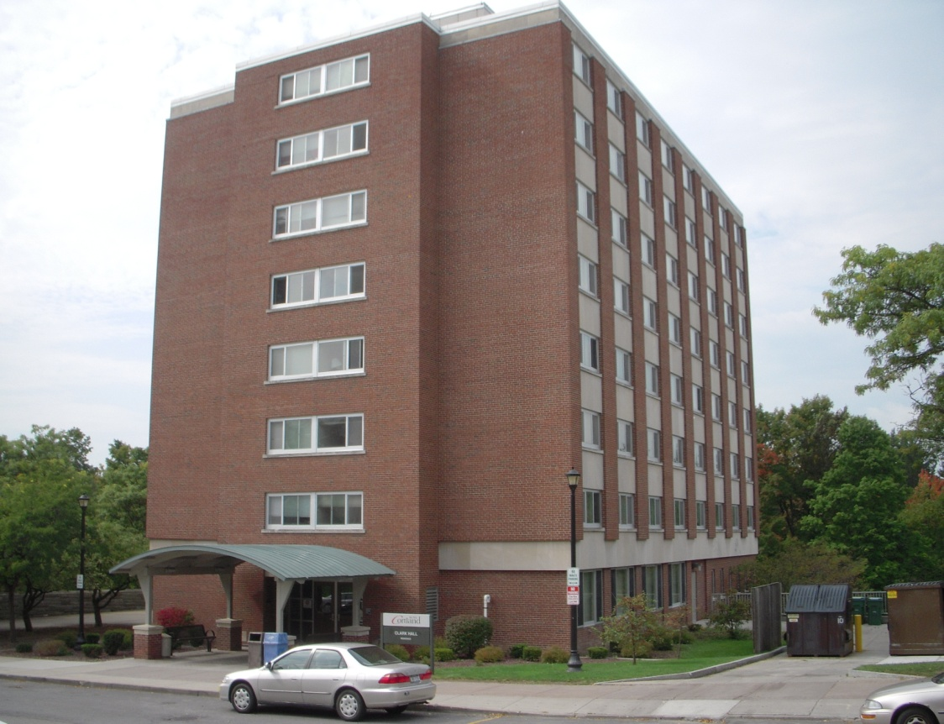
Clark Hall
Very clean and recently renovated
Contains suites, single and double rooms
Each floor has a fully furnished kitchen
  Sink, stove/oven, microwave
One RA per floor
Recreational lounge with fun activities
  Ping Pong, billiards, big screen TV
Photo Source: Dan Scripter

Slide 27
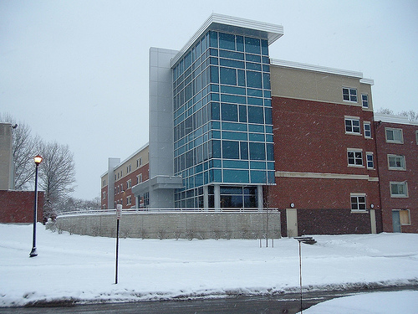
Glass Tower
Glass Tower is SUNY Cortland’s newest hall.
The cost to built: $12.6 million
  Comfort
  Top of the line Energy/Environmental design
Four floors, Double rooms and shared bathroom.
Glass Tower is the only with air conditioning
Photo Source: Flickr by rofltosh

Slide 28
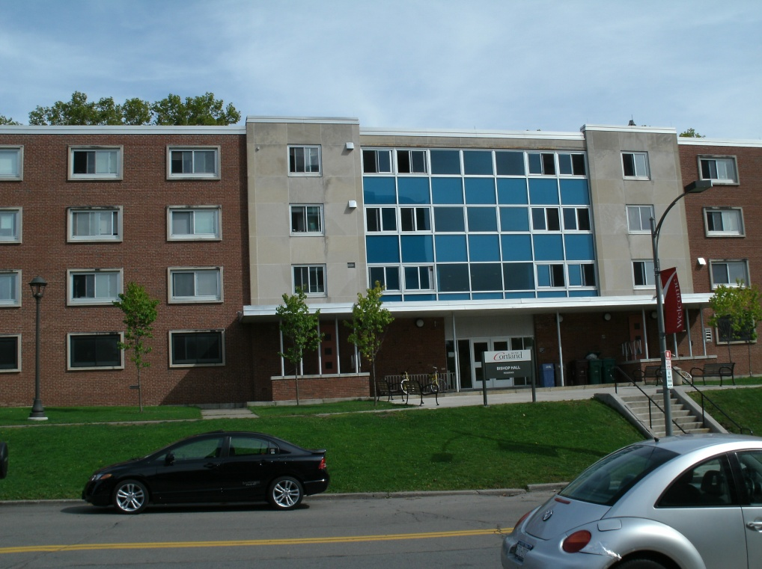
Bishop Hall
Named after Maria Bishop
  Graduated from Cortland in 1881
Three floor low rise residence hall
Mix of freshman and upper class students
Recreational and study lounges
Kitchen available on each floor
Photo Source: Alex Mayer

Slide 29
Dining Halls

Slide 30
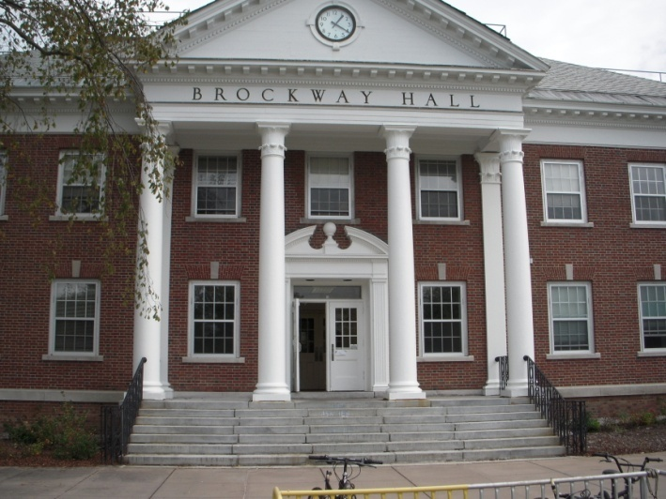
Hilltop
Hours:
  Monday-Thursday:
    8 a.m.-4:30p.m.
  Friday: 8 a.m.-3p.m.
Friendly environment
Close to classes
Sea food, grill, salads, sandwiches, and pizza!

Slide 31
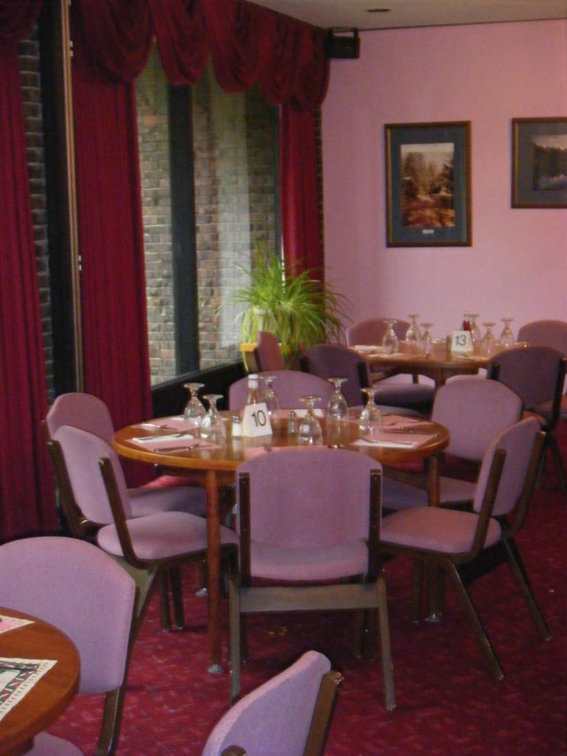
The Caleion Room
Cortland’s only tableside dining service
Open Tuesday-Thursday 5-7:30pm
Offers full menu of choices:
  Soups and Salads
  Signature Sandwiches
  Burgers and Fries
  Desserts
Photo by: Katie Rogers

Slide 32
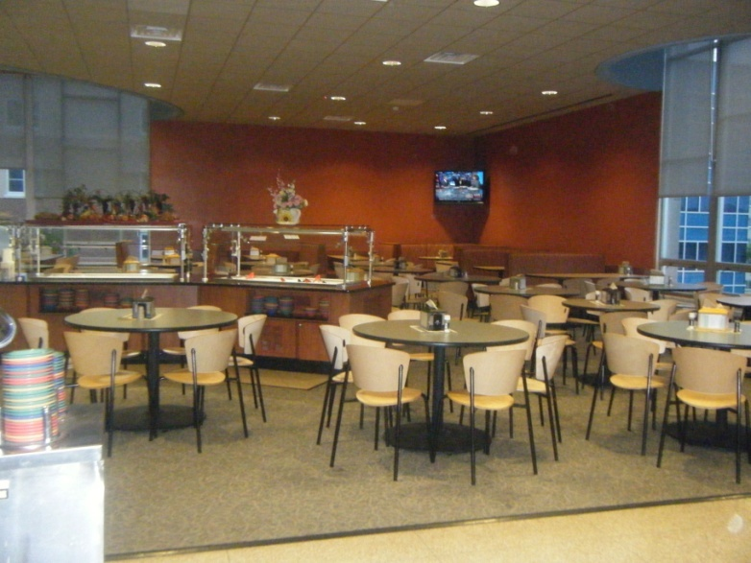
Neubig Hall
Open everyday
  Monday-Friday
    7:30a-3:00p & 4:00p-9:00p
  Sat. & Sun.
    8:00a-3:00p & 5:00p-9:00p
Daily dining & lunch specials
Salad bar, grill, deli & ice cream station!

Slide 33
References
SUNY Cortland Website

