Slide 1
New York Knicks
Christopher Di Piero
mailto:christopher.dipiero@cortland.edu
Notes:
Changed the picture style to Reflected Bevel, Black. Added a picture of a basketball from clip art and made the modification to the Slide Master.

Slide 2
Team History
The team was established in 1946 as one of the leading members of the Basketball Association of America (BAA), which became the NBA after merging with their rival, the National Basketball League (NBL) in 1949.
The Knicks are one of only two teams of the original National Basketball Association still located in its original city (the other being the Boston Celtics).
The "Knickerbocker" name comes from the fictitious name used by Washington Irving in his book A History of New York, a name which became applied to the descendants of the original Dutch settlers of what later became New York, and later, by extension, to New Yorkers in general.

Slide 3
History of the New York Knicks

Slide 4
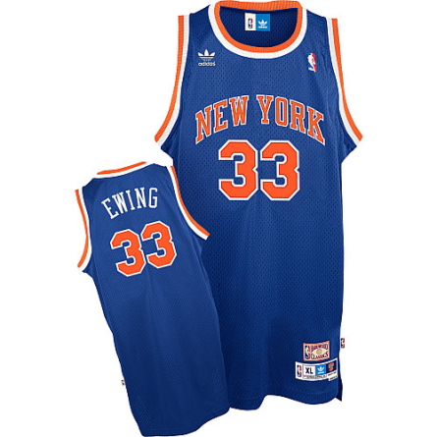
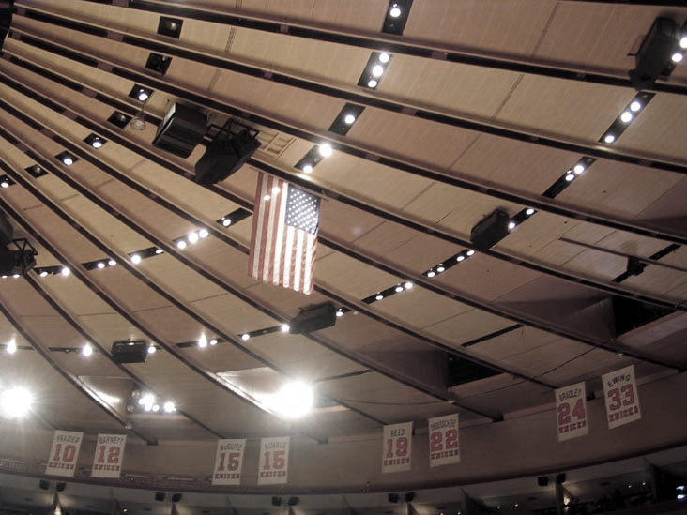
Retired Numbers
Walt Frazier #10
Dick Barnett # 12
Earl Monroe # 15
Dick McGuire #15
Dave DeBusschere # 22
Bill Bradley # 24
Patrick Ewing # 33
Notes:
Added Word Art to title: Gradient Fill- Gray 50%, Accent 6, Inner Shadow. Brown, 18pt Glow, Accent Color 2 . Added picture contrast to MSG photo with 33% saturation. Added a picture style of drop shadow rectangle and a border color of blue with a thickness of 6 pt.

Slide 5
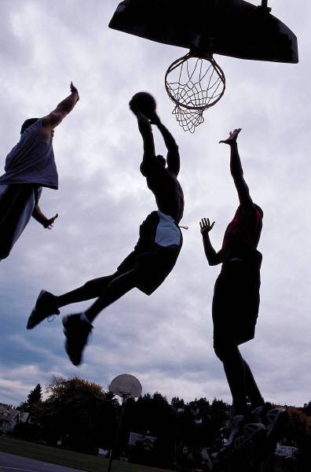
Rivalries
Past Rivalries
Current Rivalries
Miami Heat
Chicago Bulls
Indiana Pacers
Brooklyn Nets-
(Rising in intensity)
Boston Celtics
Notes:
Added rounded rectangle shape. Added style shape- Moderate Effect- Gray-50%, Accent 6. Added Shape Effect- Circle Bevel.

Slide 6
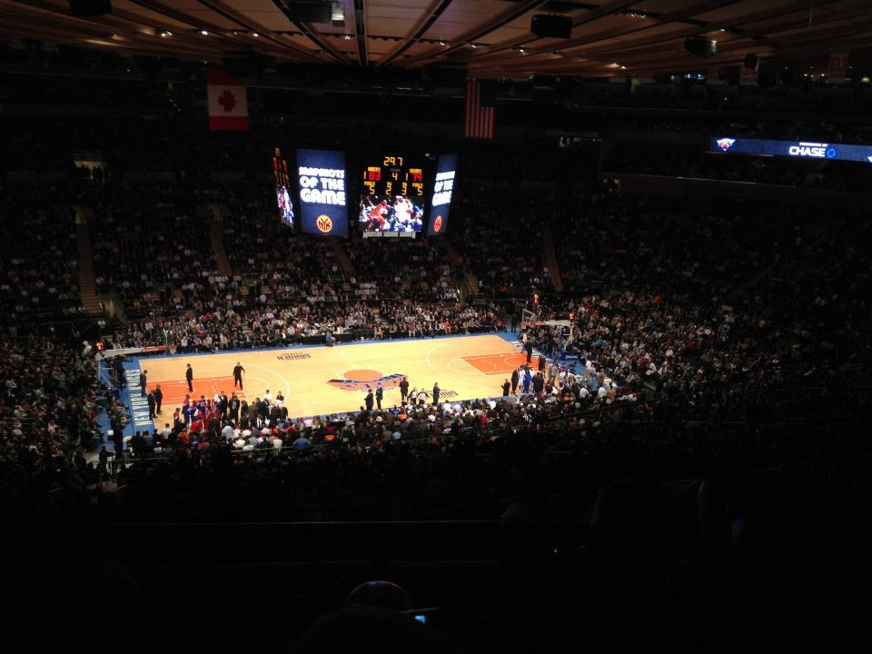
Madison Square Garden
Opened on February 11, 1968, it is now the oldest active major sporting facility in the New York metropolitan area and is the oldest arena in the National Hockey League and the second-oldest arena in the National Basketball Association (after the Oracle Arena in Oakland, California).
Notes:
Formatted the text box with colored outline-Black, Dark 1. Filled text box with Gray-50%, Accent 6, Lighter 40%. Shape Effect- Bevel Circle.

Slide 7
Player | Field Goal %
C. Anthony | .463
R. Brewer | .485
T. Chandler | .656
J. Kidd | .529
R. Felton | .446
Notes:
Added Chart Style 42. Added Riblet Bevel under Shape Effects to pie chart.

Slide 8
2012-2013 Conference Regular Season Standings
Eastern Conference (As of 11/24/12)
Eastern | W | L | GB | CONF | DIV | HOME | ROAD
Miami | 9 | 3 | --- | 4-1 | 1-0 | 5-0 | 4-3
New York | 8 | 3 | 0.5 | 5-0 | 2-0 | 4-0 | 4-3
Brooklyn | 7 | 4 | 1.5 | 5-1 | 2-0 | 5-1 | 2-3
Milwaukee | 6 | 4 | 2.0 | 5-3 | 2-0 | 3-2 | 3-2
Atlanta | 7 | 4 | 1.5 | 4-1 | 3-1 | 3-2 | 4-2
Philadelphia | 7 | 5 | 2.0 | 4-5 | 3-2 | 4-3 | 3-2
Charlotte | 6 | 5 | 2.5 | 4-1 | 1-1 | 5-3 | 1-2
Boston | 7 | 6 | 2.5 | 5-5 | 1-2 | 4-3 | 3-3
Updated Standings: http://www.nba.com/
Notes:
Table Style added: Themed Style 1- Accent 5. Circle bevel effect added. Added a Gradient fill with 63 % position orange and blue.

Slide 9
2012 Coaching Staff
Head Coach: Mike Woodson
Knicks Record Under: 26-9
Assistant Coach: Herb Williams
Assistant Coach: Darrell Walker
Coach from 2011-Present
Assistant Coach: Jim Todd
Notes:
Dark 2 Fill, Simple Filled added to Smart Art. Added Indigo, 18 pt glow, Accent color 5 to text. Changed background texture to Newsprint.

