Slide 1
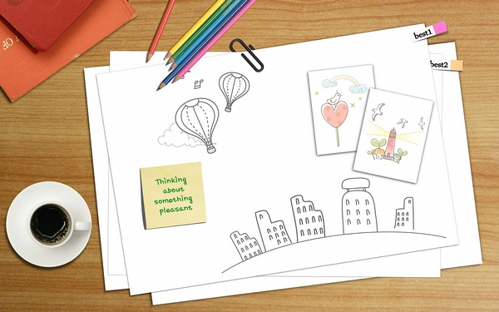
Places to Visit
= Holiday locations
ICC 523
Dan ZHU
Nov. 5th, 2013

Slide 2
OBJECTIVES
Students will be able to…
Spell out the nouns and prepositional phrases related to holiday locations correctly.
Choose appropriate adjectives to describe the scenery in different holiday locations.
Use “because” and “because of” correctly to provide reasons.

Slide 3
TABLE OF CONTENT
Guess the places!
How to say it?
Exercise One: Name it!
Exercise Two: Spell it!
How to describe it?
Why do they like it?
Activities
One: Make a dialogue!
Two: Talk show time!

Slide 4
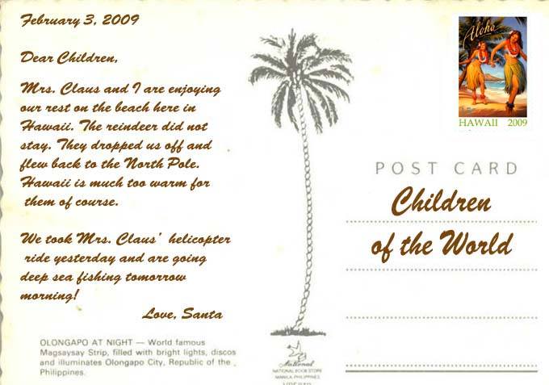
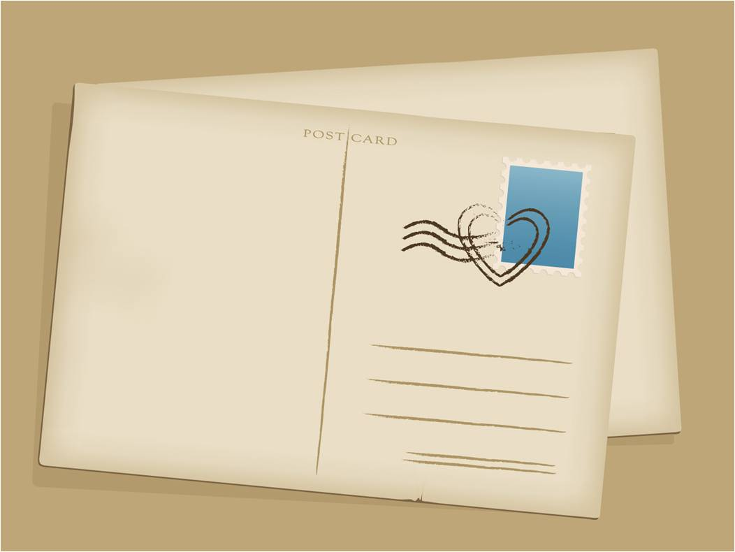
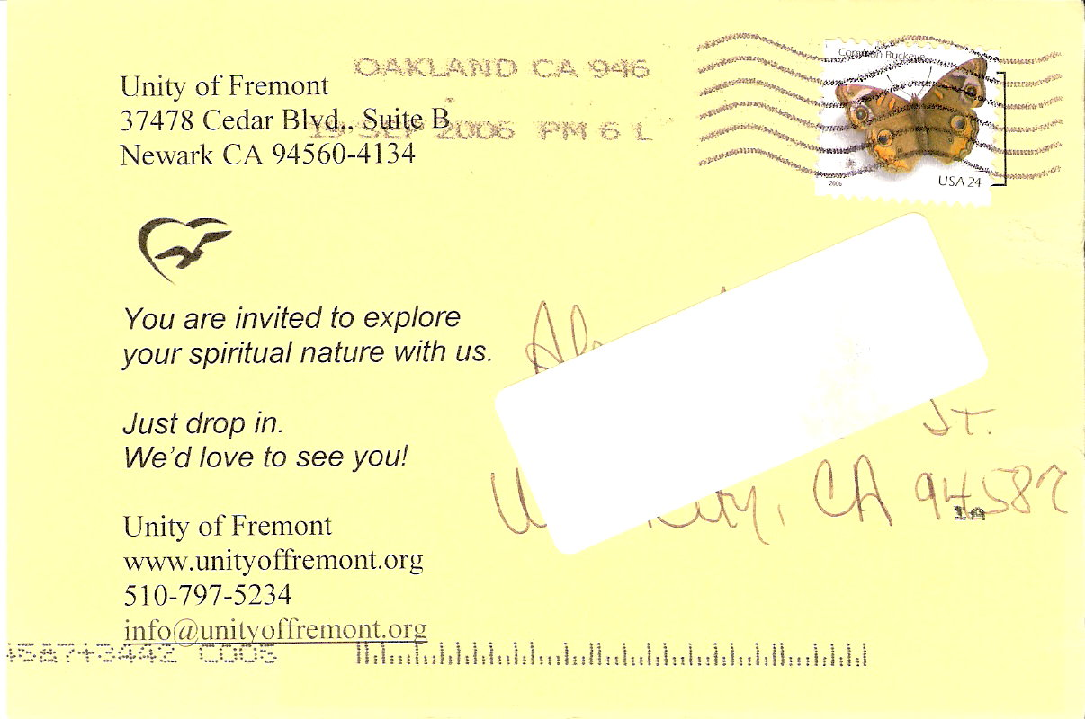
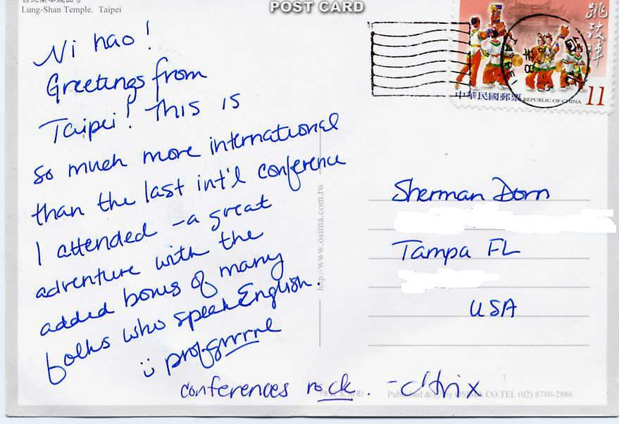
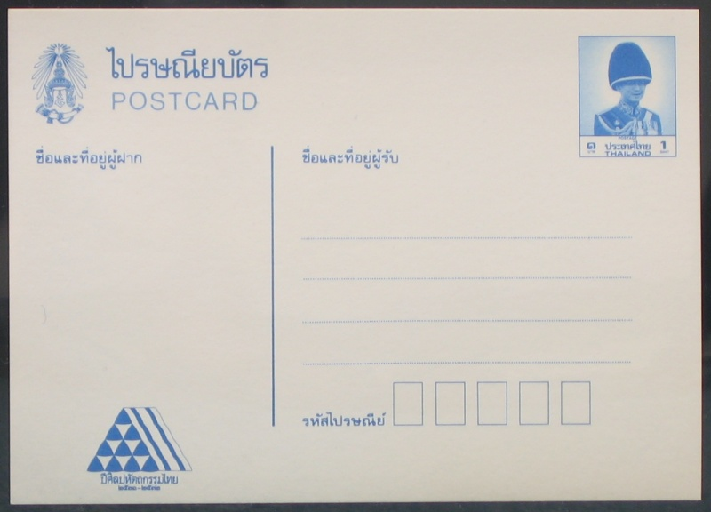
Guess the places!

Slide 5
Dear Julia,
This is a really noisy and crowded place.
It’s always sunny and hot, but people still like to be here.
The greatest thing is the sunbathing!
Michael
At the seaside
In the forest

Slide 6
Dear Julia,
Hard stones are everywhere.
This is a quiet place, too.
Mary
In the desert
In the mountains

Slide 7
Dear Julia,
You can’t find any place so large, quiet and empty.
What’s more, we’ve got golden hills!
Jessie
On the island
In the desert

Slide 8
Dear Julia,
There are lots of tall and green things here.
A quiet place with only birds and animals.
May
At the seaside
In the mountains

Slide 9
Dear Julia,
We had a fantastic time here!
It’s surrounded by a lot of palm trees.
We went to a temple in the middle of this place.
Joe
On the island
In the forest

Slide 10
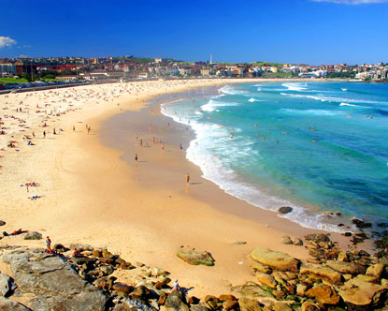
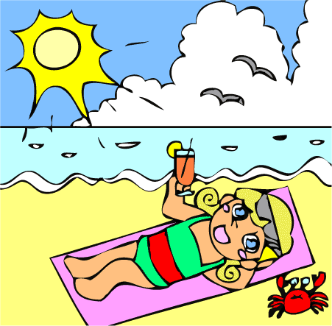
At the seaside
ship
on the coast/ seashore
boat
coast/ seashore
on the beach
beach
ocean
sea
sandy
sunbathing
sand
rock music
rock

Slide 11
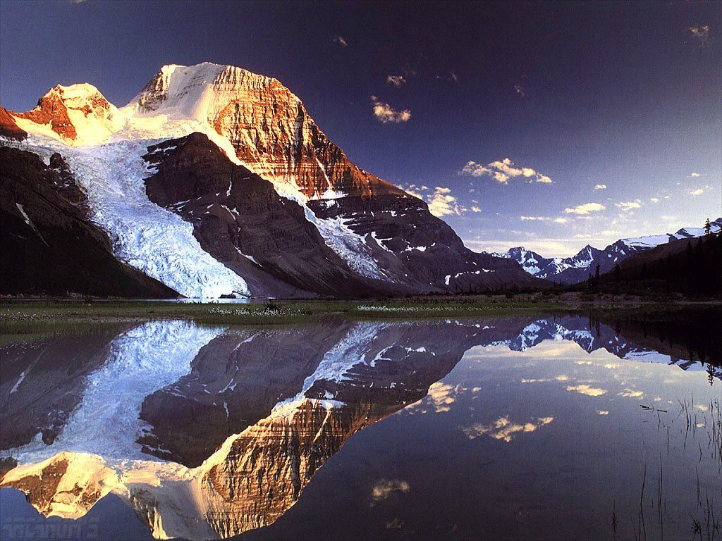
summit/ peak
In the mountains
top
snow
foot
lake

Slide 12
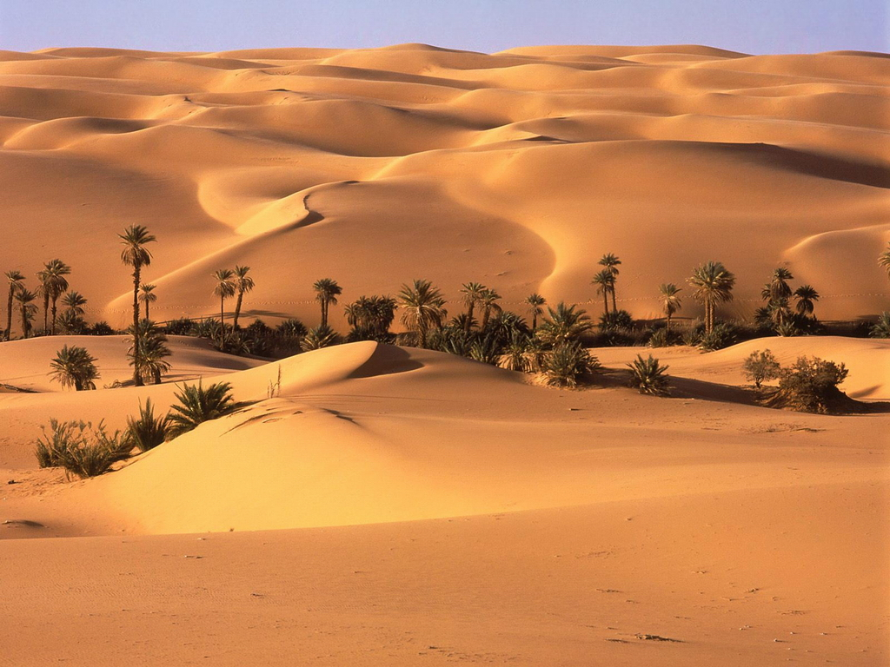
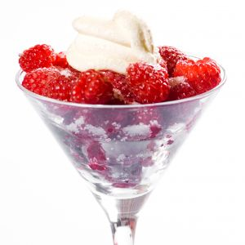
sand dune
dune
camel
palm tree
dessert
In the desert

Slide 13
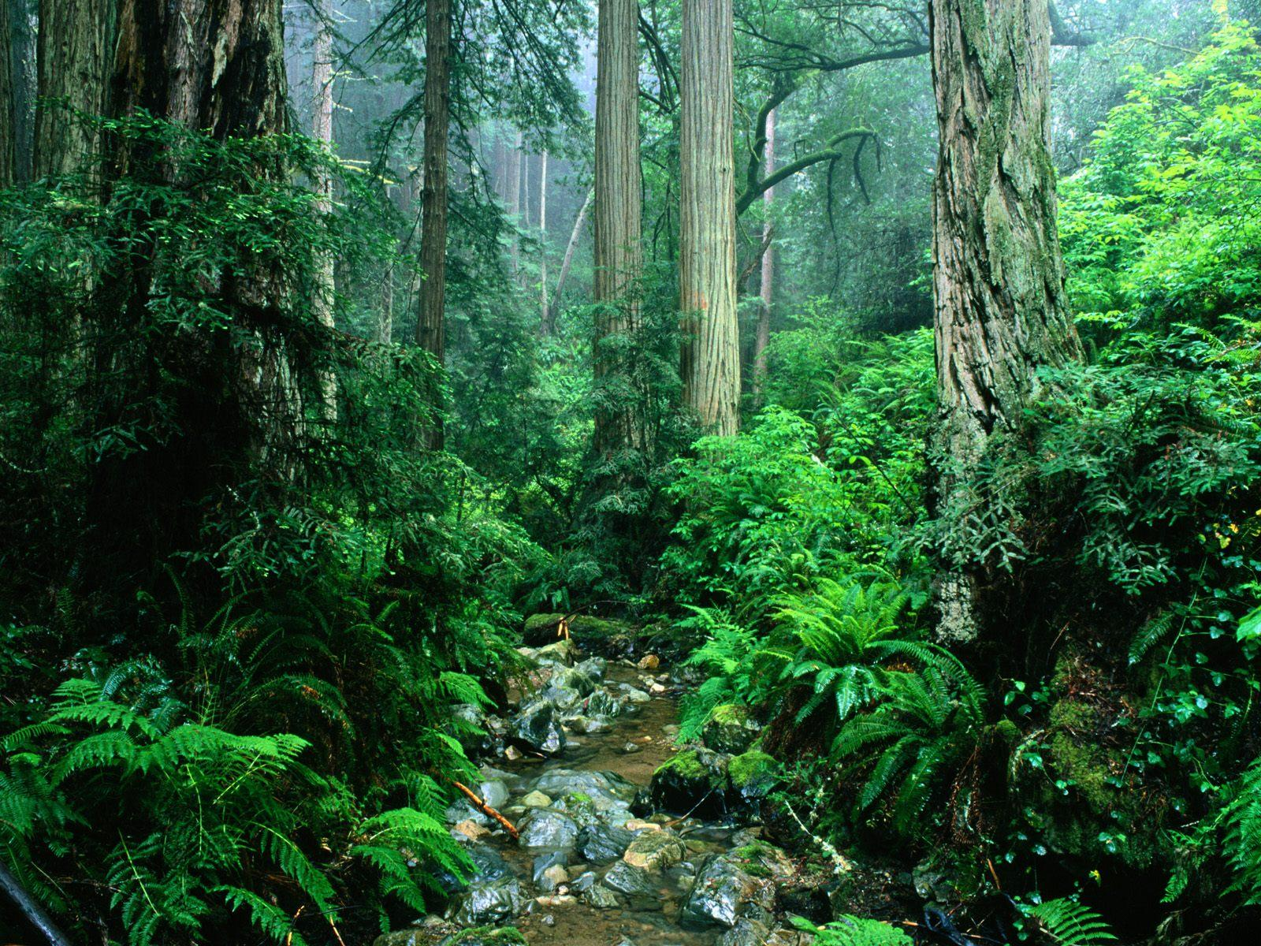
In the forest
tree
tropical rain forest
stream

Slide 14
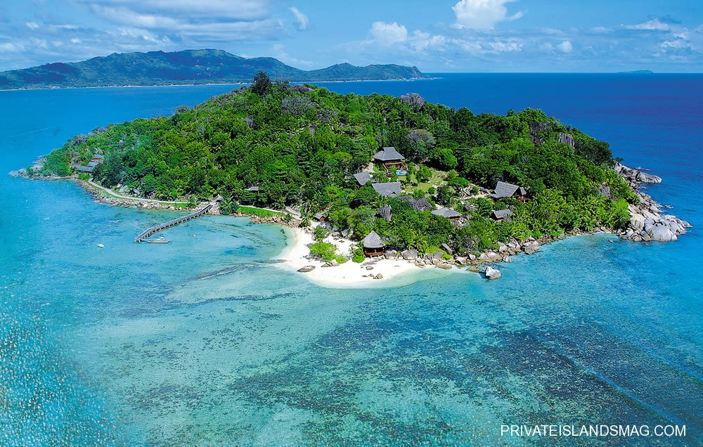
temple
On the island

Slide 15
Name it!

Slide 16
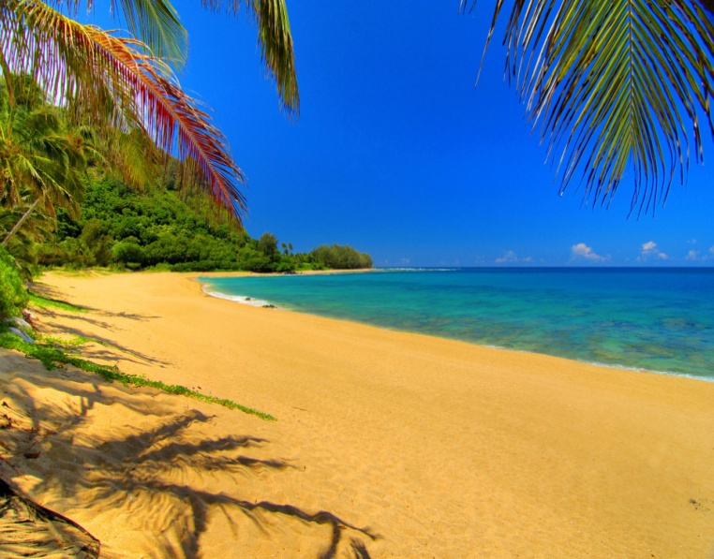
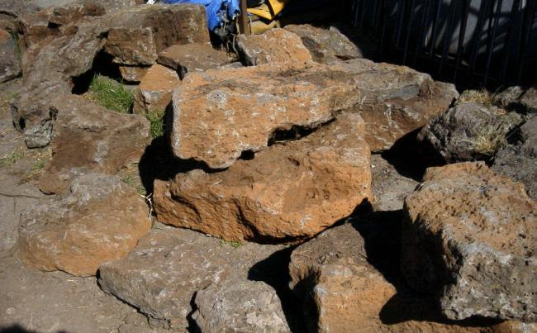
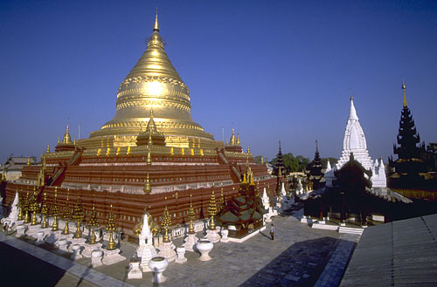
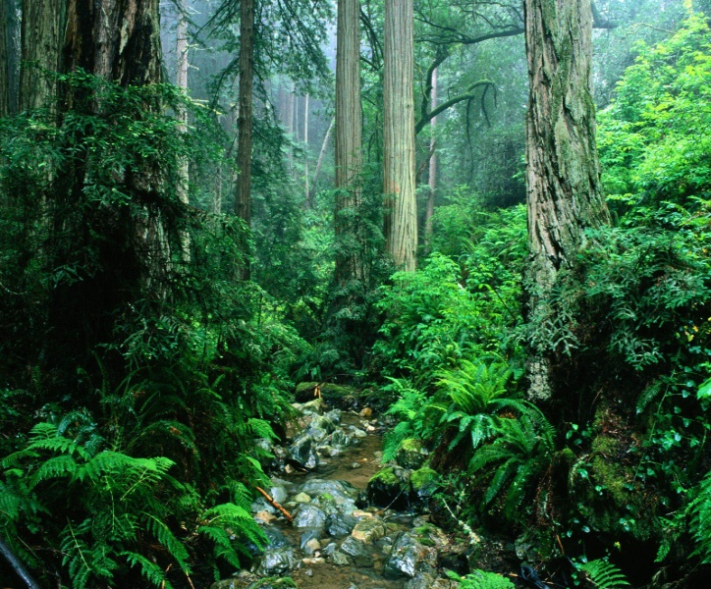
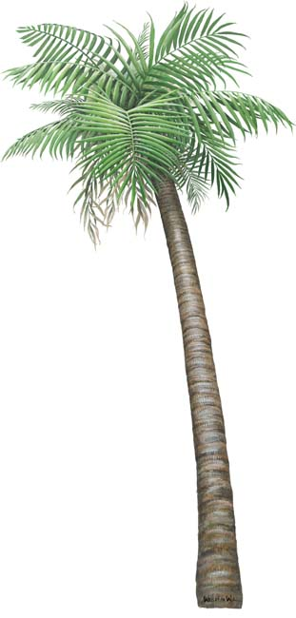
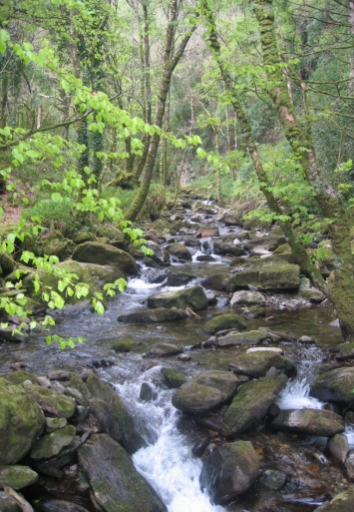
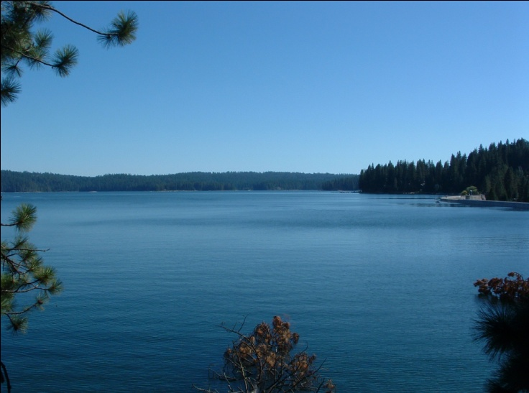

Slide 17
Spell it!

Slide 18
palm tree

Slide 19
temple

Slide 20
dune

Slide 21
sunbathing

Slide 22
island

Slide 23
camel

Slide 24
How to describe it?

Slide 25
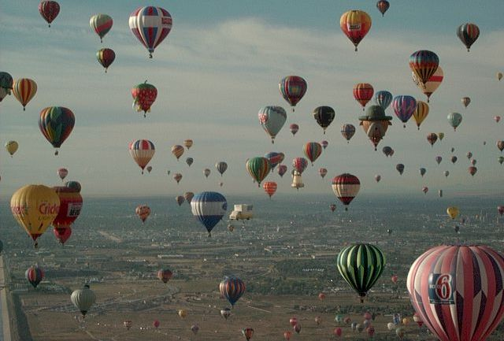
empty
crowded
sky

Slide 26
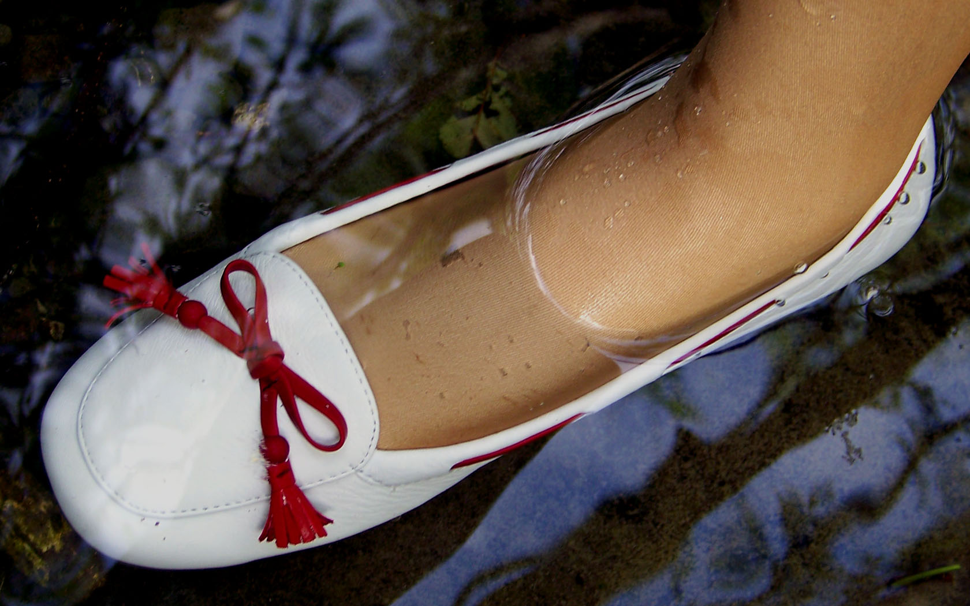
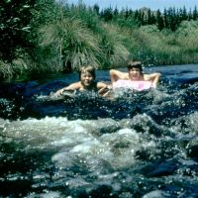
deep
shallow
stream

Slide 27
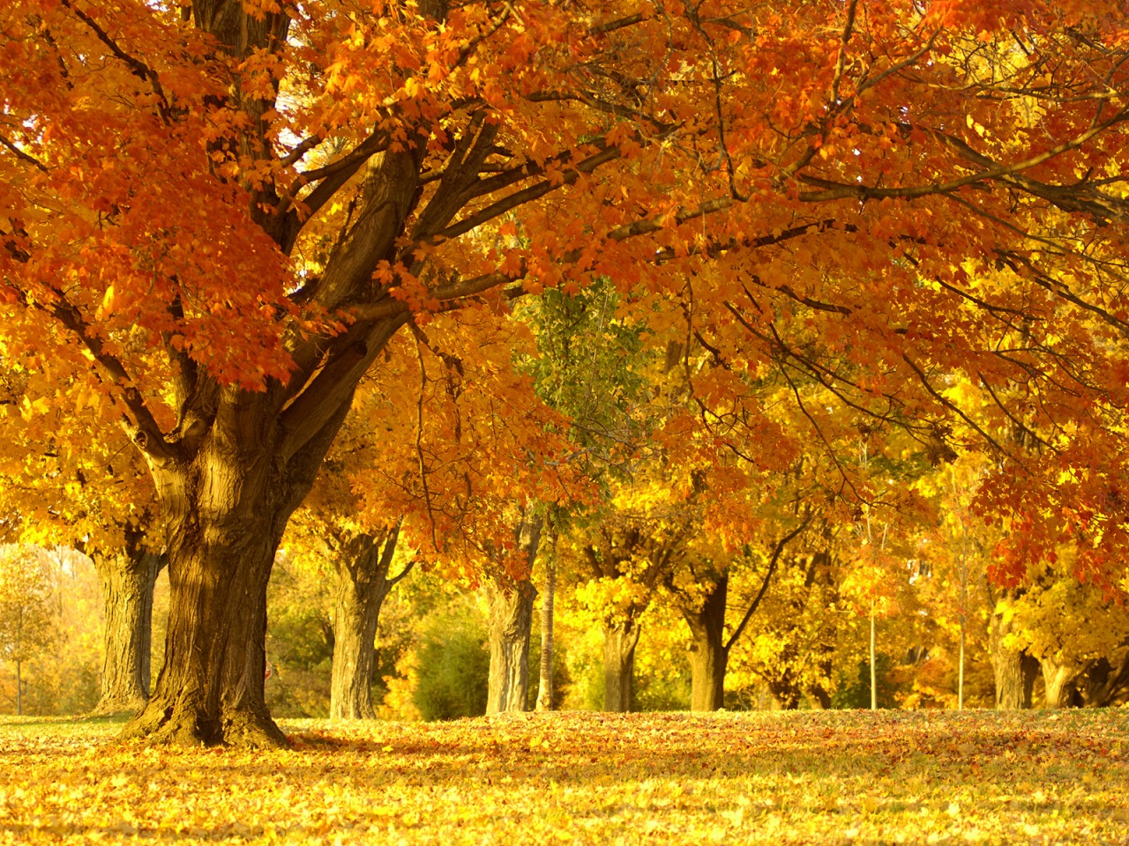
golden/yellow
trees

Slide 28
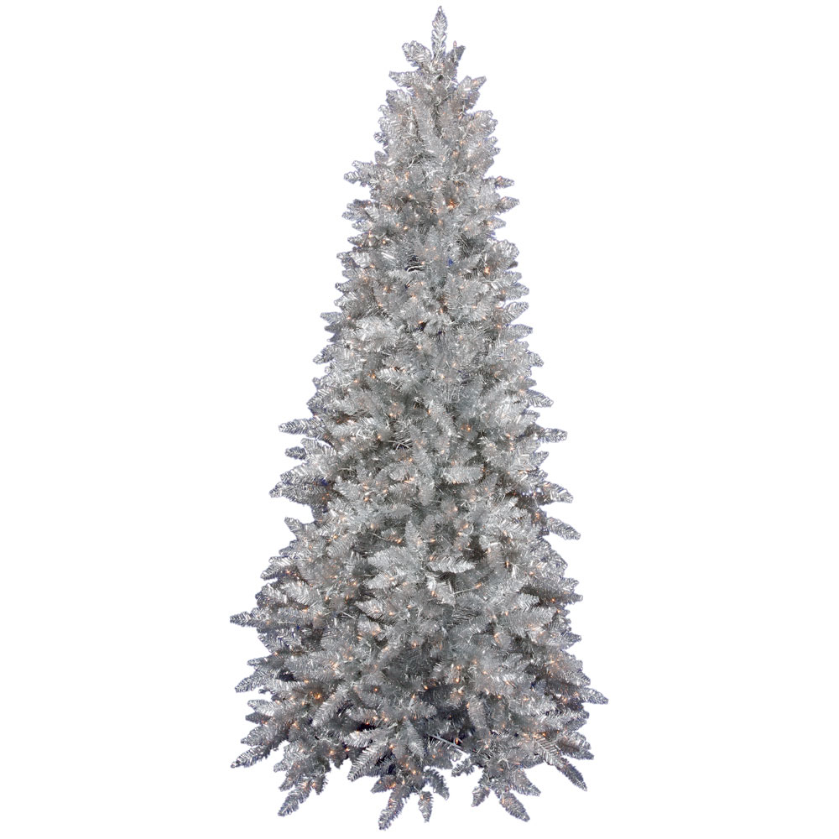
silver
tree

Slide 29
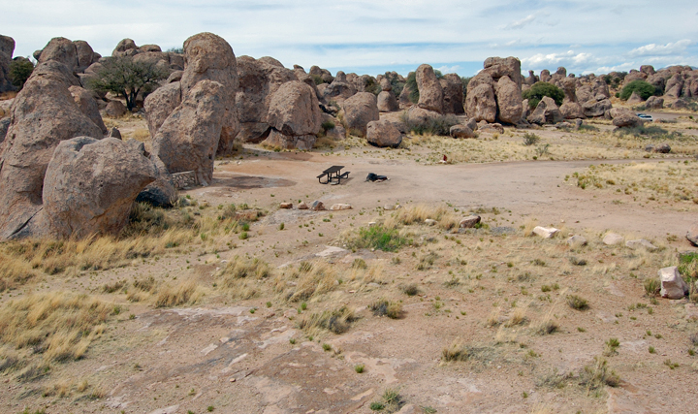
crowded
empty
rocks

Slide 30
Why do they like it?
Listen to three people talking about their favorite holiday places. Make notes about them in the chart.
1. Place
Country
Time
2. Reasons
3. Check answers

Slide 31
 | place | country | reasons | usual time for holiday
Helen | seaside |  | lovely beaches shallow sea
Rob |  | the U.S.
Jill |  |  |  | March / April
Portugal
June
forest
trees, animals, fresh air
September
Helen would like to go to the seaside
because the beaches are lovely and the sea is shallow.
because of the lovely beaches and the shallow sea.
mountains
big lakes, quiet hotel
Italy

Slide 32
Pair work:
Make a dialogue!
“Which place do you like?”
A: Where would you like to go?
B: I’d like to go to …, because (of)…

Slide 33
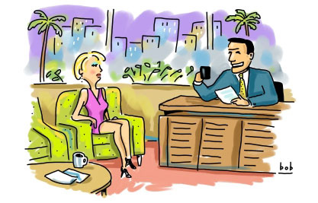
Group work:
Talk Show Time!
“Best Place to Visit”
1 host, 3 guests
Use nouns, prepositional phrases & adjectives,
provide more than 3 reasons

Slide 34
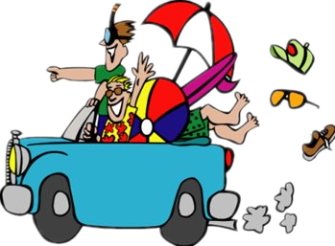
Great Job!

Slide 35
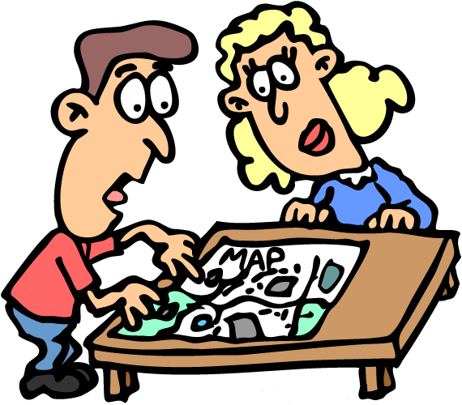
Sorry, please try again…

Slide 36
That’s all for today.

