Slide 1
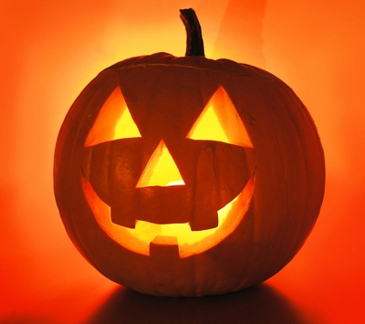
Halloween
October 31st

Slide 2
Table of Contents
The beginnings of Halloween pg. 3
The First Jack O’lantern pg. 4
Dia De Los Muertos pg. 5
An American Halloween pg. 6
Halloween Quiz pg. 7-14
Make a Jack O’ Lantern pg. 15
Permission Slip for Carving pg. 16
Bibliography pg. 17

Slide 3
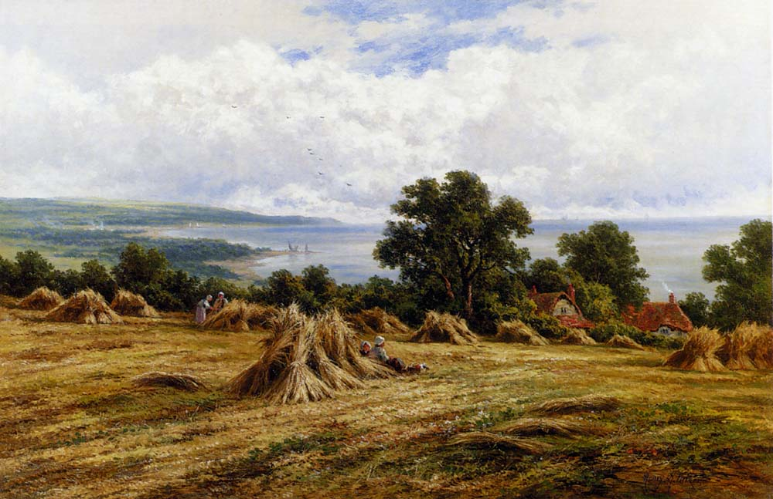
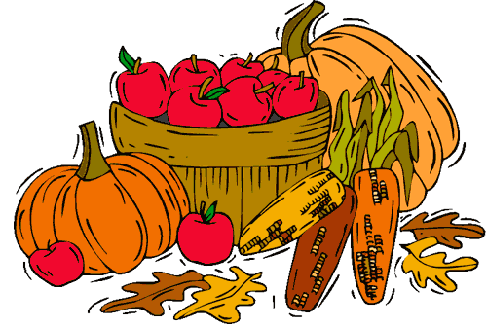
The Beginning
All Hallows Eve or Halloween was celebrated on October 31st.
It was a celebration of the end of the harvest, and an end to the year!
The ghosts of the dead came back to Earth for the night.
The Lord of Darkness looked for spirits to take down to the Underworld.

Slide 4
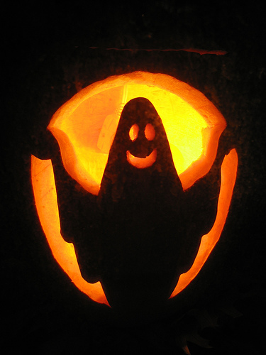
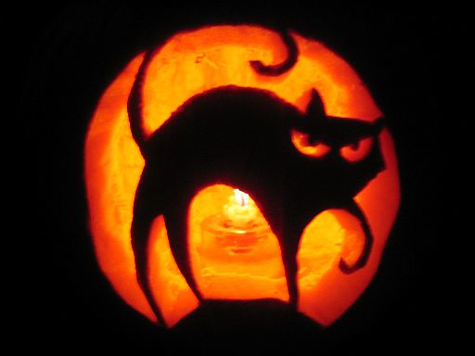
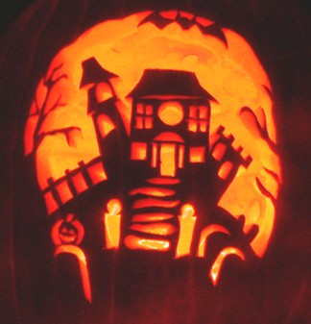
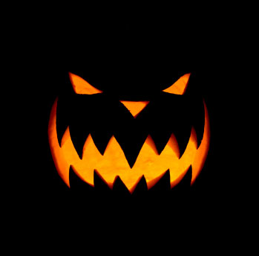
Pumpkins and the First Jack O’Lantern
Pumpkins have grown on this earth for a long time. The Native Americans used pumpkins for food.
In Europe, the Irish carved or cut shapes into Turnips. They would be coals or candles into the turnips.
The Irish would place the turnips outside their homes to keep evil spirits away!
When they came to America, the Irish carved pumpkins instead of turnips. Pumpkins were easier to cut into.
The carved pumpkins are Jack O’ Lanterns!
Now Jack O’ Lanterns are used for decorations. They can have scary faces or cats on them.

Slide 5
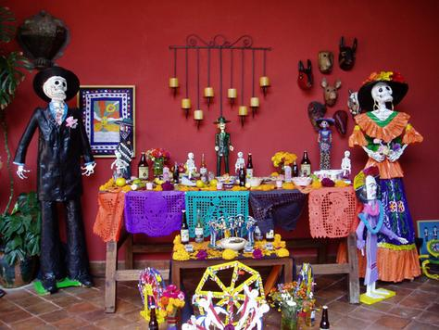
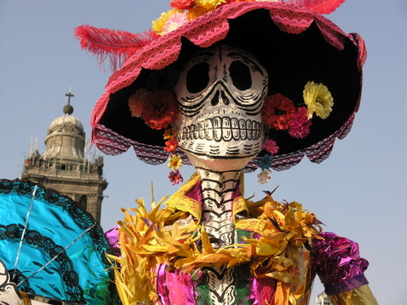
El Dia De Los Muertos
“The Day of the Dead” – is a Mexican holiday that honors the dead.
Mexicans take this time to remember their loved ones.
They decorate tombs and alters with flowers and food.
Asian cultures also honor their dead during October.
La Catrina or Lady Death

Slide 6
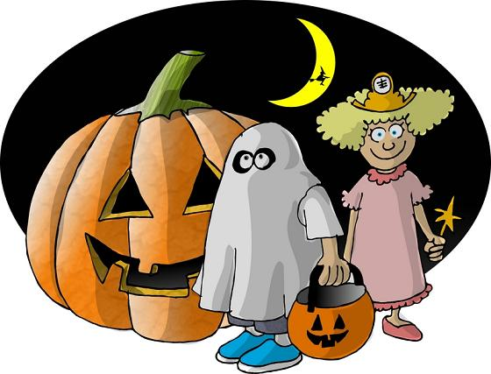
An American Halloween
Halloween is celebrated October 31st.
Americans carve pumpkins to decorate their houses.
Children dress up in costumes and go trick or treating.
For Americans Halloween is a time for fun!

Slide 7
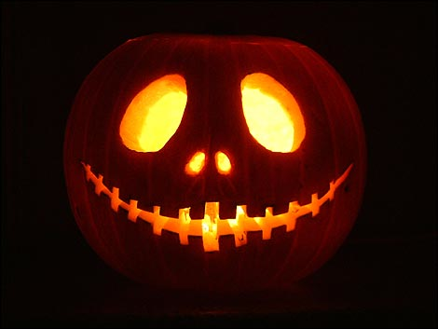
This is a picture of what?
A Pumpkin
A Jack O’ Lantern

Slide 8
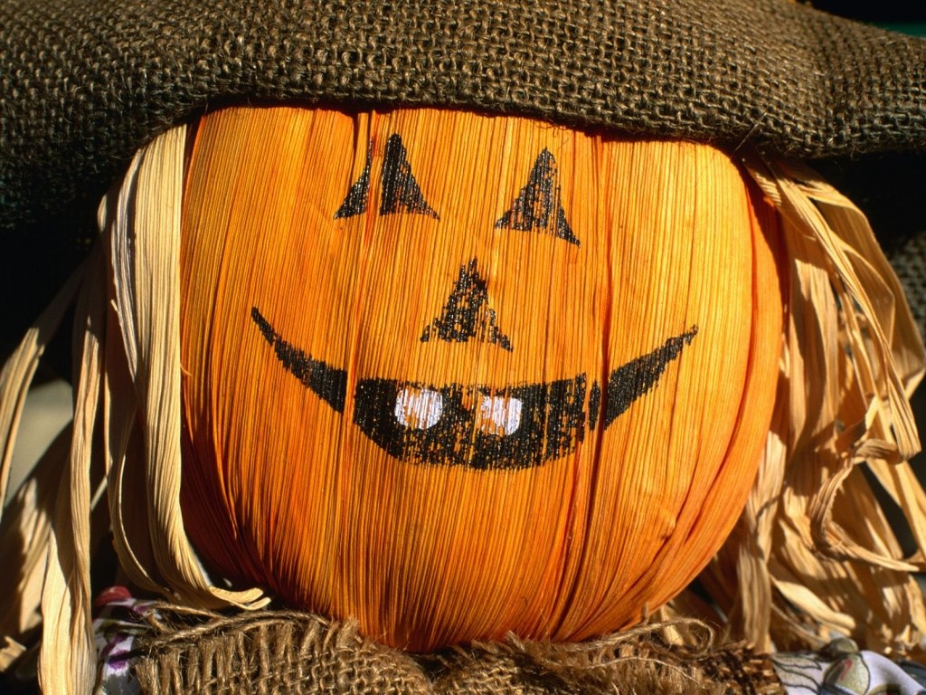
Correct!!
This is a picture of a Jack O’ Lantern. A Jack O’ Lantern is pumpkin that has a design carved into it.
Great Job

Slide 9
Incorrect
That is incorrect. While the picture is of a pumpkin, it’s a carved pumpkin or a Jack O’ Lantern.
Try Again!

Slide 10
Trick or Treat?
1. What is trick or treating?
When children go to houses and ask for candy.
When people put pumpkins outside their houses to ward off children from coming to the door.
On Halloween people wear costumes to dress up as other people or things.
a. False
b. True

Slide 11
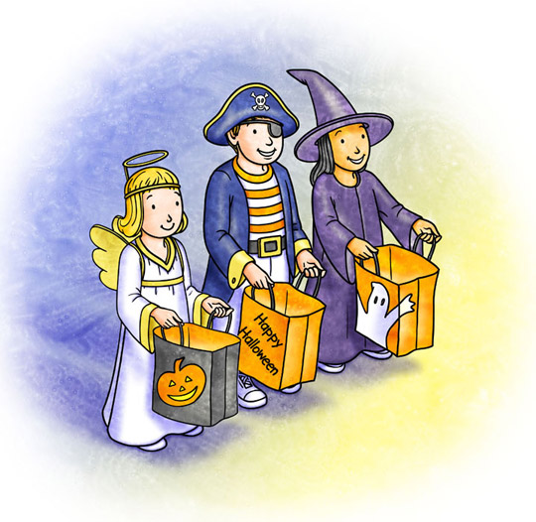
Correct!!
Great Job! Children go to houses on Halloween and ask for candy by saying Trick or Treat!

Slide 12
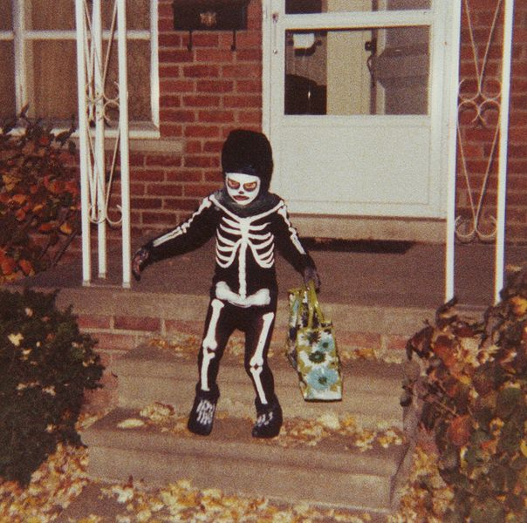
Incorrect
Sorry no candy for you! Try again!

Slide 13
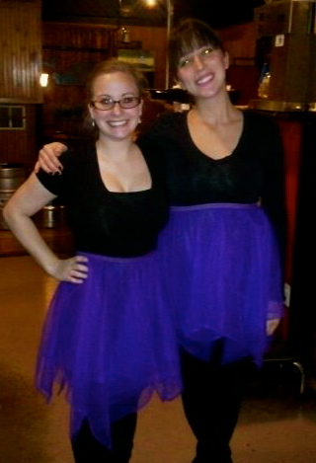
Correct
People wear costumes on Halloween. Here we are ballerinas for the night!

Slide 14
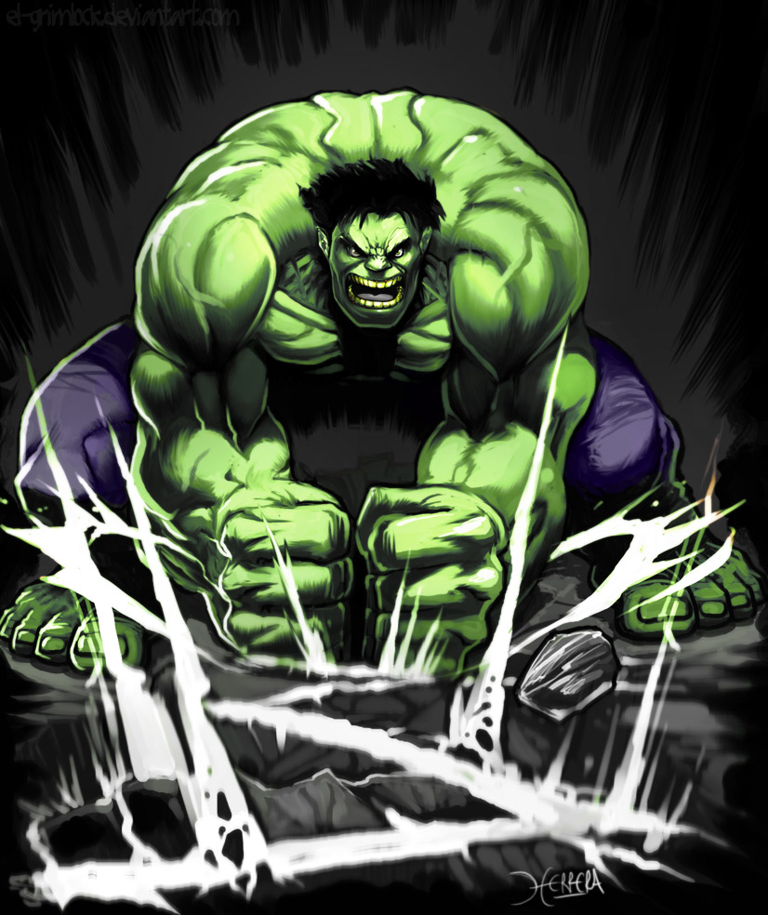
Incorrect
Sorry, that is incorrect. People wear costumes to go trick or treating or to celebrate Halloween!

Slide 15
How to Carve a Pumpkin
First, clean your pumpkin.
Second, cut the top off of your pumpkin.
Clean out the inside of the pumpkins by scraping the sides.
Cut a small hole into the top of the pumpkin. (So the smoke from the candle can escape.)
Next, pick out a design or make your own!
Then, trace the design onto the pumpkin using a marker, or a small nail.
After that, remove the pattern and carefully cut the pumpkin following the lines of your design.
Throw out all garbage.
You can save the pumpkin seeds to cook for a snack!!!!!

Slide 16
Pumpkin Carving
Dear Parent or Guardian,
To celebrate Halloween students may carve pumpkins while in class. They will be using pumpkin carving tools such as small pokers (similar to nails but plastic), scrapers (to clean out the inside of the pumpkin) and small knives (to cut into the pumpkin). Students would have used scalpels in their science classes so they would be familiar with using sharp objects as well as being responsible and careful. The Jack O’ Lanterns will be displayed in the classroom as decorations. If the student wishes to take the Jack O’ Lantern home they will need to pick it up after school to avoid the pumpkins being thrown or smashed while on school property.
Both the student and you need to sign this form.
Student- By signing this form, the student will agree to be respectful and careful while handling the carving tools as well as acting appropriately with other students and their designs. If these requirements are not met the school will take disciplinary action.
Parent or Guardian- By signing this form you agree to allowing the student to handle the pumpkin carving tools as well as participate in the class activity. You are also agreeing that if the student misbehaves, doesn’t follow directions or misuses the tools in anyway that they school may and will take disciplinary action.
Student Signature __________________ Parent/Guardian ____________________
Date_________ Date___________

Slide 17
Bibliography
http://holidayinsights.com/halloween/facts.htm
Images found using google.com/images

