Slide 1
FAQ’s
ALPHA
SIGMA
ALPHA
GAMMA CLIO
By Hayley Brennan
Notes:
Changed slide master to show footer.
Slide 2:
Changed bullets on slide 2 to symbol
Changed smart art style to polished, changed shape to circles from rounded rectangles

Slide 2
How do you choose positions?
First we take nominations
Then we create a mock slate
Then we pick one person from each category to be on the final slate
The people on the final slate do speeches
Then we vote to pass or fail the final slate
Nominations
Mock Slate
Speeches/Voting
Final Slate
If it doesn’t pass,
We re-nominate
And vote again!
Notes:
Added word art and changed effect to center shadow
Animation

Slide 3
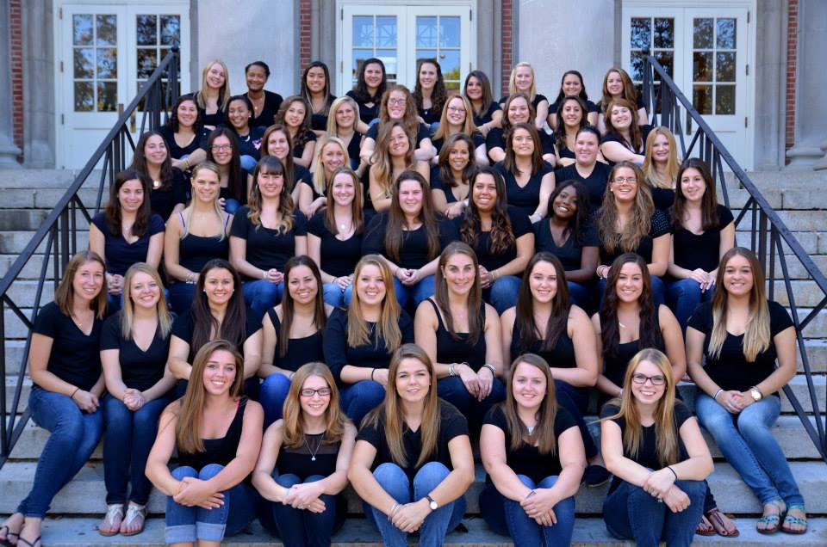
Who takes all of your Photos?
One of our Sisters Hannah Willis gives up her time to make us look beautiful in our group pictures.
Notes:
Style applied to photo- reflected rounded rectangle
Text box added and formatted

Slide 4
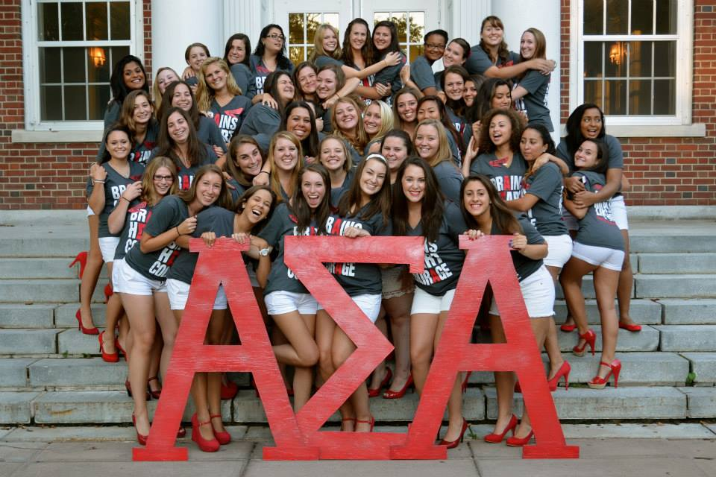
OUR SORORITY

Slide 5
Why did you join ASA?
I joined ASA because of my biological sister. She is also a member of Gamma Clio which makes me a Legacy.
A Legacy is the: Sister/step-sister,
Daughter/step-daughter,
Granddaughter/step-granddaughter,
Niece/step-niece of an Alpha Sigma Alpha member.
She never pushed me to join but ever since I was younger I always followed in her footsteps
Notes:
Image recolored to sepia

Slide 6
Is ASA a national sorority?
Yes Alpha Sigma Alpha is a Nationally recognized Sorority.
There are over 90 collegiate chapters throughout the United States
These chapters are broken up into districts
Gamma Clio is in district 3
ASA NATIONAL WEBSITE
Notes:
Animation
Hyperlink to external site

