Slide 1
Parts of Speech
By Miss Fivie
Click here to start learning!

Slide 2
Table of Contents
-Objectives
-What is a noun?
-What is a verb?
-What is an adjective?
-Test yourself!

Slide 3
Objectives
SWBAT identify and describe a noun, verb and adjective.
SWBAT recognize the different parts of speech in sentences.
SWBAT test their knowledge of different parts of speech by completing a short quiz.

Slide 4

What is a noun?
Definition
Examples
A noun is a person, place or thing.
bicycle
school
friends

Slide 5
More examples of nouns
Person
Place
Thing
Dad
teacher
sister
police
President
Miss Fivie
house
USA
Cortland
living room
backyard
mall
park
pencil
phone
notebook
computer
shirt
desk
chair

Slide 6
Examples
I live in New York.
I put my backpack on my chair.
The police stopped the car.

Slide 7
Quick check!
What are the nouns in this sentence?
The leaves are falling of the trees.
Answer

Slide 8

Answer!!!
Tree and leaves

Slide 9
What is a verb?
Definition
Examples
A verb is a word that expresses an action or tells what someone is doing.
work
stay
walk

Slide 10
Examples
My best friend visited me at school.
My dad ran to work today.
My brother jumped on the trampoline.

Slide 11

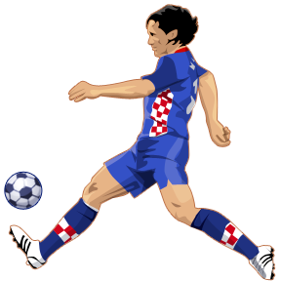
More examples of verbs
call
smell
hug
drop
end
march
open
yell
kick

Slide 12
Quick Check!!
What are the verbs in this sentence?
I called my mom after school.
Answer

Slide 13
Answer!!!
called

Slide 14
What is an adjective?
Definition
Examples
An adjective is a word that describes a noun.
shiny
clean
purple

Slide 15
Examples
She made a difficult decision.
The boy was very bored.
The haunted house is scary.

Slide 16

More examples of adjectives!!
important
colorful
fluffy
sweet
soft
silent
red
flat
long
kind

Slide 17
Quick Check!!
What are the adjectives in this sentence?
The car was green and very fast.
Answer

Slide 18
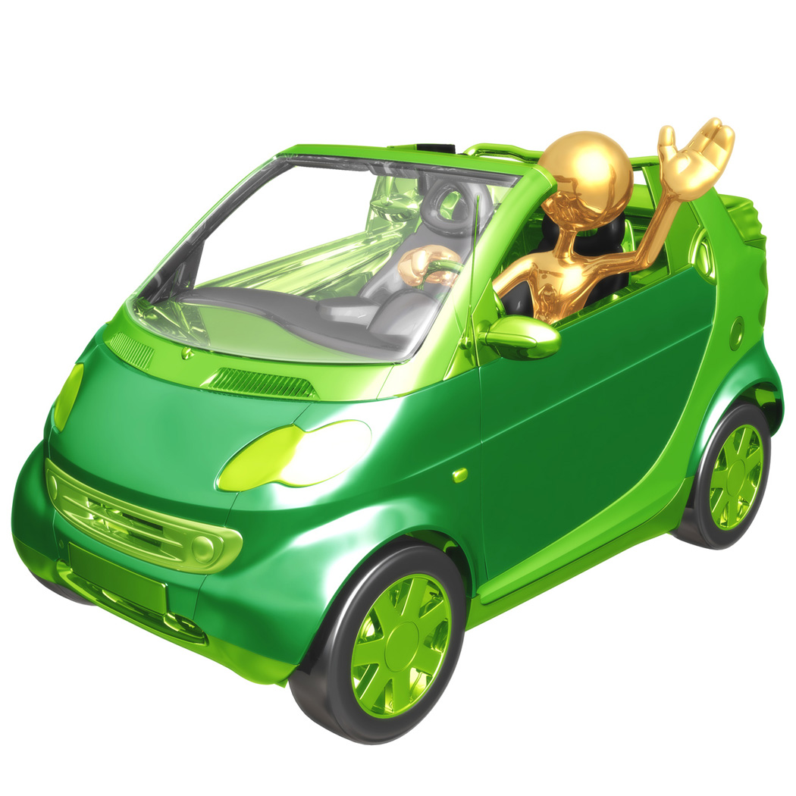
Answer!!!
Green and fast

Slide 19
Quiz!!!
Let’s test your knowledge on nouns, verbs and adjectives!!

Slide 20
What are the nouns?
Click on the correct nouns for the sentence.
Bobby came to class late.
late, Bobby
Bobby, class

Slide 21
What are the verbs?
Click on the correct verbs for the sentence.
The cheetah chased the antelope.
the
chased

Slide 22

What are the adjectives?
Click on the correct adjectives in the sentence.
A little yellow fuzzy bumblebee was on the flower.
bumblebee, fuzzy, yellow
yellow, little, fuzzy

Slide 23

What is the word take in this sentence?
I am going to take a picture.
verb
Yes
adjective
No
noun
No

Slide 24
What are the words giant and fuzzy in this sentence?
That dog is giant and fuzzy. He can also run fast.
verbs
No
adjectives
Yes
nouns
No

Slide 25

What are the words Amanda, ball and brother in this sentence?
Amanda threw the ball to her brother.
verbs
No
adjectives
No
nouns
Yes

Slide 26

Listen to the sentences by clicking on the sound button and then select the correct answer.
What is the verb?
lunch
ate
Brittany
school
Sorry ☹
Yeah ☺
Sorry ☹
Sorry ☹

Slide 27

Listen to the sentences by clicking on the sound button and then select the correct answer
What is the adjective?
shiny
sidewalk
ball
small
Yeah ☺
Sorry ☹
Sorry ☹
Sorry ☹

Slide 28

Want to learn more about nouns, verbs and adjectives? Click on the pictures to learn more and play games!
Click on the space ship to learn more about verbs!!
Click on the fish to learn more about nouns!!
Click on the apple to learn more about adjectives!!

Slide 29

The End!!!!!!!

Slide 30
Sources
http://www.sheppardsoftware.com/grammar/adjectives.htm
http://www.sheppardsoftware.com/grammar/nouns.htm
http://www.sheppardsoftware.com/grammar/verbs.htm
http://www.google.com

Slide 31

Correct!!!

Slide 32

Try Again!!!

