Slide 1
MONEY!
By: Kayla Stirpe

Slide 2
Objectives:
-Students will be able to communicate effectively in social and academic settings.
-Students will be able to identify and count money.

Slide 3
Click on the image below
if you are ready to start learning about money!

Slide 4
One Dollar $1.00

Slide 5
Five Dollars $5.00

Slide 6
Ten Dollars $10.00

Slide 7
Twenty Dollars $20.00

Slide 8
Fifty Dollars $50.00

Slide 9
One hundred Dollars $100.00

Slide 10
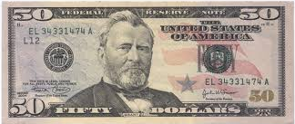
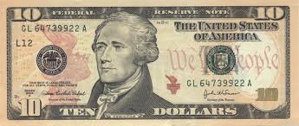
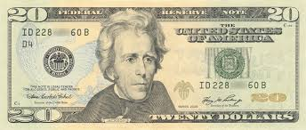
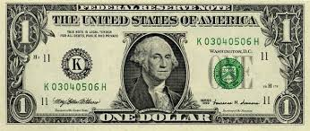
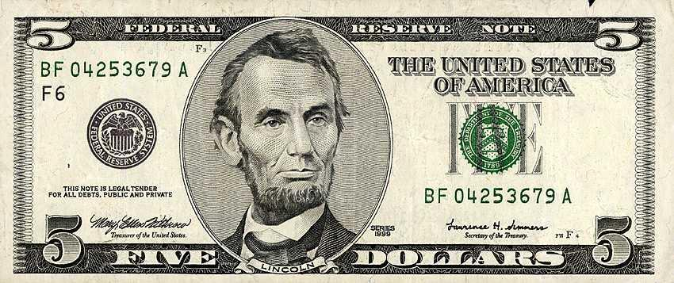
Match the word to the
picture:
g
Twenty Dollars
One Dollar
.
Ten Dollars
.
Five Dollars
.
Fifty Dollars
.

Slide 11
Click here if you are want to continue learning.
Click here if you want to learn the American dollars again.

Slide 12
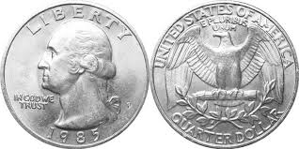
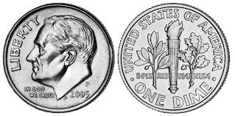
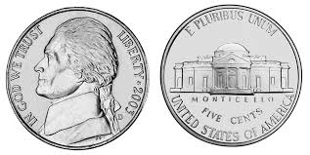
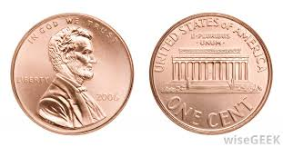
The American Coin System
There are four coins in the American currency system.
*Note: One hundred cents is equal to one dollar.
100¢ equals $1.00
Name of the coin | Image of the coin
A quarter (front and back)
A dime (front and back)
A nickel (front and back)
A penny (front and back)

Slide 13
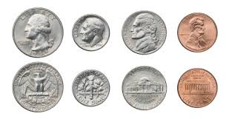
The American Coin System
A nickel
5¢ or $0.05
20 nickels makes a dollar
A quarter
25¢ or $0.25
4 quarters makes a dollar.
A penny
1¢ or $0.01
100 pennies makes a dollar
A dime
10¢ or $0.10
10 dimes makes a dollar.

Slide 14
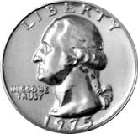
Match the word to the
picture:
gdg
A Penny
A Quarter
.
A Nickle
.
Two Quarters
.
A Dime
.

Slide 15
Click here if you want to
go shopping in America!
Click here if you want to learn
the American dollars again.
Click here if you want to learn
the American coin system again.

Slide 16
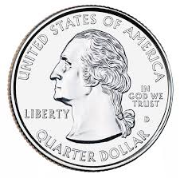
This notebook costs $0.75.
a.)
No, try again!
b.)
c.)
No, try again!

Slide 17
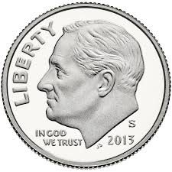
An ice cream cone costs $1.25.
a.)
b.)
No, try again!
c.)
No, try again!

Slide 18
A chocolate bar costs $2.00
a.)
b.)
No, try again!
c.)
No, try again!

Slide 19
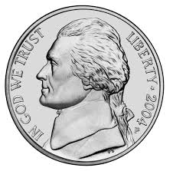
A cheeseburger costs $5.20
a.)
No, try again!
b.)
No, try again!
c.)

Slide 20
AWESOME JOB!!

Slide 21
RESOURCES:
-www.prezi.com
-http://currencyguide.eu/usd-en/1usd-en.html
-http://currencyguide.eu/usd-en/5usd-en.html
-http://currencyguide.eu/usd-en/10usd-en.html
-http://currencyguide.eu/usd-en/20usd-en.html
-http://currencyguide.eu/usd-en/50usd-en.html
-http://currencyguide.eu/usd-en/100usd-en.html
-www.clker.com
-http://coins.about.com/od/worldcoins/ig/World-Coins-Gallery-Index/American-Money---Coins.htm
-http://www.clipartguide.com/_pages/0511-0810-0602-1322.html
-http://www.clker.com/clipart-money-4.html
-http://www.mycutegraphics.com/graphics/school/supplies/red-spiral-notebook.html
-http://www.clipartbest.com/cartoon-smiley-face-with-thumbs-up
-http://www.clipartbest.com/clipart
-http://www.clipartbest.com/clipart-of-candy
-http://www.clipartof.com/portfolio/seamartini/illustration/cheeseburger-1246534.html
-http://www.business2community.com/b2b-marketing/b2b-marketing-tips-painting-future-like-playing-fireworks-0730027

