Slide 1
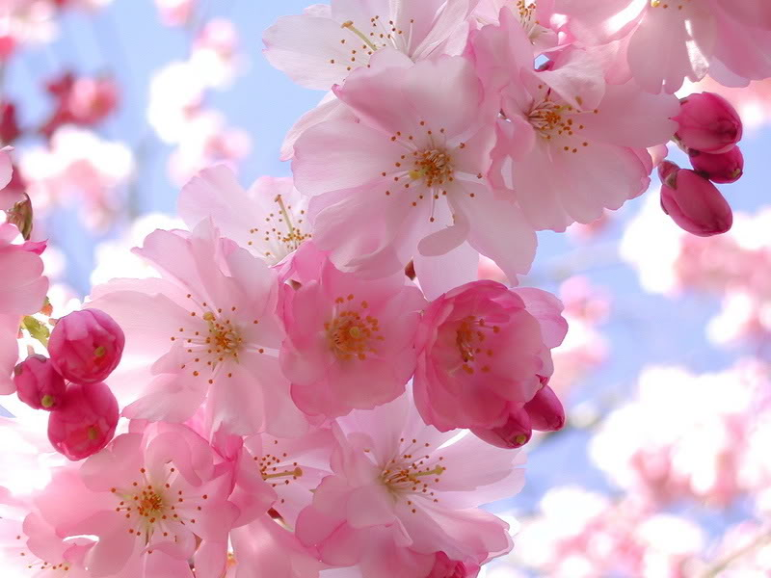

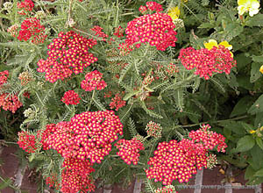

The Blooming of a New Year
PERSIAN NEW YEAR
NOROOZ
Begin

Slide 2
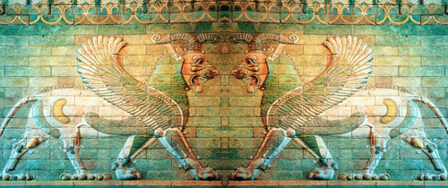
HISTORY
Norooz, in word, means "new day". It is the new day that starts the year. The Norooz celebration is a 3,000-year-old tradition and lasts 13 days.
Norooz is the time of New Year in Iran which begins in the first day of spring, March 21. As the spring is the season in which the nature becomes new, Iranians believe that they should also become new by changing bad thoughts and behavior to good ones, so they celebrate this season for their changes that they decide to do in the New Year.

Slide 3
PREPARATION FOR THE NOROOZ
Couple weeks before arrival of Norooz, Iranians clean their house which called Khaneh Tekani, literal translation means “shaking your house”. Like nature in spring, this symbolizes throwing out old things and bringing new things.
Near the time of new year all members of the family go shopping to buy new clothes and new things for their house. In Iran, shops before Norooz is very crowded, similar to Christmas in Western world.
They also buy cookies, fruits, different kinds of pastry and nuts known as Ajîl and redfish .

Slide 4
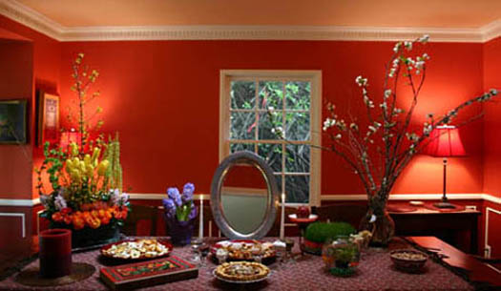
HAFT SIN
They also buy the seven ‘S’s which is a major tradition of Norooz. Then, they prepare a Haft Sin table. Today the haft sin table includes seven specific items, all starting with the letter S or Sîn (س in the Persian Alphabet).
“ Haft Sin” Table

Slide 5
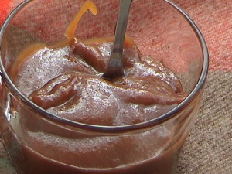
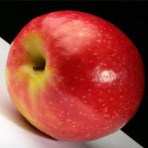
Let’s see what Haft Sin items are;
Samanu :sweet pudding made from wheat germ - symbolizing affluence
Sîb : apples - symbolizing beauty and health

Slide 6
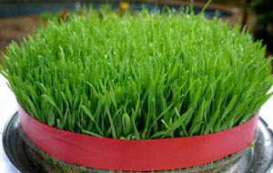
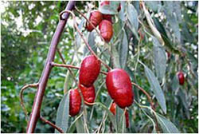
Sabzeh: wheat, barley or lentil or sprouts growing in a dish - symbolizing rebirth
Senjed :the dried fruit of the oleaster tree - symbolizing love

Slide 7
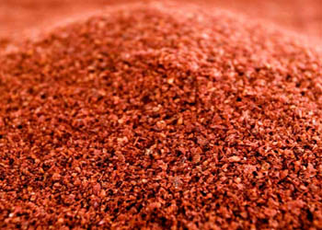
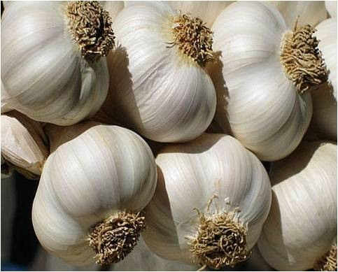
Sîr :garlic - symbolizing medicine
Somaq: sumac berries - symbolizing (the color of) sunrise

Slide 8
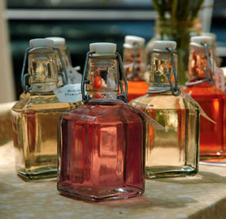
…and the last Haft Sin item is:
Serkeh: vinegar-
symbolizing age
and patience

Slide 9
Which one represents beauty and health?
Sîb : apples
Serkeh : vinegar

Slide 10
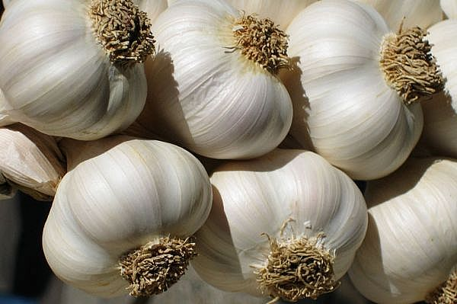
Which one represents sunrise?
Sîr : garlic
Somaq: sumac
The End

Slide 11
Great Job!

Slide 12

Try Again!

