Slide 1
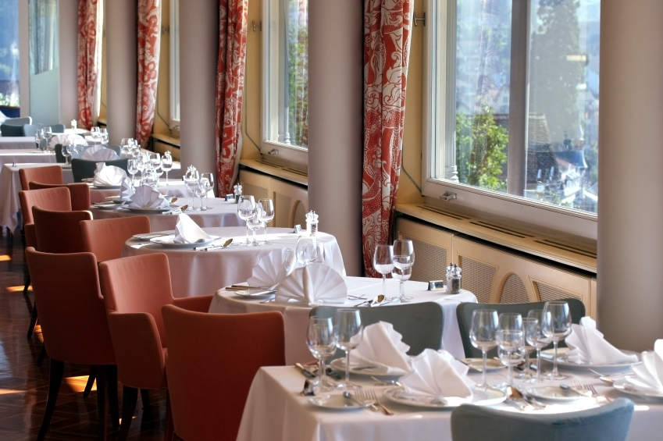
En el restaurante
Capítulo 2 Nivel 2
Señora Daniels

Slide 2
Table of Contents
Cultural Questions
Introduction of Vocabulary
Vocabulary Practice
Source

Slide 3
¿Cuánto dinero dejas para una propina en los estados unidos en un restaurante?
10 %
20 %
30 %
NO
Sí
NO
Click on the percent to find the correct answer.

Slide 4
¿Cuánto dinero dejas para una propina en España en un restaurante?
10 %
20 %
30 %
Sí
NO
NO
Click on the percent to find the correct answer.

Slide 5
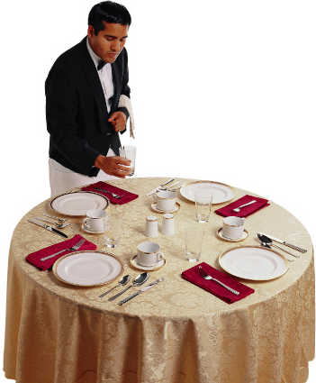

El mesero pone la mesa.
el plato
el cuchillo
el tenedor
el mantel
Click on the blue box as they appear. Click the audio button to hear the pronunciation.
Click the arrow to go to the next slide.

Slide 6
El mesero pone la mesa.
el vaso
la taza
la servilleta
Click on the blue box as they appear. Click the audio button to hear the pronunciation.
Click the arrow to go to the next slide.

Slide 7
El mesero pone la mesa.
el mesero
Click here to return to vocabulary words.

Slide 8
El mesero pone el plato en la mesa.
el plato
Click here to return to vocabulary words.

Slide 9
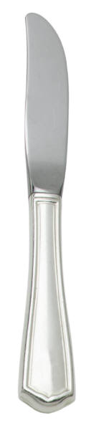
El mesero pone el cuchillo en la mesa.
el cuchillo
Click here to return to vocabulary words.

Slide 10
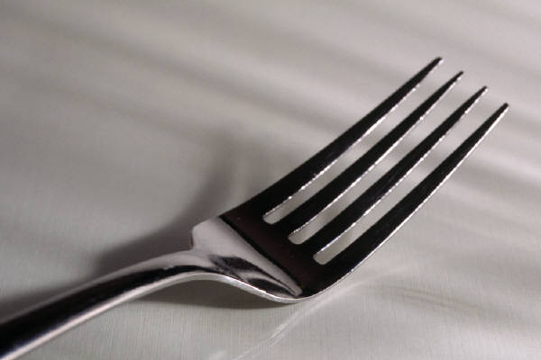
El mesero pone el tenedor en la mesa.
el tenedor
Click here to return to vocabulary words.

Slide 11
El mesero pone el mantel en la mesa.
el mantel
Click here to return to vocabulary words.

Slide 12
El mesero pone la taza en la mesa.
la taza
Click here to return to vocabulary words.

Slide 13
El mesero pone el vaso en la mesa.
el vaso
Click here to return to vocabulary words.

Slide 14
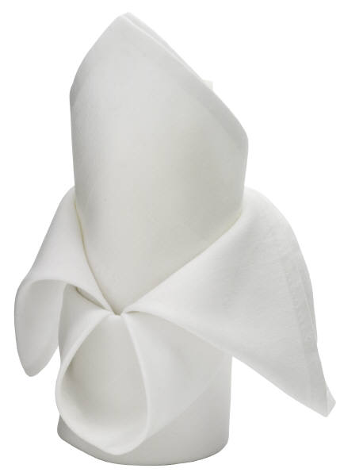
El mesero pone la servilleta en la mesa.
la servilleta
Click here to return to vocabulary words.

Slide 15
Click on the audio button to hear the question.
Click on the picture of the vocabulary word spoken.
el plato
Click for next slide

Slide 16
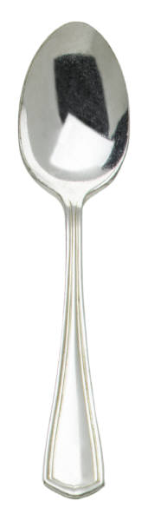
Click on the audio button to hear the question.
Click on the picture of the vocabulary word spoken.
el cuchillo
Click for next slide

Slide 17
Click on the audio button to hear the question.
Click on the picture of the vocabulary word spoken.
el mantel
Click for next slide

Slide 18

Click on the audio button to hear the question.
Click on the picture of the vocabulary word spoken.
la taza
Click for next slide

Slide 19
Click on the audio button to hear the question.
Click on the picture of the vocabulary word spoken.
el vaso
Click for next slide

Slide 20
Resource
Buen Viaje Level 2 The McGraw Hill Companies

