Slide 1
Reflection:
This artifact demonstrates my understanding of basic geometry definitions. It also provides an example of a creative approach to teaching students basic geometry concepts by demonstrating to the students that we are surrounded by geometric features in all aspects of our lives.
This task required me to review the definitions of certain geometric features. I also spent a considerable amount of time learning the finer points of Power Point, which I’m certain will benefit me in the future. Additionally, I now have a better appreciation of how I can use technology to enhance my lessons.

Slide 2
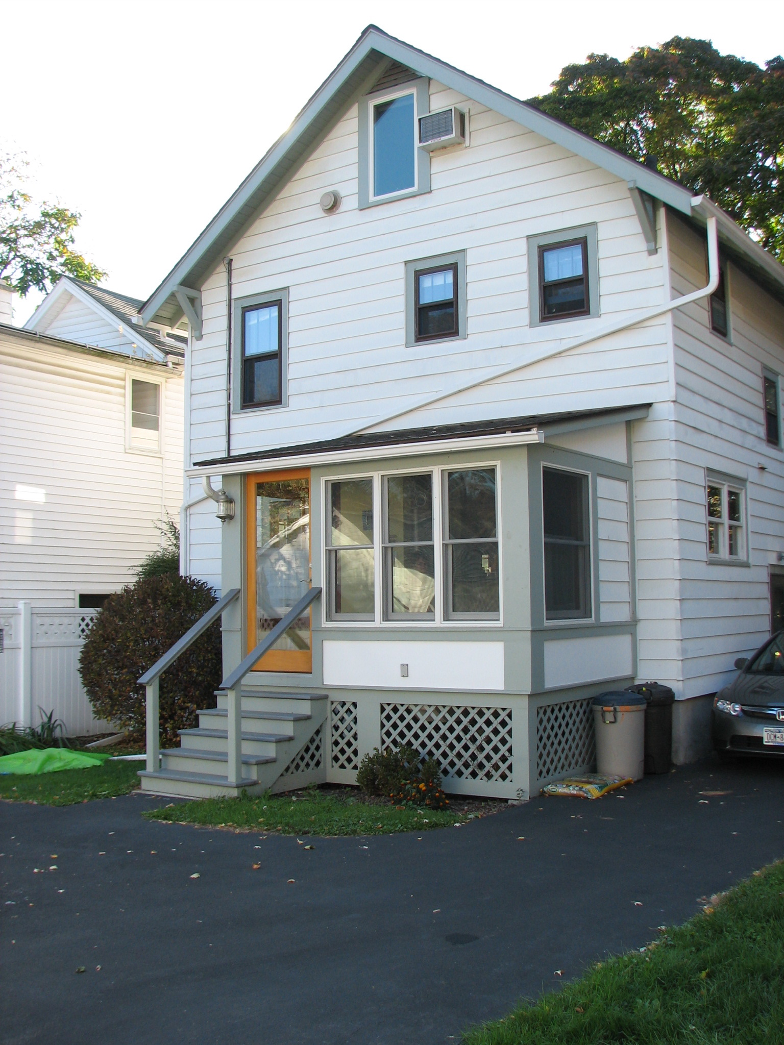
Geometry Lesson Plan by Mike Cecere
411 Auburn Street, Ithaca, NY, 14850

Slide 3
In this lesson we will locate hidden geometric features in the previous photo.
We will find the following:
a. Acute, right, obtuse, congruent, and adjacent supplementary angles
b. Parallel, non-perpendicular and perpendicular lines
c. Isosceles, and right triangles
d. Rectangle, rhombus, and square quadrilaterals
e. Pentagon
f. Symmetric, non-symmetric, and concave polygons
g. Polygon composed by two (or more) smaller polygons
h. Mirror image

Slide 4
Can you find one or more acute angles?
An acute angle is an angle that measures less than 90 degrees.

Slide 5
Here are some acute angles -

Slide 6
Can you find one or more right angles?
A right angle is an angle that measures exactly 90 degrees.

Slide 7
Here are some right angles -

Slide 8
Can you find one or more obtuse angles?
An obtuse angle is an angle that measures greater than 90 degrees.

Slide 9
Here are some obtuse angles -

Slide 10
Can you find one or more congruent angles?
Congruent angles have the same angle in degrees.

Slide 11
Here are two pairs of congruent angles -

Slide 12
Can you find one or more adjacent supplementary angles?
`
Adjacent supplementary angles are two angles next to each other that add up to 180 degrees.

Slide 13
Here are two pairs of adjacent supplementary angles -

Slide 14
Can you find one or more pair of parallel lines?
`
Parallel lines are lines that never intersect (i.e. they have the same slope).

Slide 15
Here are some parallel lines -

Slide 16
Can you find one or more pair of non-perpendicular lines?
`
Non-perpendicular lines are lines that do not form congruent, adjacent angles at their point of intersection.

Slide 17
Here are some non-perpendicular lines -

Slide 18
Can you find one or more pair of perpendicular lines?
`
Perpendicular lines are lines that form congruent, adjacent angles at their point of intersection.

Slide 19
Here are some perpendicular lines -

Slide 20
Can you find one or more isosceles triangles?
`
An isosceles triangle has two sides that are equal in length.

Slide 21
Here is an isosceles triangle -

Slide 22
Can you find one or more right triangles?
`
A right triangle is a triangle with one angle that is exactly 90 degrees.

Slide 23
Here is a right triangle -

Slide 24
Can you find one or more rectangles?
`
A rectangle is a quadrilateral that has four 90 degree angles .

Slide 25
Here is a rectangle -

Slide 26
Can you find one or more rhombuses?
`
A rhombus is a four-sided polygon in which every side has the same length.

Slide 27
Here is a rhombus -

Slide 28
Can you find one or more squares?
`
A square is a four-sided polygon with four equal sides and four 90 degree angles.

Slide 29
Here are some squares -

Slide 30
Can you find one or more pentagons?
`
A pentagon is a five-sided polygon.

Slide 31
Here is a pentagon -

Slide 32
Can you find one or more symmetric polygons?
`
A symmetric polygon is a polygon that has at least one plane of symmetry.

Slide 33
Here are some symmetric polygons -

Slide 34
Can you find one or more non-symmetric polygons?
`
A non-symmetric polygon is a polygon that doesn’t have a plane of symmetry.

Slide 35
Here is a non-symmetric polygon -

Slide 36
Can you find one or more concave polygons?
`
A concave polygon is a polygon that has at least one angle greater than 180 degrees.

Slide 37
Here is a concave polygon -

Slide 38
Can you find a polygon composed by two (or more) smaller polygons?
`

Slide 39
Here is a polygon composed by more than two smaller polygons -

Slide 40
Can you find a polygon that is a mirror image of another polygon?
`

Slide 41
Here are two polygons that are a mirror image of one another -

Slide 42
Some geometry standards targeted in this assignment are:
3.G.1 Define and use correct terminology when referring to shapes
4.G.1 Identify and name polygons, recognizing that their names are related to the number of sides and angles
4.G.2 Identify points and line segments when drawing plane figures
4.G.6 Draw and identify intersecting, perpendicular, and parallel lines
4.G.8 Classify angles as acute, obtuse, right, and straight
5.G.4 Classify quadrilaterals by properties of their angles and sides
5.G.6 Classify triangles by properties of their angles and sides

Slide 43
Final Thought
We are surrounded by geometric shapes in our everyday lives. Use a critical
geometry-seeking eye to find angles and shapes the next time you are walking
around town. Look at buildings/homes, traffic signs, playgrounds,
automobiles, etc.

