Slide 1
Pronoun Baseball
Created by Sasha Endo for ICC 523, SUNY Cortland
October 29, 2012
Baseball vocabulary
Parts of a Sentence
Pronouns

Slide 2
Baseball Positions Click the number to see the name

Slide 3
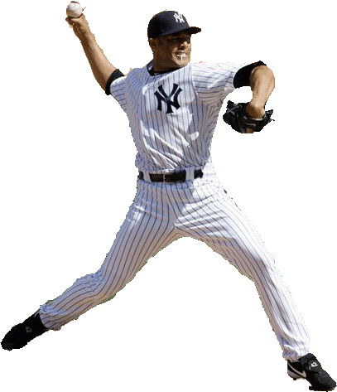
Parts of a Sentence Click on each word in the example to learn what part of the sentence it is called.
Subject – the person or thing doing the action in the sentence
Object – the person or thing affected by the action in the sentence
Object
Subject
Action
Object
Example: The pitcher throws the ball to the catcher.

Slide 4
Identify the Action, Subject(s), and Object(s) Click on the words below to check your answers.
Subject
Object
Action
Object
The batter hits the ball to the shortstop.

Slide 5
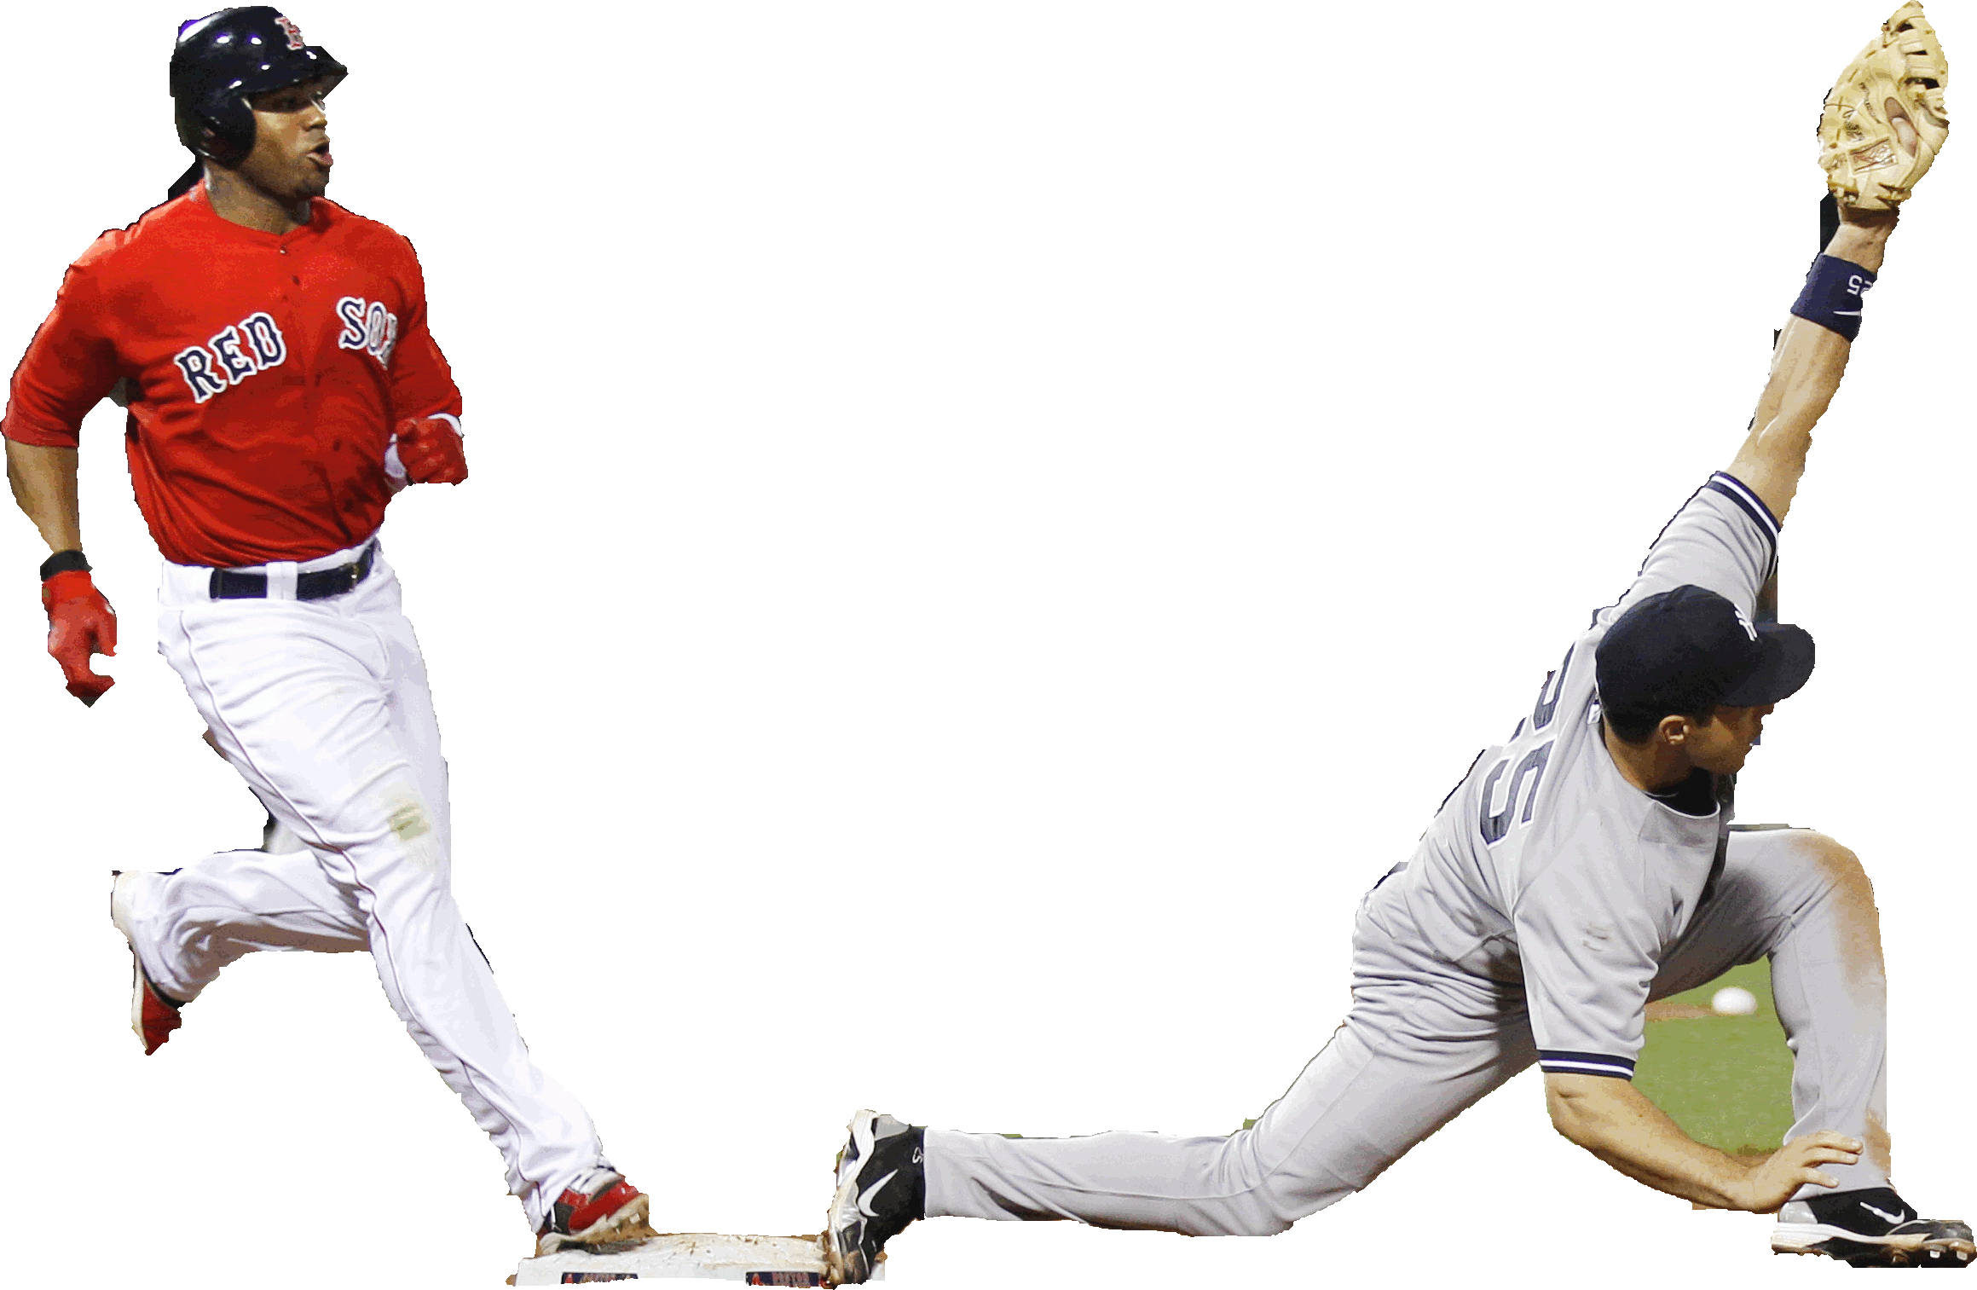
Identify the Action, Subject(s), and Object(s) Click on the words below to check your answers.
Subject
Subject
Action
Object
The batter and the first baseman touch the plate.

Slide 6
Pronouns: the small words that can replace nouns in a sentence
Subject Pronouns (replace the subject):
I
you
he / she / it
we
they
Object Pronouns (replace the object):
me
you
him / her / it
us
them

Slide 7
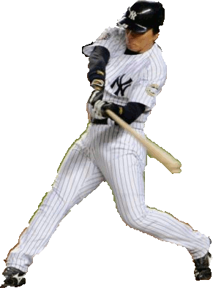
Decide which pronoun should replace each noun below. Click on the options on the lines to check your answers.
Subject Pronouns:
I
you
he / she / it
we
they
Object pronouns:
me
you
him / her / it
us
them
He
/ Him
him /
it
he /
him
_________ hits _______to _______________.
The batter hits the ball to the center fielder.

Slide 8
Decide which pronoun should replace each noun below.
Subject Pronouns:
I
you
he / she / it
we
they
Object pronouns:
me
you
him / her / it
us
them
He
it
him
_________ hits _______to _______________.
The batter hits the ball to the center fielder.

Slide 9
Decide which pronoun should replace each noun below. Click on the options on the lines to check your answers.
Subject Pronouns:
I
you
he / she / it
we
they
Object pronouns:
me
you
him / her / it
us
them
She
/ Her
he / him /
it
_________ slides into __________.
The batter slides into the plate.

Slide 10
Decide which pronoun should replace each noun below.
Subject Pronouns:
I
you
he / she / it
we
they
Object pronouns:
me
you
him / her / it
us
them
She
it
_________ slides into ______.
The batter slides into the plate.

Slide 11
Decide which pronoun should replace each noun below. Click on the options in the lists to check your answers.
Subject Pronouns:
I
you
he / she / it
we
they
Object pronouns:
me
you
him / her / it
us
them
She
it
__________ catches _______.
The catcher catches the ball.

Slide 12
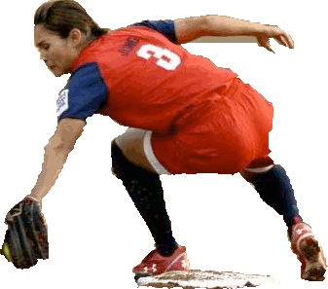
Decide which pronoun should replace each noun below. Click on the options in the lists to check your answers.
Subject Pronouns:
I
you
he / she / it
we
they
Object pronouns:
me
you
him / her / it
us
them
She
him
it
___________________ tags _________ with _______.
The first basewoman tags the batter with the ball.

Slide 13
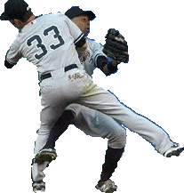
Decide which pronoun should replace the noun below. Click on the noun to check your answer.
They
__________________ collide.
The two outfielders collide.

Slide 14
Decide which pronoun should replace each noun in the listening example. Click on the options in the lists to check your answers.
Subject Pronouns:
I
you
he / she / it
we
they
Object pronouns:
me
you
him / her / it
us
them
She
it
_____________ catches ________.
Subject (female) verb object

Slide 15
We win!
Thanks for playing!

Slide 16
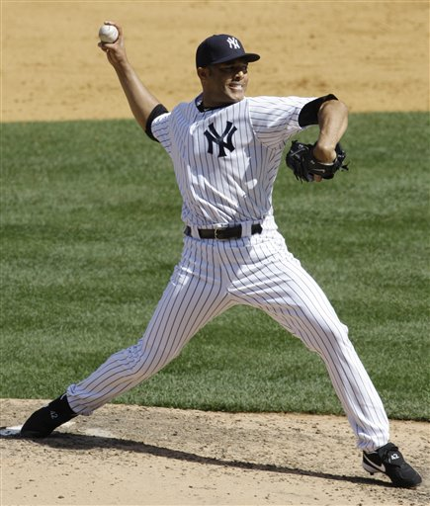
Works Cited
http://yankees.lhblogs.com/wp-content/uploads/2010/05/Rivera.jpg
http://ihatelupica.blogspot.com/2011_01_01_archive.html
http://llleaguesports.com/l-l-league-baseball-all-stars/19786/
http://www.chicagotribune.com/sns-mlb-pg-267,0,7537079.photo
http://espn.go.com/blog/boston/red-sox/post/_/id/17659/soxprospects-up-and-coming-outfielders

Slide 17
Works Cited
http://www.timesunion.com/sports/article/Red-Sox-upbeat-despite-loss-3519839.php
http://www.wbur.org/2011/08/06/red-sox-59
http://espn.go.com/espn/thelife/news/story?id=4105979
http://www.nj.com/yankees/index.ssf/2012/05/yankees_narrowly_avoid_disaste.html
http://www.zimbio.com/pictures/BqYFuJ-dpZl/Boston+Red+Sox+v+New+York+Yankees/z22wPf8y23H/Derek+Jeter

Slide 18
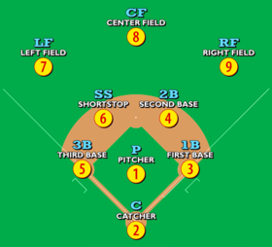
Works Cited
http://bostondirtdogs.boston.com/Headline_Archives/2006/09/cant_quit_strok.html
http://www.dailymail.co.uk/sport/othersports/article-1225383/Baseball-Hideki-Matsui-inspires-New-York-Yankees-win-World-Series-record-27th-time.html
http://kennedyscommentary.blogspot.com/2011/01/red-sox-rotation-key-to-success-in-2011.html
http://en.wikipedia.org/wiki/Baseball_positions
http://urbansavvy.com/news/?p=25

Slide 19
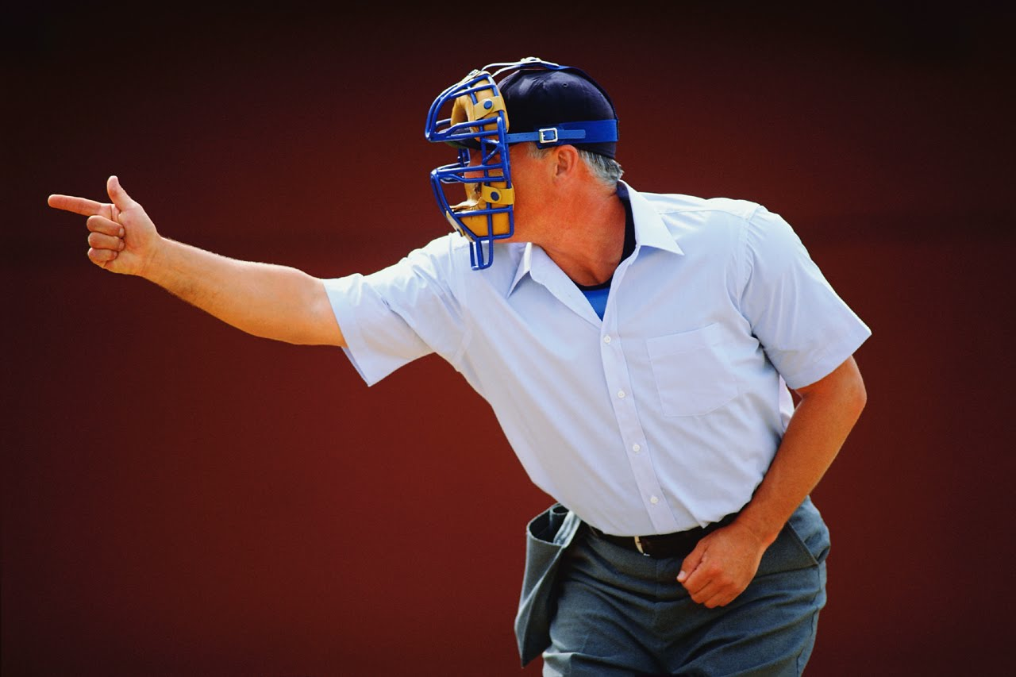
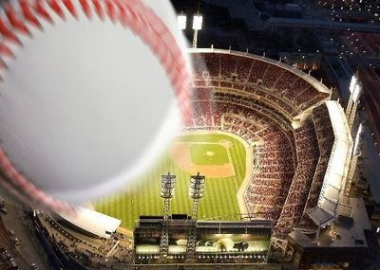
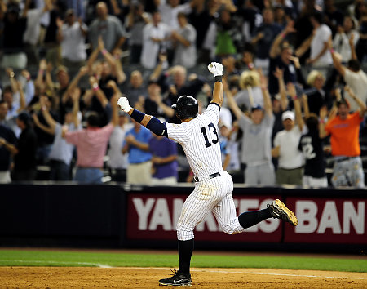
Works Cited
http://women.2701.us/2012/08/09/solo-parenting-three-strikes-youre-in/
https://www.sbyouthbaseball.com/Home%20Run%20Club.aspx
http://articles.nydailynews.com/2009-08-07/sports/17930220_1_phil-coke-yankee-stadium-burnett
http://www.stack.com/softball-drills/
http://patrickmeredith.blogspot.com/

Slide 20
Works Cited
http://www.2008.nbcolympics.com/athletes/athlete=132/bio/index.html
http://www.poyi.org/65/06/second_01.php
http://latimesblogs.latimes.com/olympics_blog/softball/index.html
http://uk.eurosport.yahoo.com/01102012/5/photo/01102012001635.html
http://asapblogs.typepad.com/news/photo/

Slide 21
Strike!!!!
Click on the screen to return
to the previous slide.
Try again.

Slide 22
Home Run!!!
Click on the screen to return
to the previous slide.
You win a point for your team!

