Slide 1
English Listening Class
Making suggestions
Su Min Son

Slide 2
[Lead-in] Before Watching the Video
1.
Why is Susan so depressed?
2.
What do her friends tell her to do?

Slide 3

[Lead-in] Watching the Video

Slide 4
[Lead-in] After Watching the Video
1.
Why is Susan so depressed?
She has a problem with her kidney, and it is not easy to find a donor.
2.
What do her friends tell her to do?
They suggest her to find a donor herself, and are willing to help her to find one.

Slide 5
The Vocabulary
abusive
harass
hang up
prisoner
upset
insurance

Slide 6
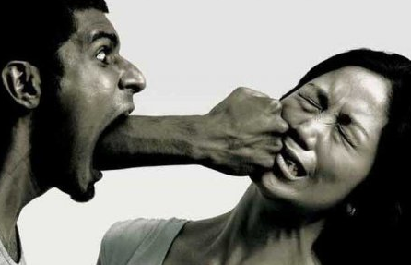
abusive
adj. using cruel words or physical violence
Smith denies using abusive language to the referee.

Slide 7

hang up
v. to end a telephone call by suddenly and unexpectedly putting the telephone down to end a telephone conversation by putting the telephone receiver down or switching the telephone off
I was talking and he just hung up the phone.

Slide 8


upset
v. to make someone feel unhappy or worried
Don't do anything that would upset him.

Slide 9

harass
v. to make someone's life unpleasant, for example by frequently saying offensive things to them or threatening them
A number of black youths have complained of being harassed by the police.

Slide 10
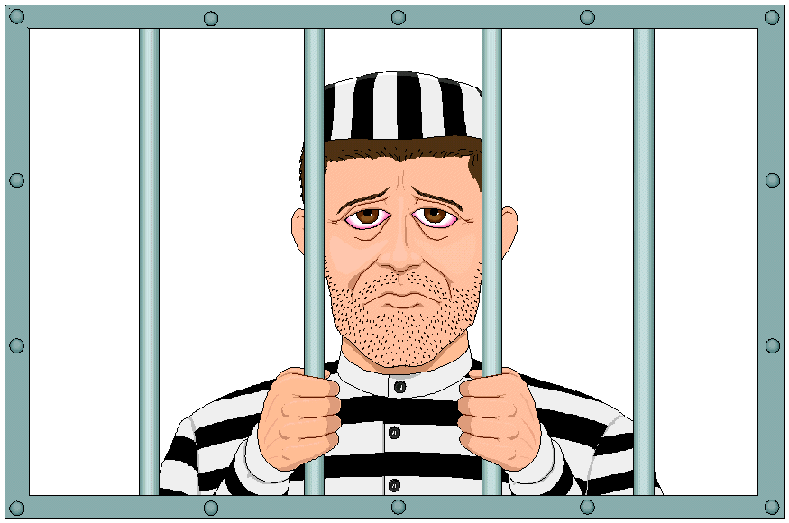
prisoner
n. someone who is taken by force and kept somewhere
The guerillas kept her prisoner for three months

Slide 11
insurance
n. an arrangement with a company in which you pay them money, especially regularly, and they pay the costs if something bad happens, for example if you become ill or your car is damaged
Your father took out insurance to cover the mortgage.

Slide 12
The Vocabulary Activity
1. Group work
2. 8 words for each group
3. The topic : “Conflict Between Parents & Children”
4. The first S making the first sentence with the first word
5. Take turns to make a story
6. Make a whole story in each group finally
7. Time : 2 min

Slide 13


Slide 14

Try again!

Slide 15
1st Listening
Listen carefully and choose the right answer.
1. What is the speaker’s job?
student
salesperson
counselor
2. Whom does the speaker have the conflict with?
brother
sister
parents
3. How much does it cost for her car insurance per a month?
$12/month
$20/month
$200/month

Slide 16
DEAR ABBY:
I'm a junior in college, but I don't feel like one. I am still afraid of my parents. My mom and dad never physically abused me or my brothers, but they were verbally abusive. They had a tough life, married young, and had my older brother and me while they were in their early 20s. They are now in their mid-40s and they still hate each other.
I get phone calls from home every day asking me where I am and what have I done, and if Mom doesn't like what I say, she hangs up and a few minutes later Dad calls to curse me out for "upsetting Mom" because she calls to harass him at work.
I am not going home this summer. I don't think of their house as a home. I have been in therapy for the past two years without telling them. I support myself and pay for my own schooling. The only thing I don't pay for is $200 a month for car insurance.
Abby, I love my parents, but I'm kept a virtual prisoner when I'm at home, and I'm physically ill from being harassed when I'm at school. Please print this; maybe one of them will read it.
- SHAKING SON IN THE BRONX

Slide 17
2nd Listening
Listen again and share the answers with your partner.
3 min.
1. Why does the speaker’s dad call her?
2. How does she try to get rid of her problem?
3. Tell all problems that she has.

Slide 18
DEAR ABBY:
I'm a junior in college, but I don't feel like one. I am still afraid of my parents. My mom and dad never physically abused me or my brothers, but they were verbally abusive. They had a tough life, married young, and had my older brother and me while they were in their early 20s. They are now in their mid-40s and they still hate each other.
I get phone calls from home every day asking me where I am and what have I done, and if Mom doesn't like what I say, she hangs up and a few minutes later Dad calls to curse me out for "upsetting Mom" because she calls to harass him at work.
I am not going home this summer. I don't think of their house as a home. I have been in therapy for the past two years without telling them. I support myself and pay for my own schooling. The only thing I don't pay for is $200 a month for car insurance.
Abby, I love my parents, but I'm kept a virtual prisoner when I'm at home, and I'm physically ill from being harassed when I'm at school. Please print this; maybe one of them will read it.
- SHAKING SON IN THE BRONX

Slide 19
Think Further
“What if you were Abby?”
Group
Work
(4 people)
3 min
Choose the best

Slide 20
Yesterday, you made up your mind
to go on a diet, but your mom forces
you to have a meal.
What would you do?
Your mom and dad are going to be
divorced. Yesterday, they asked
you, “Whom do you want to live
with, mom or dad?”
You really love both of my parents.
What would you do?
A
A
Your mom promised you to buy
a pretty but expensive bag, but she
has kept delaying to buy it.
What would you do?
Your parents told you not to hang
out with your best friend anymore.
What would you do?
B
B

Slide 21
Post-listening
Pair work
Counselor A’s
suggestion for B
Counselor B’s
suggestion for A
5 min.
Try..
I suggest..
How/What about..?
Why don’t you..?
It might be a good idea if..
What do you think about..?
☆ Useful Expression ☆

Slide 22
Let’s Wrap it up!
Topic
(video clip)
Voca
Listening
What if?
Role-play

Slide 23
Thank you !

