Slide 1
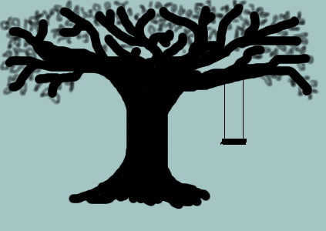
What do we do in Spring?
Present Progressive Tense
Click here to begin

Slide 2

-ing ending
If something is happening right now, we add “-ing” to the end of the verb to express that.
fly + ing = flying

Slide 3


Fly fly + ing = flying
Plant plant + ing = planting
Jump jump + ing = jumping
Clean clean + ing = cleaning
Play play + ing = playing

Slide 4
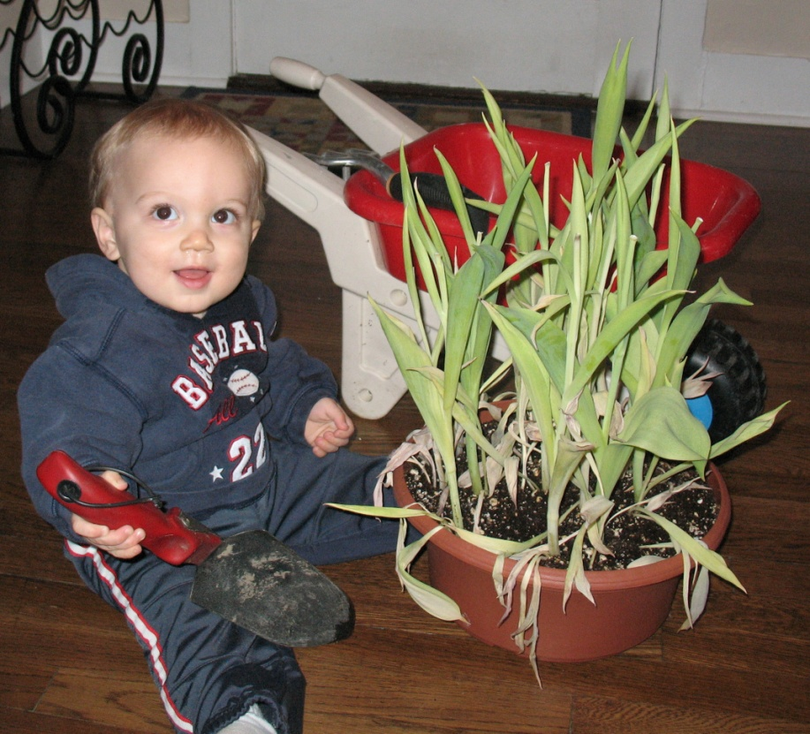
What is he doing?
He is cleaning the house.
He is planting flowers.

Slide 5
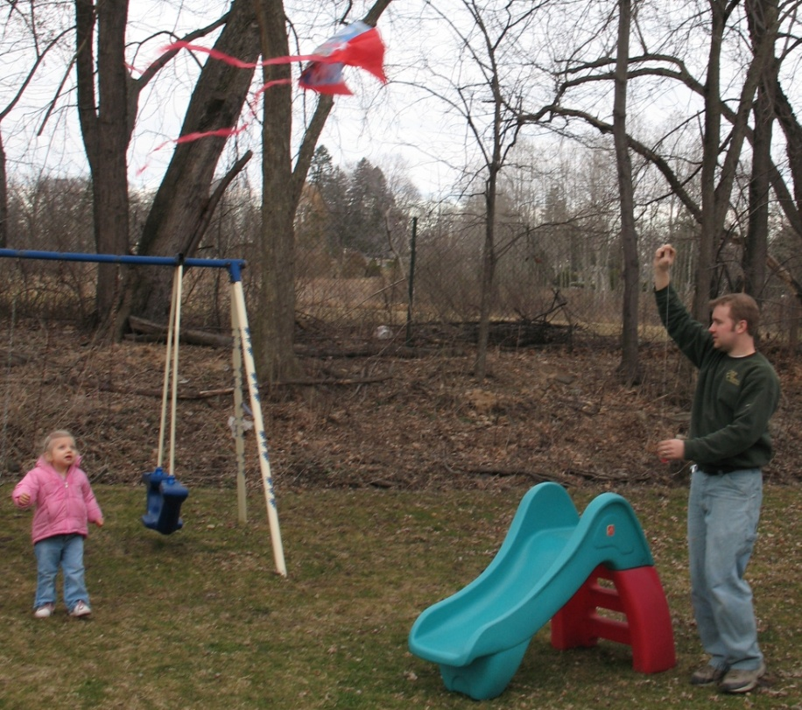
What are they doing?
They are flying a kite.
They are planting flowers.

Slide 6
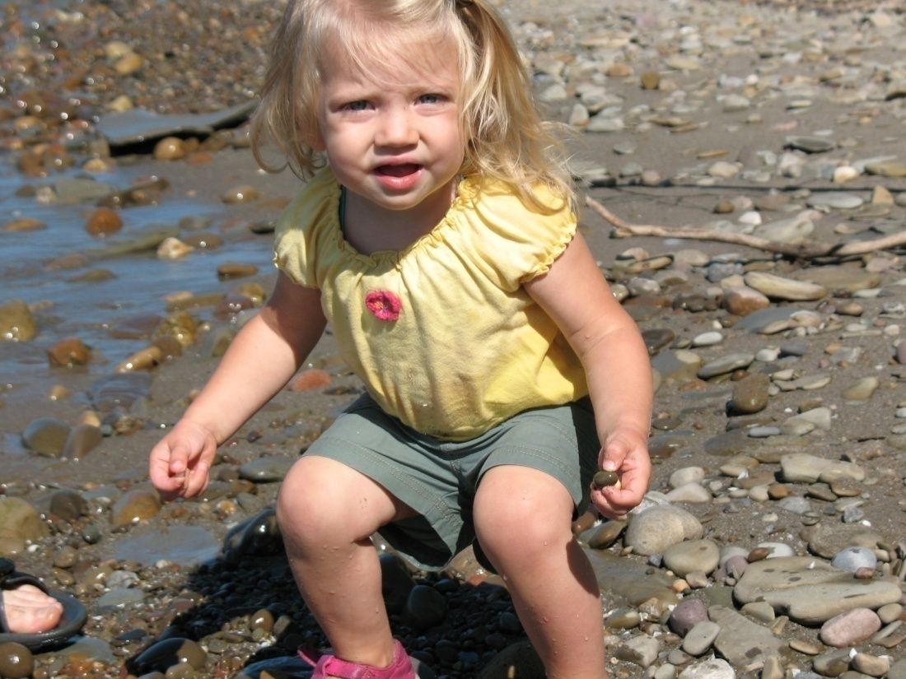
What is she doing?
She is jumping in puddles.
She is cleaning the house.

Slide 7
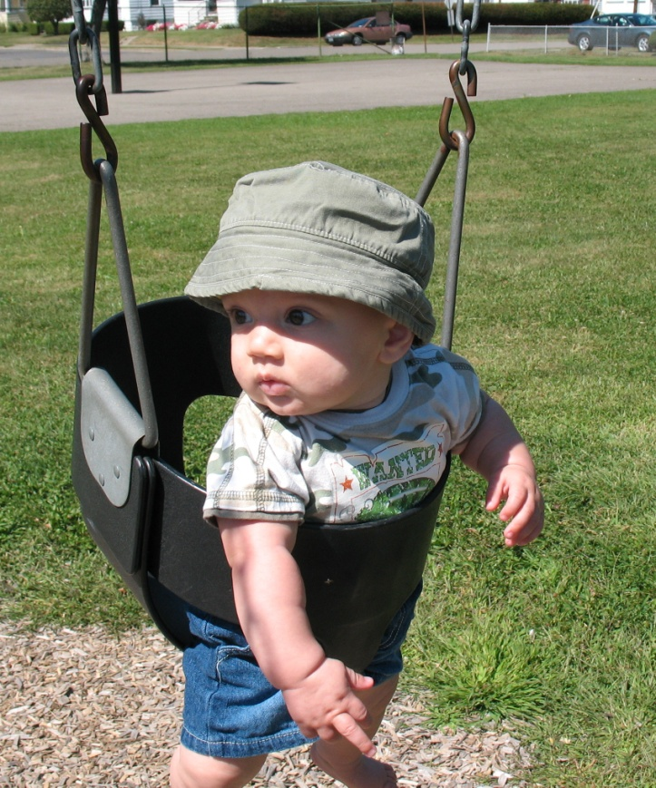
What is he doing?
He is planting flowers.
He is playing in the park.

Slide 8
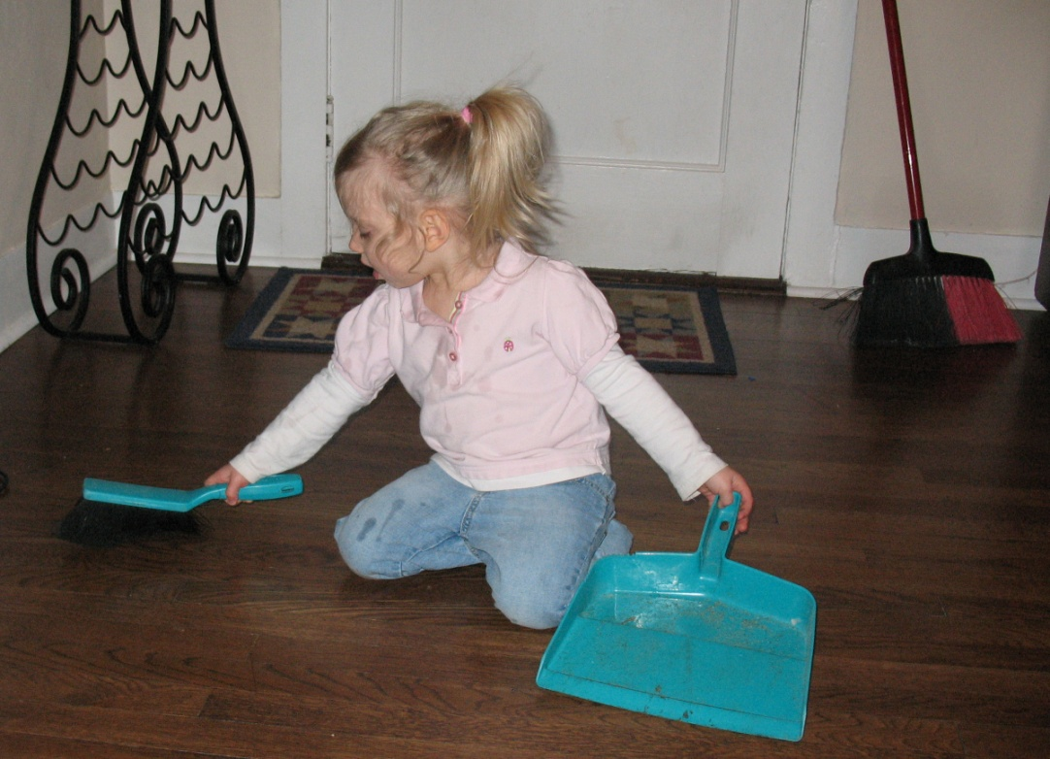
What is she doing?
She is cleaning the house.
She is jumping in puddles.

Slide 9
Sorry! Try again.

Slide 10
Excellent!!

Slide 11
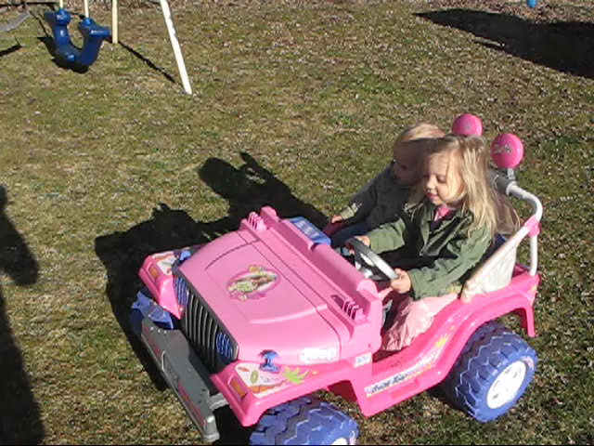
The End

