Slide 1
CORAL REEFS
“Rainforests of the Oceans”
By: Jaime Denny and Mary Wood

Slide 2
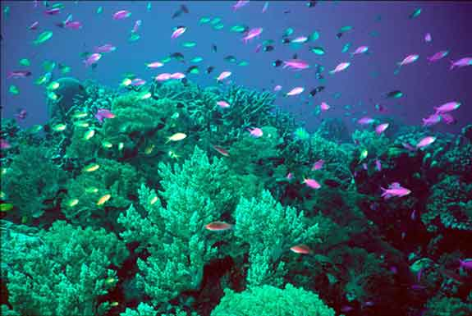
Coral Reefs
Marine Animals
Class - Anthozoans
Phylum: Cnidaria
Sessile Animals
Live in shallow warm water that is nutrient starved between 30 degrees North and 30 degrees South of the equator
Each individual animal is called a polyp
Hard outer skeleton made of calcium carbonate

Slide 3
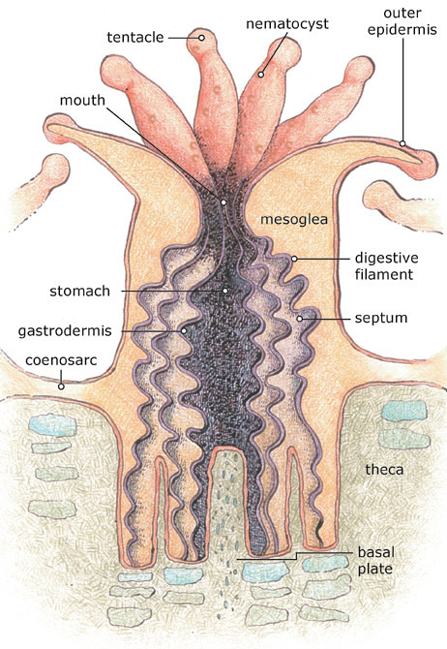
POLYP
Skeleton – hard outer shell made up of calcium carbonate - protection
Calcium carbonate is secreted at the base of the polyps and over time huge coral reefs can be formed
Different species of coral make different structures
Stomach takes up most of the polyps anatomy
Uses tentacles and nematocysts (stinging cells) to take in food
Waste also secreted through mouth

Slide 4
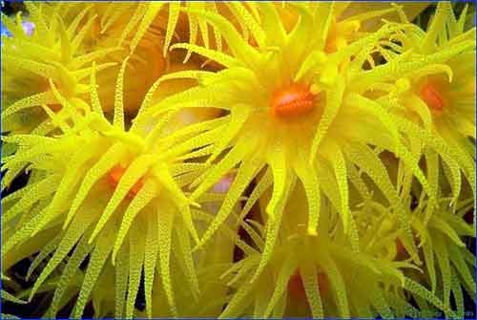
Tentacles
Help coral to capture plankton
Remove debris
Used for defense
Cnidocyte – cells unique to cnidarians – contain cnidae – stinging cell
Nematocysts – deliver this toxin to help capture prey

Slide 5
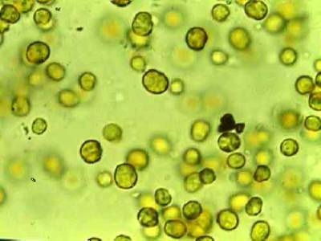
Zooxanthella
Algae – inside gastrodermal cells
Symbiotic relationship – key to the biological diversity and the limestone secreting capacity of reef building corals
Algae provide coral
Help with waste removal
Oxygen
Organic products of photosynthesis
Glucose, glycerol, amino acids
Used for the manufacture of
Proteins
Fats
Carbohydrates
Synthesis of calcium carbonate (CaCO3)
Coral provides algae
Protective environment
Compounds necessary for photosynthesis
Carbon dioxide (from coral respiration)
Inorganic nutrients
Nitrates and phosphates (coral metabolic waste products.

Slide 6
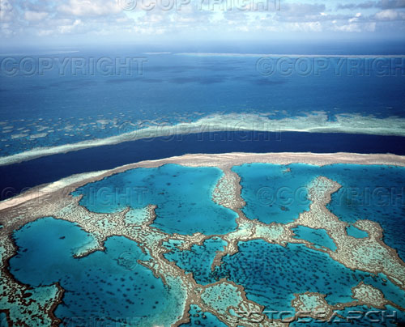
Types of Coral Reefs
Fringing – attached directly to shore or borders it with a shallow channel or lagoon in between
Barrier – separated from the shore by a large lagoon. (The Great Barrier Reef in Queensland, Australia
Atolls – reefs that surround a lagoon
Created when an island that is surrounded by a reef sinks below the ocean surface.

Slide 7
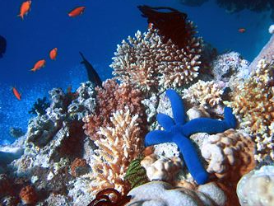
Importance of Coral Reefs
Home to many types of fish
These fish feed approximately 30 to 40 million people per year
Many of these fish are sold as pets also contribute to the economy
Control the amount of carbon dioxide in the ocean (Reefs use carbon dioxide to make their limestone shells)
Also protect the coasts from erosion (Great Barrier Reef)

Slide 8
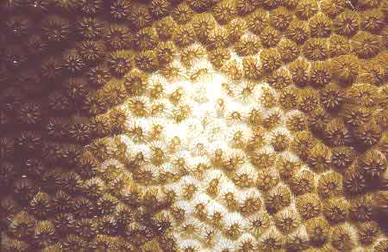
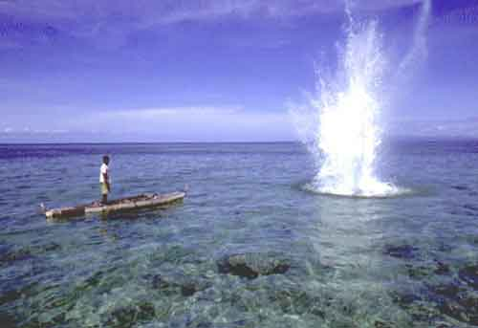
Destruction of Coral Reefs
Ten percent of all Coral Reefs have been destroyed
Global Warming
Reefs live within certain temperatures and salinity, the increase in ocean temperature has made the corals sick and then they die.
Even one degree rise in temperature can cause a lot of damage to the reefs.
Coral bleaching – algae inside leave or die which causes it to turn white
Physical Destruction by humans
Fisherman destroy the reefs by blowing up the reefs to catch fish and also use cyanide.

Slide 9
CREDITS
http://www.solcomhouse.com/coralreef.htm
http://oceanworld.tamu.edu/students/coral/coral2.htm

Slide 10
http://video.nationalgeographic.com/video/player/environment/habitats-environment/oceans/coral-reefs.html

