Slide 1
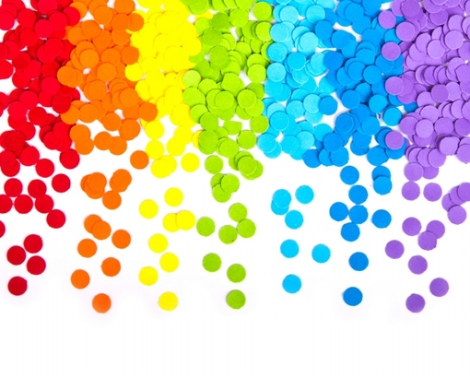
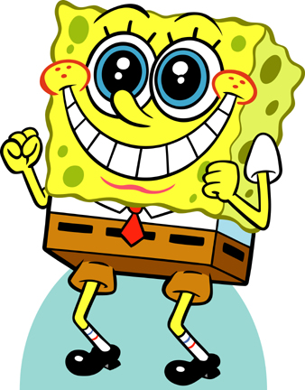
Learning Feelings
SWBAT:
Know the meaning of the words for basic feelings;
Describe feelings;
Develop the awareness of feelings in different cultures.
Are you ready?

Slide 2
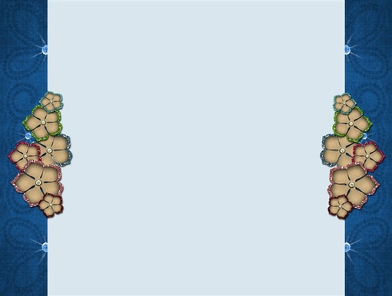
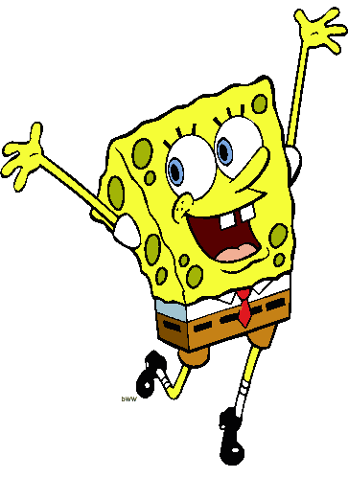
Content
Get to know the meaning of the emotion words
Practice the words with the videos
Role play
Emotions and culture

Slide 3
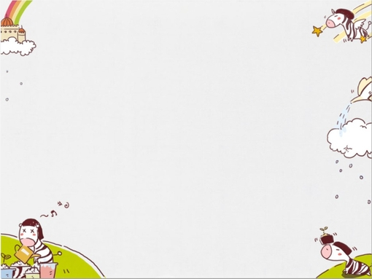
Get to know the meaning
Read each sentence and choose the correct word.

Slide 4
If you see a monster, will you feel scared or sad?
scared
sad

Slide 5
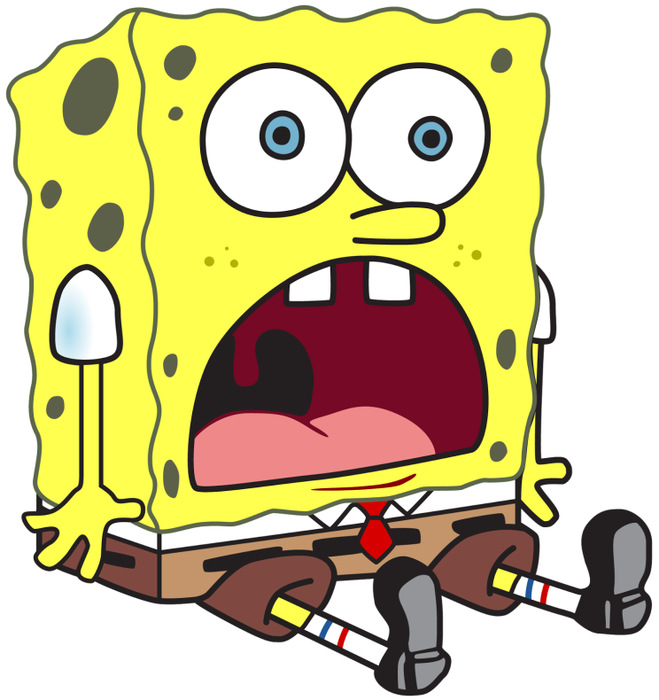
That’s right!
Scared means frightened.
You will certainly feel scared or frightened if you see a monster.
Next

Slide 6
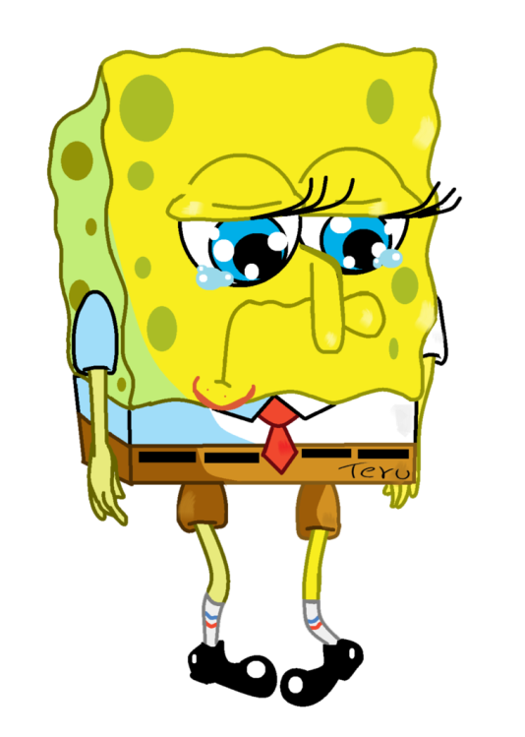
Oops!
Sad means you are unhappy.
You feel sad when you lost all your candy.
Try again

Slide 7
If you receive a gift that you wanted it for a long time, will you be shy or surprised?
shy
surprised

Slide 8
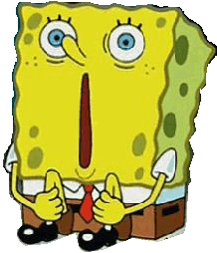
That’s right!
You are surprised at something because it’s unexpected or unusual.
Getting a wanted gift without knowing it will make you surprised.
Next

Slide 9
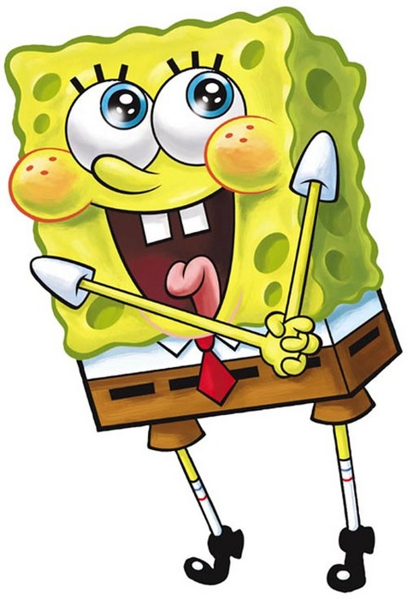
Oops!
You feel shy when you are uncomfortable in the company of other people.
You will probably feel shy if you spoke in front of the whole class.
Try again

Slide 10
If you get straight As on your report card, will you feel happy or bored?
happy
bored

Slide 11
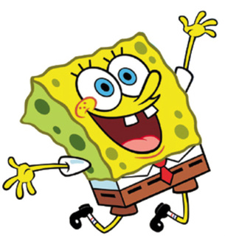
That’s Right
You feel happy because something nice happens.
You will be very happy when you get all As.
Next

Slide 12
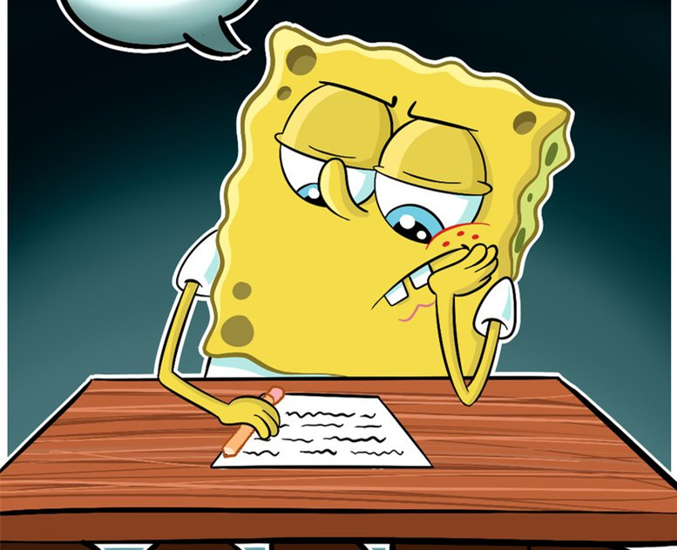
Oops!
Bored means you don’t have interests in something and get tired.
You will be bored, if you watch the advertisement on TV for one hour.
Try again

Slide 13
If you only sleep for 2 hours last night, will you be excited or sleepy?
excited
sleepy

Slide 14
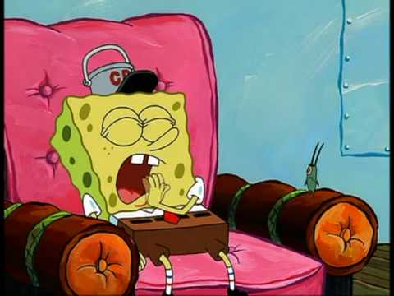
That’s right!
If you are sleepy, you are very tired and almost asleep.
Only sleeping for 2 hours one day will certainly make you sleepy.
Next

Slide 15
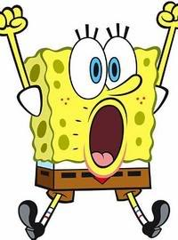
Oops!
If you feel excited, you will be too happy to relax, because you always think about something nice is going to happen to you.
You will feel excited if you meet your idol.
Try again

Slide 16
If your best friend lies to you, will you feel angry or bored?
angry
bored

Slide 17
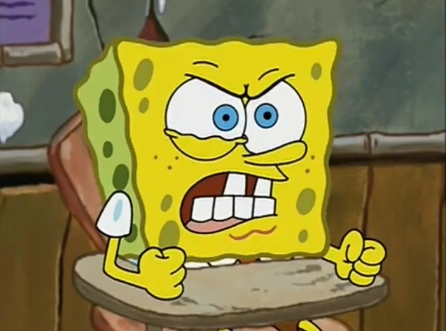
That’s Right
When you feel angry, you feel strong dislike about something or someone.
You will be very angry when your best friend lies to you.
Next

Slide 18
Oops!
Bored means you don’t have interests in something and get tired.
You will be bored, if you watch the advertisement on TV for one hour.
Try again

Slide 19
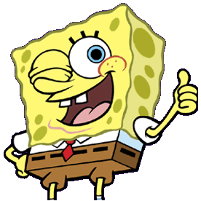
If you finished this game…
…you have a better understanding of the vocabulary for emotions.

Slide 20
Practice with the videos
Watch each video and choose the correct answer.

Slide 21
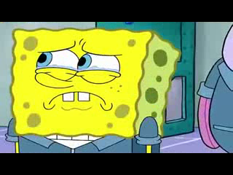
sad
angry
SpongeBob feels _______ and _______, so he leaves.
Sad
Surprised
No…
Sleepy
No…
Happy
No…
Angry
Next

Slide 22
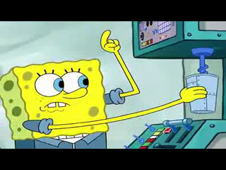
When SpongeBob says “oh, dear”, he feels _______, so he is sweating.
scared
Surprised
No…
Bored
No…
Scared
Next

Slide 23
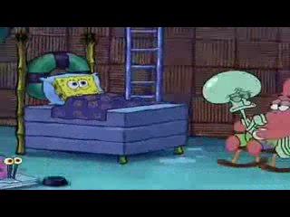
SpongeBob tries to sleep, because he feels very _______.
sleepy
Surprised
No…
Sleepy
Bored
No…
Next

Slide 24
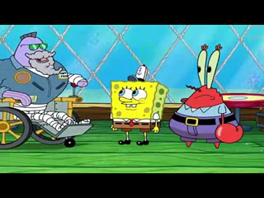
When SpongeBob gets his license, he is _______ and _______, so he laughs.
surprised
happy
Board
No…
Sleepy
No…
Surprised
Happy
Shy
No…
Next

Slide 25
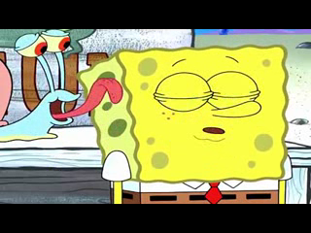
After the snail (Gary) licks SpongeBob, SpongeBob feels _______ and ______.
shy
excited
Shy
Bored
No…
Excited
Sleepy
No…
Sad
No…
Next

Slide 26
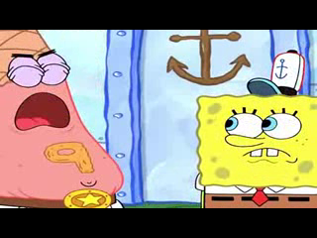
excited
SpongeBob feels very _______, because Patrick wants to be Patrick Man.
Scared
No…
Excited
Bored
No…

Slide 27
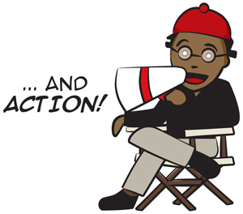
Role play
To be a friend and ask.

Slide 28
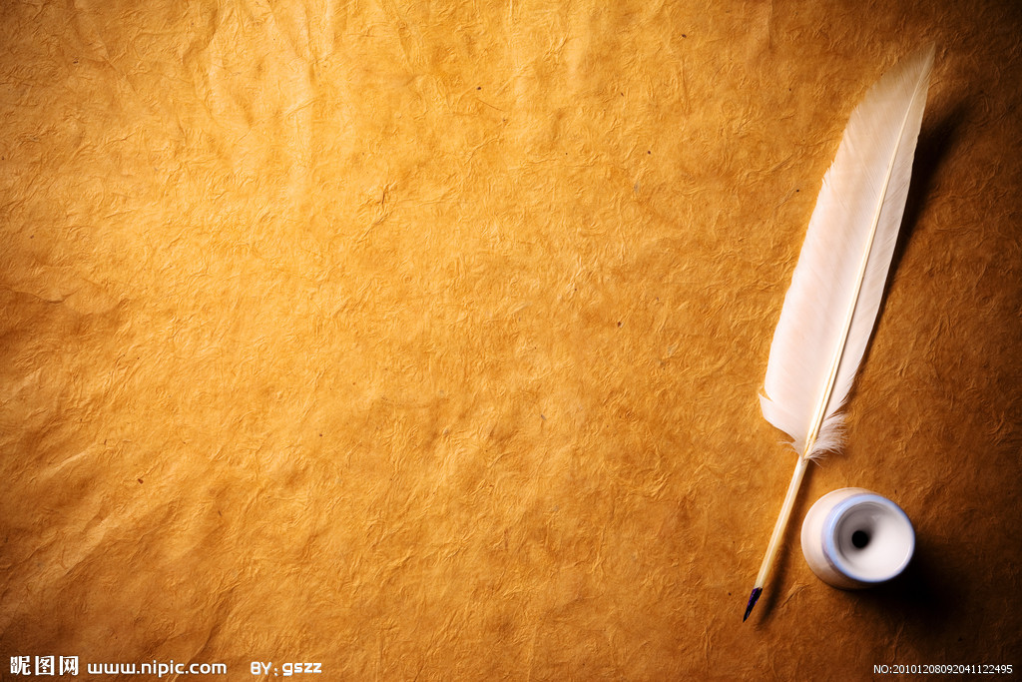
Instruction
Work in pairs
Each group spins the wheel one by one to get your emotion
Make a dialogue with your partner. You can start your conversation by “I feel .... (happy/sad)”. Your partner then asks why you feel that, and if possible, s/he can offer advice to you and make you feel better.

Slide 29
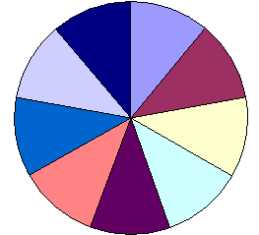

End Game
Role play
Sad
Bored
Group 1
Sleepy
Group 2
Excited
Group 3
The Big
Wheel
Group 4
Angry
Scared
Group 5
Group 6
Shy
Group 7
Surprised
Happy
Group 8
Group 9
Spin Wheel
I feel ...

Slide 30

Share your dialogue with all of us!

Slide 31
Emotions and culture
Try to answer the following two questions. You can guess!

Slide 32
Do you know... ?
According to the research, do you know there are 6 basic emotions around the whole world? Guess what they are.
Surprised
Disgusting
Happy
Shy
Cold
Hot
Sleepy
Angry
Scary
Confused
Sad
Bored

Slide 33
Do you know... ?
Do you know people from different countries express their emotions differently? Guess who are more expressive?
People in the Western countries, like America
People in the Eastern countries, like China

Slide 34

Good job!!!

