Slide 1
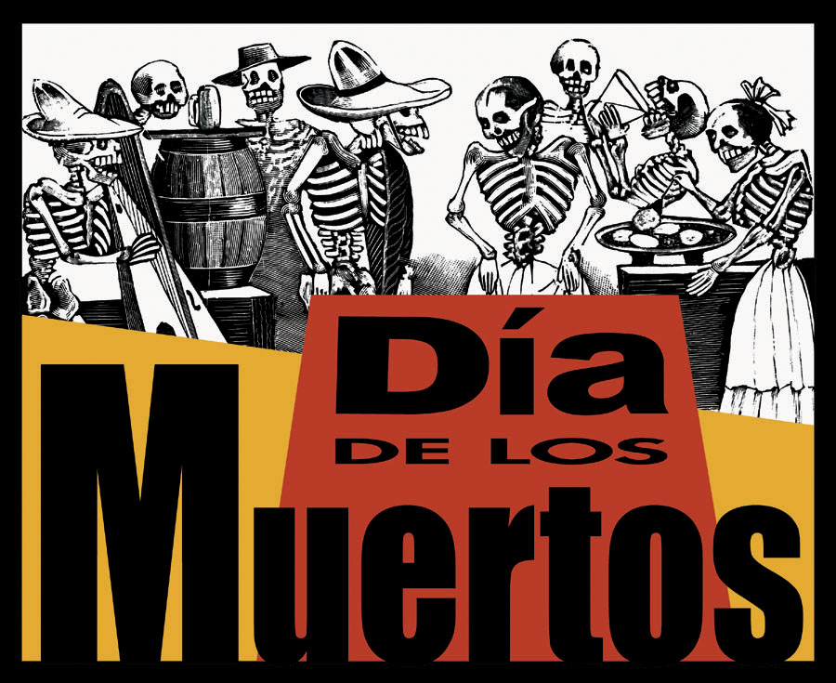
La historia
Hoy en día
La comida
Vocabulario
Prueba
Fuentes
A time to
Remember, Relive, & Rejoice

Slide 2
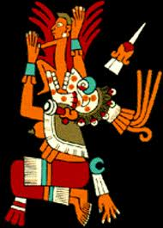
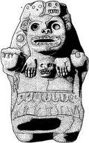
La historia
Día de los muertos has been celebrated since before the Spanish explorers came to South America.
When they arrived they observed the holiday as the Aztecs did – as a MONTHLONG celebration. The Aztecs believed that during this time, the spirits of the dead roamed the earth, and the purpose of the holiday was to honor them.
More History
Depictions of Mictecacihuatl – “Lady of death” The Aztec Goddess of el día de los muertos

Slide 3
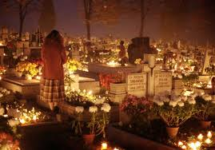
Más sobre la historia
For the Aztecs, death = continuation of life.
Life = dream
Death = awake
For Spaniards death = the end of life. The idea of spirits living among them for a month was scary.
To make the ritual more Christian, it was moved so that it was celebrated on the same days as All Saints and All Souls days, November 1 and 2.
Back
Next
To How it’s celebrated today

Slide 4
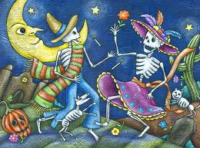
Hoy en día
Find out more about how Día de los muertos is celebrated today!!
Today, El día de los muertos is celebrated in Mexico, Guatemala and certain parts of los Estados Unidos. Although this celebration is associated with death, it’s NOT sad. It’s a celebration of a life well lived. It is about family, happiness, colors, excitement and remembrance. The people express and celebrate their culture through the crafts, decorations and food that they make in honor of their loved ones.
Back
To History

Slide 5
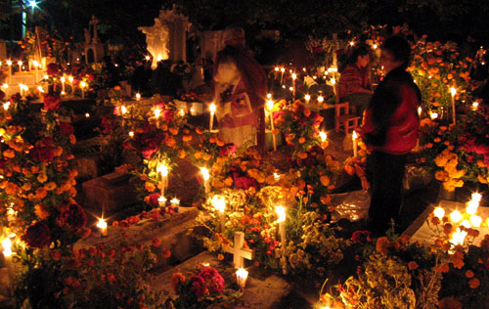
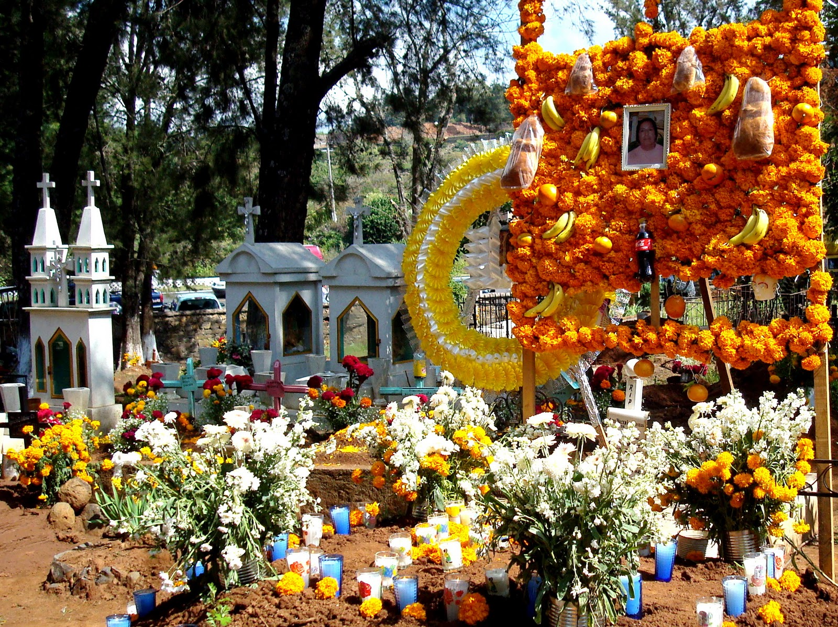
Hoy en día
Find out more about how Día de los muertos is celebrated today!!
Families celebrate by going to the cemeteries where their loved ones are buried on November 2. They clean and decorate the graves with candles and flowers. They put up pictures and leave food and gifts for the spirits. Candlelight vigils are held to honor the dead.
Back

Slide 6
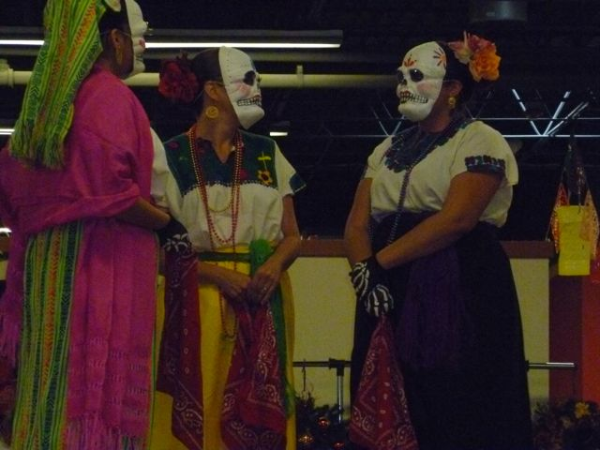
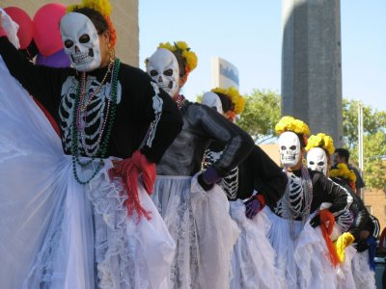
Hoy en día
In many communities people come together and dance to honor the dead.
Find out more about how Día de los muertos is celebrated today!!
Back

Slide 7
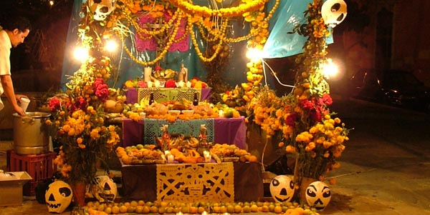
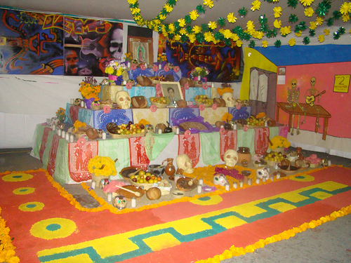
El altar de muerto
Hoy en día
Families construct altars in their homes to honor their loved ones who have passed. On top of the altar are las ofrendas – offerings of the favorite food and drink of the person being honored. There are also pictures, clothing, personal items and other posessions of this family member. La ofrenda also includes candles, flowers, paper decorations and candy skulls.
Back
Next
To la comida

Slide 8
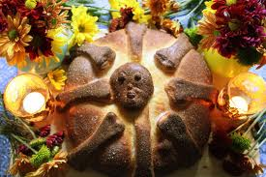
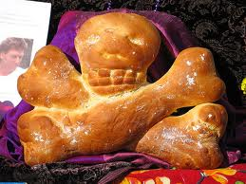
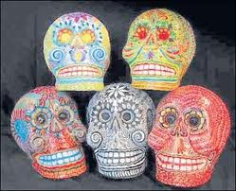
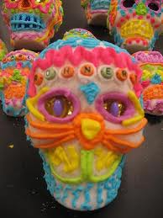
La comida
A special meal is also cooked and eaten by family members in remembrance of their ancestors and loved ones. Each altar is laden with food that is set out for the spirits to feast on as well. Tamales and mole are popular Mexican dishes eaten on this feast day, but there are certain foods that are always made:
Pan de Muertos (bread of the dead) – flat bread baked in the shape of a skull and crossbones. In each loaf there is a plastic toy skeleton hidden. Whoever bites into that piece is supposed to have good luck for a year.
Sugar Skulls – candies made as treats for the children. These often end up on the altar and many times the name of the person being honored is written across the forehead.
Next
Back
To hoy en día
To vocabulary

Slide 9
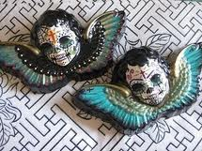
Vocabulario y otros palabras útiles
Angelitos “little angels” - The souls of little children. These are the souls that return first for the celebration. There are often smaller altars built for children with smaller plates and toys.
Back
More vocab
To la comida

Slide 10
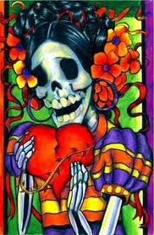
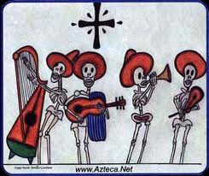
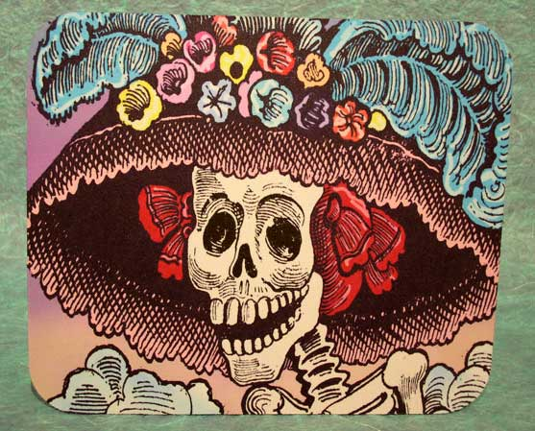
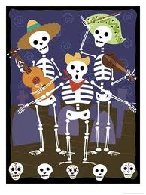
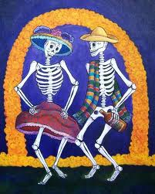
Vocabulario y otros palabras utiles
Calacas - Whimsical skeleton figures that represent death.
Back
More vocab

Slide 11
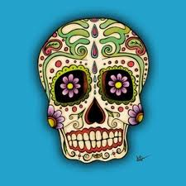
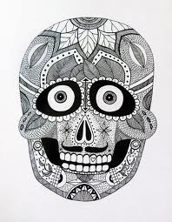
Vocabulario y otros palabras utiles
Calaveras – Decorative skulls that are often part of las ofrendas on the altar.
Back
More vocab

Slide 12
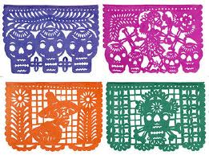
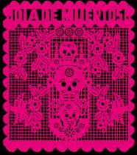
Vocabulario y otros palabras utiles
Papel picado – Colorful tissue paper decorations with intricate designs cut out. They are placed on the altar as part of las ofrendas as well.
Back
More vocab

Slide 13
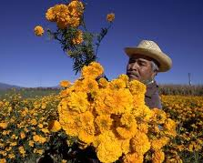
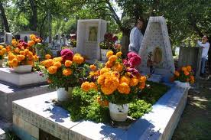
Vocabulario y otros palabras utiles
Cempazuchitl – A yellow marigold, the symbol of death. These petals are sprinkled through out the cemeteries and pinned on the displays both in cemeteries and on the altars.
Back

Slide 14
Una Pruebita
True or False – Read the following statements and if they are true, click cierto, if they are false, click falso.
1. For the Aztecs, death was the end of life.
CIERTO
FALSO
Move on to the next question

Slide 15
Una Pruebita
True or False – Read the following statements and if they are true, click cierto, if they are false, click falso.
2. Today, Día de los Muertos is not a sad occasion, it is a happy festival in which family members honor and remember their ancestors and loved ones.
CIERTO
FALSO
Move on to the next question

Slide 16
Una Pruebita
5. Two of traditions that people practice to celebrate Día de los Muertos are:
A. Going to the cemeteries to decorate graves, eating chocolate cake
B. Going to a midnight mass, having a big dinner with family
C. Building an altar in the house to honor deceased family members, holding candle light vigils
Move on to the next question

Slide 17
Una Pruebita
4. Which of these items is NOT part of the ofrendas?
A. Food for the spirits to feast on
B. Money as an offering to the spirits
C. Photos that honor loved ones
D. Personal items that belonged to ancestors/loved ones

Slide 18
¡Muy bien!
Click HERE to go back to the question

Slide 19
Estas equivocado/a.
Click HERE to go back and try again

Slide 20
¡Muy bien!
¡Fin!

Slide 21
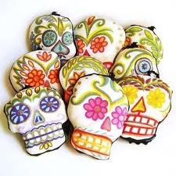
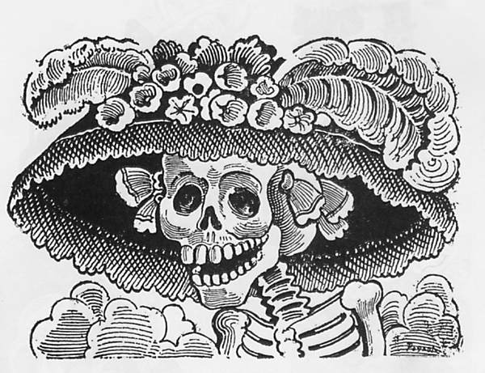
Fuentes
All pictures used in this presentation were taken from google images.
Information in this presentation was taken from Arizona Central’s Día de los Muertos webpage. To read more about the celebration go to: http://www.azcentral.com/ent/dead/

